Slide 1
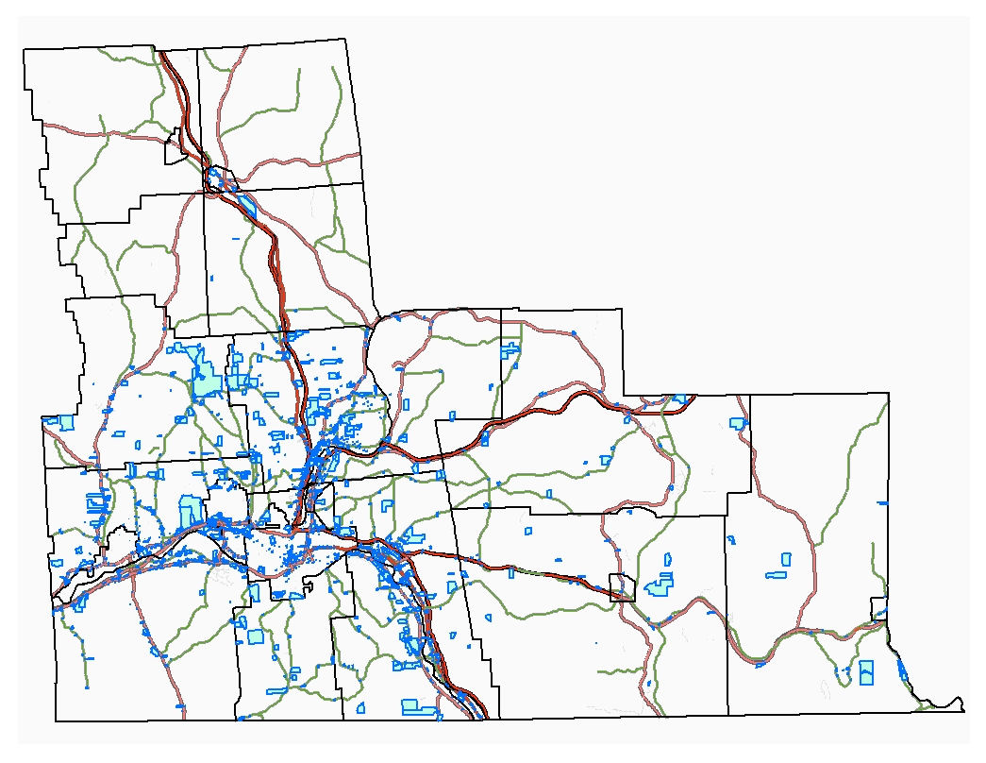
239 Review in
Broome County
GML §239-l, -m, -n, and –nn
Presented by:
Lora Zier, Senior Planner
Broome County Department of Planning
www.goalloutbroome.com/planning

Slide 2
Tools and Guidance
Broome County Planning Department 239 Review webpage:
GMU §239-l, -m, -n, -nn
Broome County Guide to 239 Review Process in Broome County
239 Review Submission Form – Fillable Form
Go to: https://www.gobroomecounty.com/landuse239reviews
New York State Department of State
Presentation slides: https://gobroomecounty.com/municipaltrainingfallseries

Slide 3
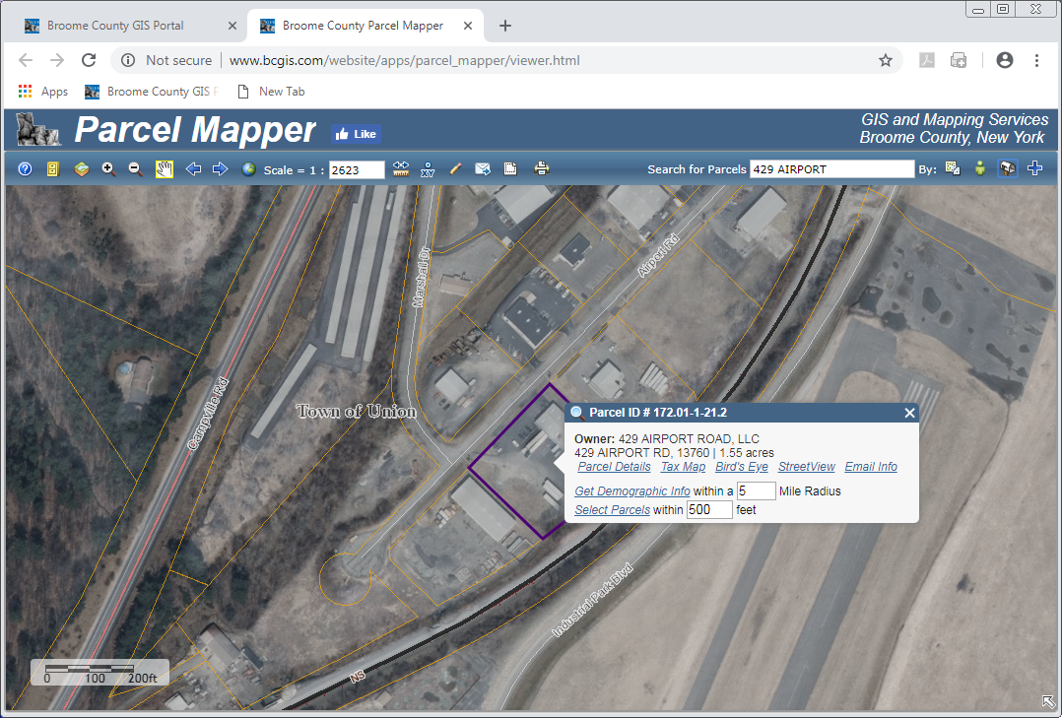
Tools and Guidance Broome County GIS Parcel Mapper
The Broome County GIS Parcel Mapper lets you know if the project site meets the location requirement for 239 Review and More!
Go to: www.bcgis.com.

Slide 4
What is the Intent of GML §239-l, -m, and -n?
GML §239-l
Intent: To address county-wide and inter-municipal impacts.

Slide 5
What Does GML §239-l, -m, -n Require the Municipal Board to Do?
GML § 239-m
Requires the Referring Body (municipal board) before taking final action to refer the proposed action to the County Planning Agency for review.
GML §239-l
In Broome County, the County Planning Agency is the Broome County Planning Department.
In Broome County, the applicant submits the application to the municipal board or staff. If that person determines that the action is subject to 239 Review, that person sends the full statement to the Broome County Planning Department.

Slide 6
Inter-municipal Referral Requirement
GML §239-nn
Intent: To let the adjacent municipality know your plans and to let their concerns be heard.
Send notice of public hearing to adjacent municipality:
Site Plan
Special Use Permit
Use Variance
Subdivision
Send notice to clerk at least 10 days prior to public hearing.
Allow adjacent municipality to speak at public hearing.

Slide 7
What Actions are Subject to 239 Review?
GML §239-m *
Comprehensive Plans
Zoning Ordinances and Local Laws
Zoning Map Amendments
Special Use Permits
Site Plans
Use Variances and Area Variances
Other authorized planning and zoning actions (PUD)
GML §239-n
Subdivisions (Preliminary, Final, Undeveloped)
NOT ZBA Interpretations
GML §239-m and -n
If Action occurs on real property within 500 Feet See BCGIS Parcel Mapper.
Municipal boundary
Boundary of county or state park or other recreation area
ROW of state or county road
ROW of county-owned stream or drainage channel, or stream or drainage channel with county-established channel lines
Boundary of state or county land with a public building
Boundary of a farm operation located in state agricultural district (except not area variances)

Slide 8
What Does the Municipal Board Need to Send to Broome County Planning?
239 Review Submission Form
Full Statement of the Proposed Action (complete application)
Electronic format and legible site plan

Slide 9
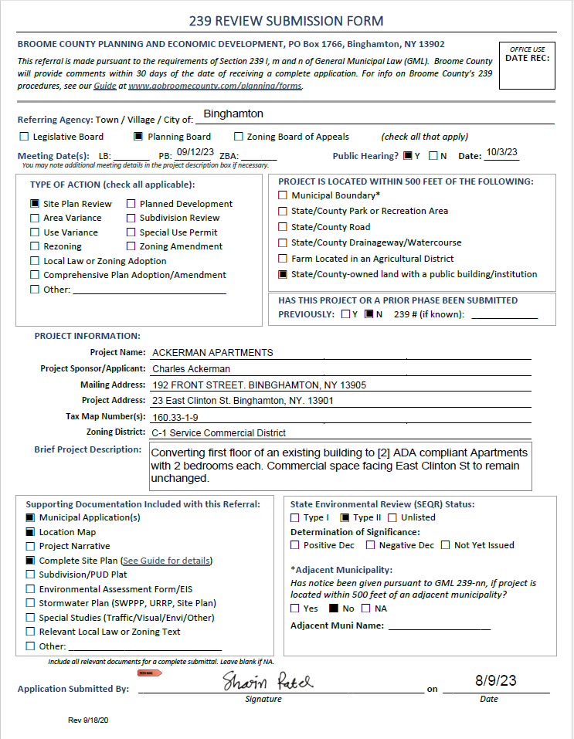
239 Review Submission Form (New)
Go to:
https://www.gobroomecounty.com/landuse239reviews
Scroll down to and click on:
239 Review Fillable Submission Form
Fill out form online, download, and save.
Example: 23 E. Clinton Street

Slide 10
Full Statement for Proposed Action
GML Section 239-m:
Complete Application for Municipal Board, including:
Complete application
All other materials required by and submitted to the referring body
Municipal sponsored action materials
Agricultural Data Statement, if applicable
Completed SEQRA Environmental Assessment Form (EAF) Part 1 and supporting documents to make determination of significance, if applicable
All other materials to make Determination of Significance
All approvals required for the project

Slide 11
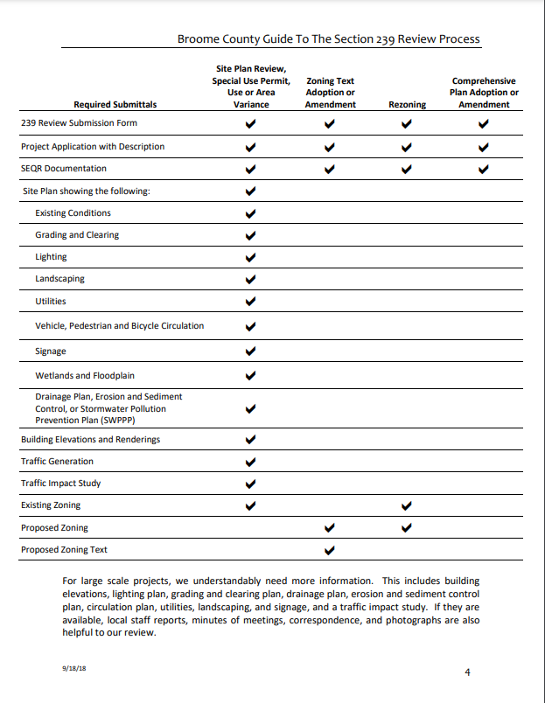
Full Statement for Each Action
Comprehensive Plan Adoption or Amendment
Existing and proposed text
Zoning Local Law or Ordinance Adoption or Amendment
Existing and proposed text
Zoning Map Amendments
Existing and Propose Zoning District
Existing and Proposed Zoning District Regulations
Site Plans, Area Variances, Use Variances, Special Use Permits, Subdivisions
All Application materials for the Action
Site Plan
Area Variances and Use Variances: Demonstrate how variance meets tests
For All Actions:
Complete Project Description
SEQRA Environmental Assessment (EAF) Part 1 and reports, if applicable
Agricultural Data Statement, if applicable

Slide 12
Agricultural Data Statement
AGM §305-A
Actions
Site Plan
Special Use Permit
Use Variance
Subdivision
If action occurs on property within AG District or on property within 500 feet of AG District
https://agriculture.ny.gov/land-and-water/section-305-review-restrictive-laws
Jeffrey Kehoe, Agricultural Protection Planner
(518)457-4626
Jeffrey.Kehoe@agriculture.ny.gov

Slide 13
Complete Project Description
Reason for the action
Required and requested setbacks for area variances
Existing and proposed uses
Building square footage
Required and proposed dimensions
Hours of operation
Numbers of employees during construction and operation
Traffic generation (number and type) during construction and operation
Parking requirements
Outdoor storage
Numbers of dwelling units and bedrooms
Future phases of development
Construction phases

Slide 14
Site Plan
Drawn to scale, north arrow and scale and tax map boundary
Special Flood Hazard Area, DEC and NWI Wetlands, and Waters
Required and proposed lot size, dimensions, and setbacks
Area of Disturbance, Tree Removal, Grading, Drainage, Stormwater Management
Existing and proposed uses and buildings (footprints, dimensions, elevations)
adjacent land uses
driveways (NYSDOT Standards, location, dimensions, intersections, curb cuts, egress and ingress)
traffic circulation patterns for vehicles, pedestrians, and bicycles
parking (employee spaces, customer spaces, accessible parking spaces, vehicle display spaces, delivery loading area)
walkways, bikeways and bike facilities
Planned demolition
Landscaping
exterior lighting
fencing and screening
architectural features
Easements
Retaining Walls
Known future phases

Slide 15
How Does a Municipal Board Refer a 239 Review to Broome County Planning?
Send 239 Review Submission Form and the Full Statement in electronic format to speed our review.
When mailing, address the submittal to:
Lora Zier, Senior Planner
Edwin L. Crawford County Planning Office Building, 5th Floor
P.O. Box 1766
Binghamton, New York 13902
When emailing, email to: lora.zier@broomecountyny.gov

Slide 16
What Are the County Review Areas?
GML §239-l
Land use compatibility
Traffic Generation
County or State institutions
Community character
Drainage
Community facilities
Official municipal and county development policies
Other Matters: Public convenience, governmental efficiency, and community environment

Slide 17
Reviewing Agencies in Broome County
Broome County Planning Department
Binghamton Metropolitan Transportation Study – BMTS
New York State Department of Transportation – NYSDOT
Broome County Department of Public Works – Engineering Division
Broome County Health Department
Broome County Transit
Broome County Office of Emergency Services
Broome County Aviation

Slide 18
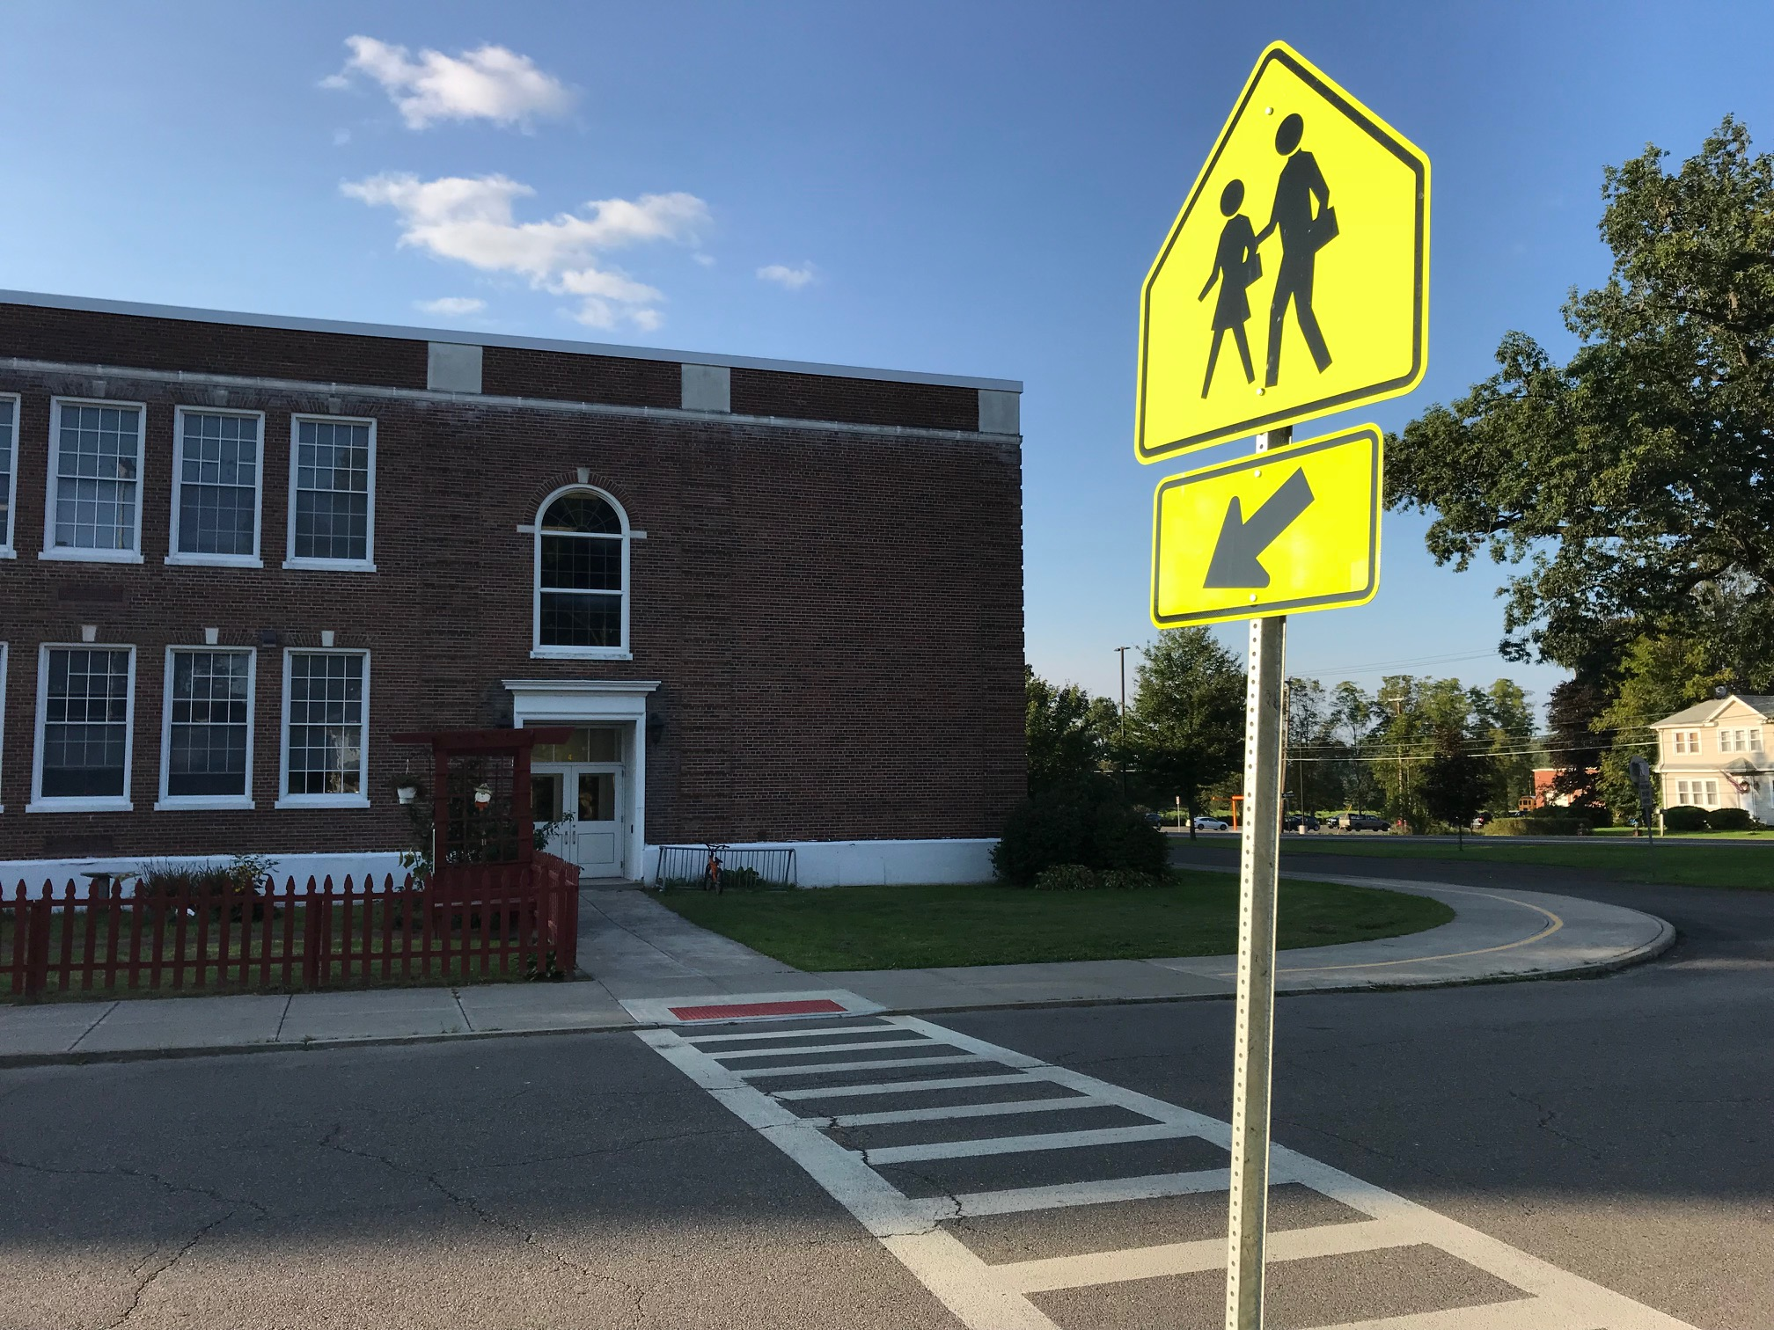
Land Use Compatibility of the Project with other Land Uses
Neighborhood
Residences
Parks
Recreation Trails
Schools
Noise
Odor, Air Pollutants, Dust
Heavy Truck Traffic, Truck Routes, Safety Hazards
Other Hazards
Noise, Air Quality, Traffic Studies

Slide 19
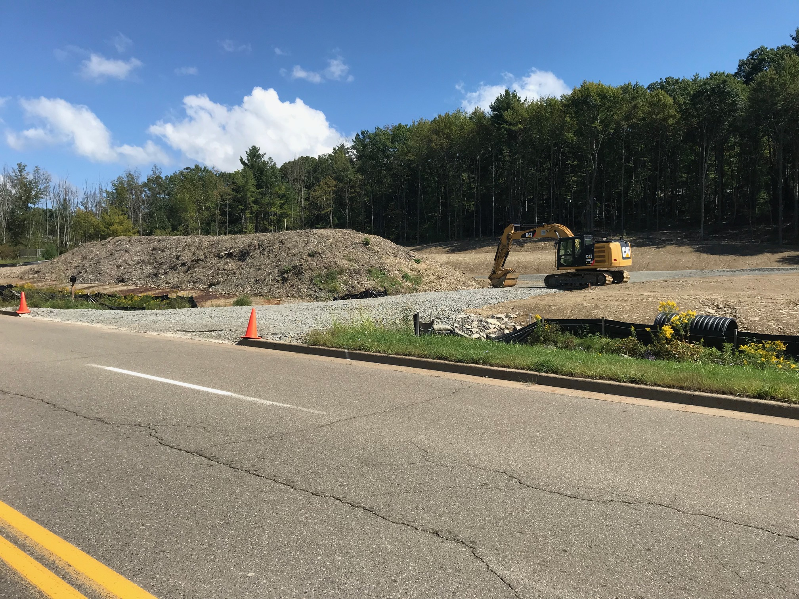
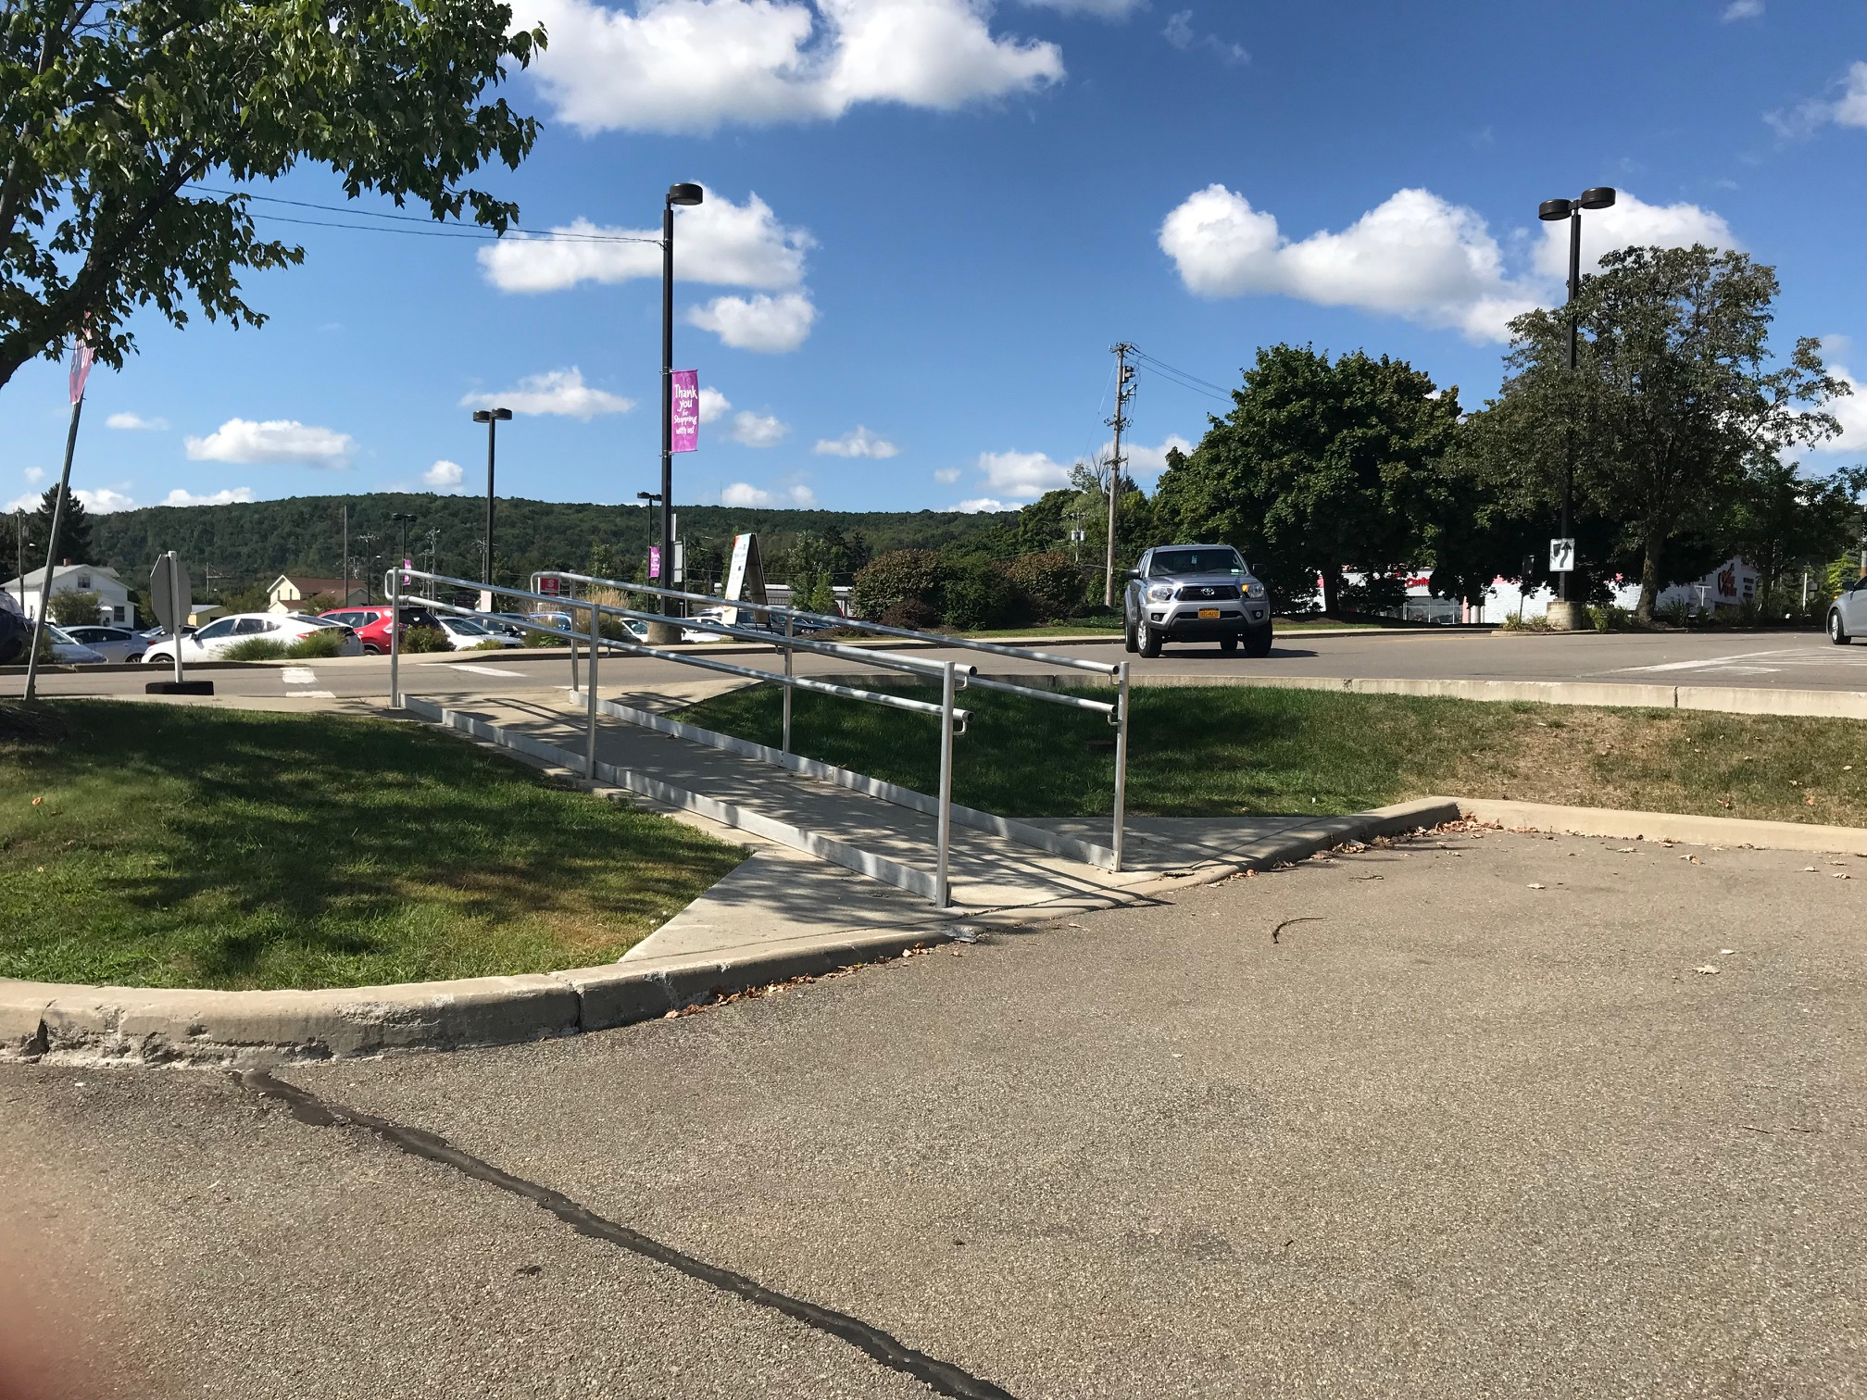
Traffic Generation and Effect on Other Land Uses and on Adequacy of Road in Accommodating Project Traffic
BMTS, NYSDOT, DPW Comments
Traffic Impact
Site Access
Internal Circulation of Site
Pedestrian and Bicycle Access
Driveway Access and Design
NYSDOT Driveway Design Standards
Traffic Study
Traffic Control Plan
Traffic Safety Concerns
Adequacy of the road facilities
Drainage
Highway Driveway and Work Permits

Slide 20
Binghamton Metropolitan Transportation Study (BMTS)
Traffic Impact
Site Access
Internal Circulation of Site
Pedestrian and Bicycle Access
Contact: Jennifer Yonkoski, PTP
Executive Director
Binghamton Metropolitan Transportation Study
(607) 778-2443 | BMTSonline.com

Slide 21
New York State Department of Transportation (NYSDOT)
NYSDOT Region 9 Site Plan Committee
NYSDOT Highway Work Permit requirements and review process
Projects located off State highway system with traffic or other impacts

Slide 22
NYSDOT Region 9 Site Plan Committee
NYSDOT Region 9 has organized an advisory committee to conduct preliminary reviews of 239 referrals and provide information on anticipated NYSDOT requirements for these proposals.
The committee consists of representatives from all functional groups within the Regional Office, and is currently chaired by the Regional Traffic Engineer, who will issue agency responses back to the County Planning Agency.
These responses will notify the municipalities of requirements that will apply for each proposal, such as NYSDOT approval of Highway Work Permits, Traffic Impact Studies, and Drainage Studies, and any additional provisions that may apply.
Site Plan Committee review as part of the 239 process is conducted prior to permit applications or other more detailed reviews.
Regional contact for the Site Plan Committee:
Sean Murphy, Regional Site Plan Review Coordinator
New York State Department of Transportation, Region 9
(607) 772-7335 | Sean.Murphy@dot.ny.gov | www.dot.ny.gov

Slide 23
NYSDOT Highway Work Permit Requirements and Review Process
Most projects located along the State highway system will require the applicant to obtain a Highway Work Permit for driveway and pedestrian facility construction, and for any other work within the State right-of-way.
These permits must be issued prior to the commencement of any work by the applicants within the State right-of-way.
Highway Work Permit review is also required if a development proposal will result in an increased intensity of use at a site, even if the applicant is not proposing any access modifications.
Review of Highway Work Permit applications generally follows Site Plan Committee review and municipal site plan approval, and issuance of these permits is contingent on the applicant’s fulfillment of the requirements identified by the Committee in the 239 review.
Visit: www.dot.ny.gov/permits for more information on this process or Call: 607-721-8082.

Slide 24
NYSDOT Projects Located off State Highway System with Traffic or Other Impacts
Some projects submitted to NYSDOT may not require a Highway Work Permit, but will be reviewed due to their proximity to the State right-of-way or anticipated impacts to the State transportation system.
In these cases, NYSDOT requirements may apply, as identified by the Site Plan Committee.
These requirements may include drainage analyses and traffic impact studies.
As sites that are located near to but not abutting the State right-of-way generally do not require applicants to obtain permits from NYSDOT, it is imperative that the municipalities ensure that all NYSDOT requirements from the 239 review are satisfied prior to local approval to avoid adverse impacts to the transportation system or its facilities.

Slide 25
Broome County Department of Public Works – Engineering Division (DPW)
Evaluate the potential impact of the proposed action on County-owned infrastructure
Materials needed for review:
Application
Full site plan (existing and proposed conditions)
SWPPP, traffic report, and any other relevant information, if applicable
What DPW-Engineering looks for:
Impacts to County owned roadways and facilities
Potential traffic impacts and/or design deficiencies
County Driveway and Work Permits
Required when working within County Right-of-Way and Acquired through Broome County Highways Department
Contact:
Roger V. Brown, P.E., Deputy Commissioner of Public Works, Broome County Department of Public Works – Engineering Division: Telephone: 607-778-1108 Roger.Brown@broomecountyny.gov
Eduard V. Lavrinovich, Engineer 1, Broome County Department of Public Works – Engineering Division: Telephone: 607-778-2465 Eduard.Lavrinovich@broomecountyny.gov

Slide 26
Broome County Health Department (BCHD)
Issues permits for hotels/motels, campgrounds, children’s camps, restaurants, mobile home parks, and public swimming pools.
Approves plans for new septic systems and subdivisions.
Keeps records for existing septic systems.
Maintains database of spills and underground tanks.
Contact:
Matthew Laine, Public Health Sanitarian
Broome County Health Department
Phone: 607-778-2814
Email: matthew.laine@broomecountyny.gov
Web: www.gobroomecounty.com/eh

Slide 27
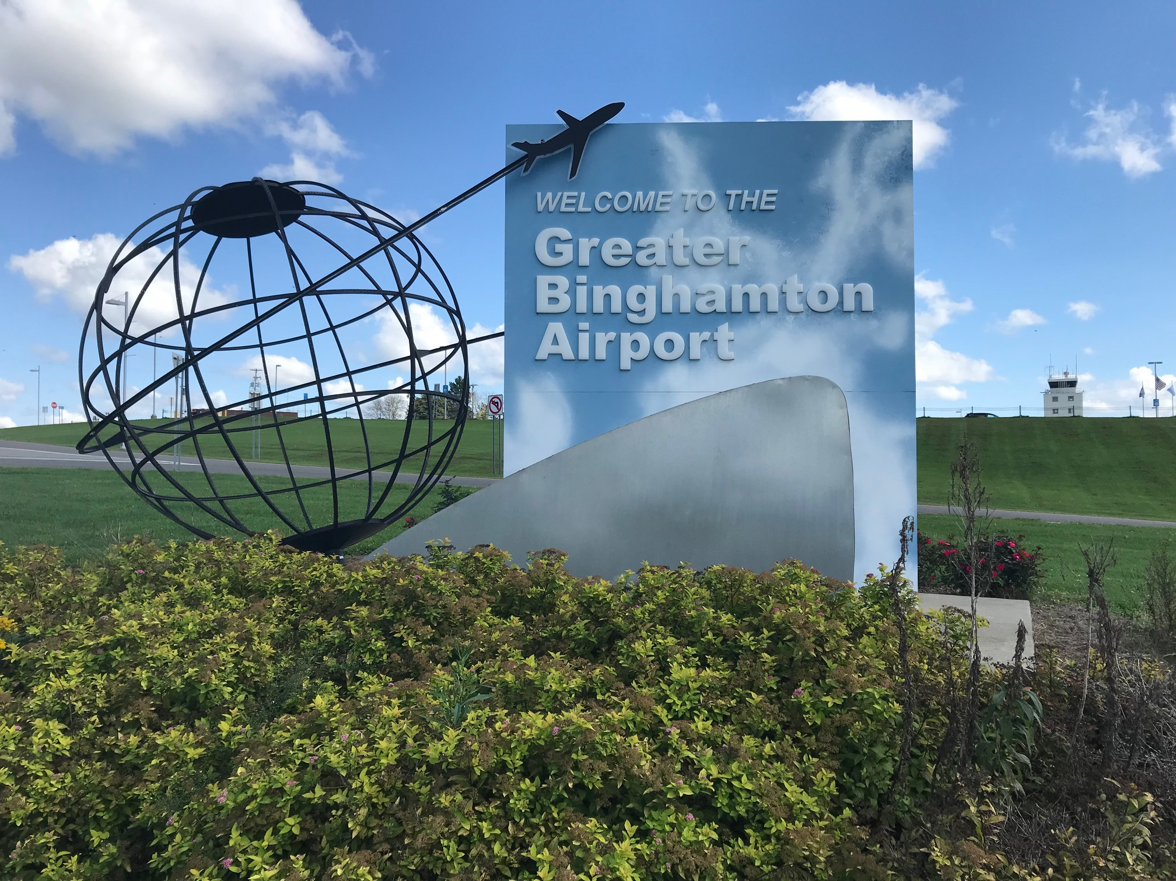
County or State Property
DPW facilities
Airport facilities
Drinking Water
Groundwater Quality
Potential Hazards of Outdoor Storage
FAA Form, Chemical Data, Phase 1, Hazard Compliance

Slide 28
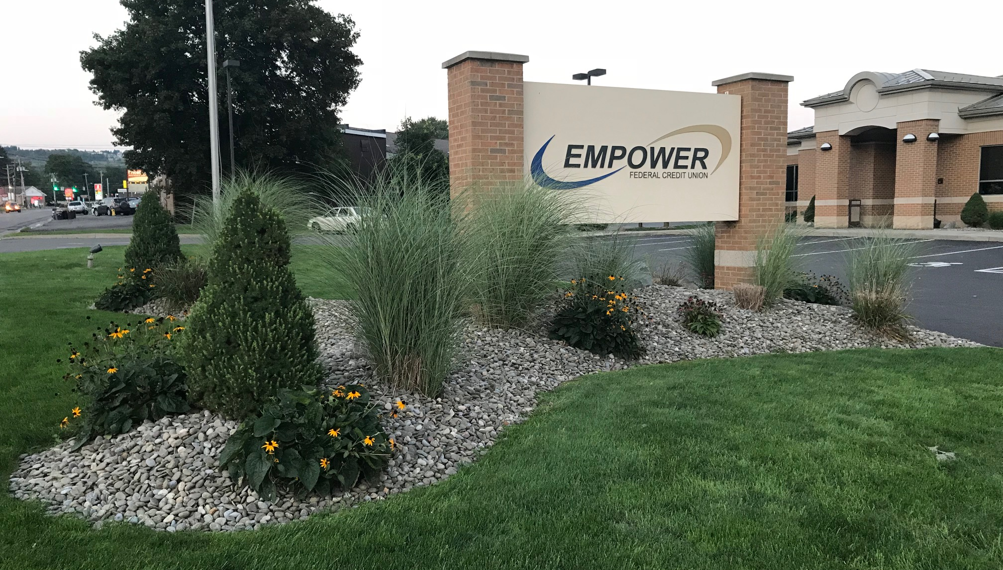
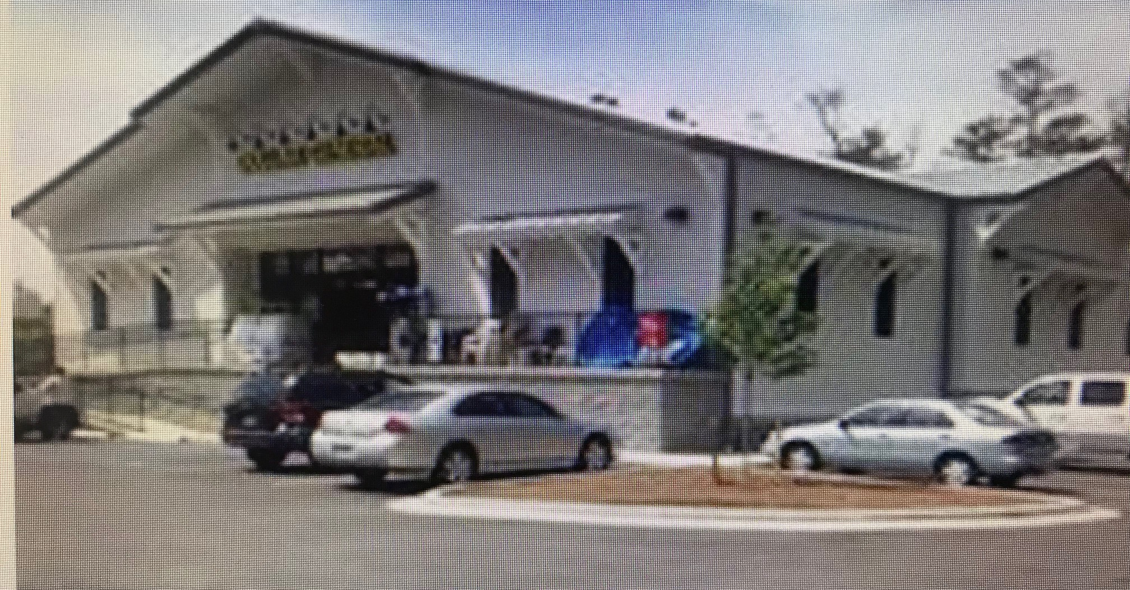
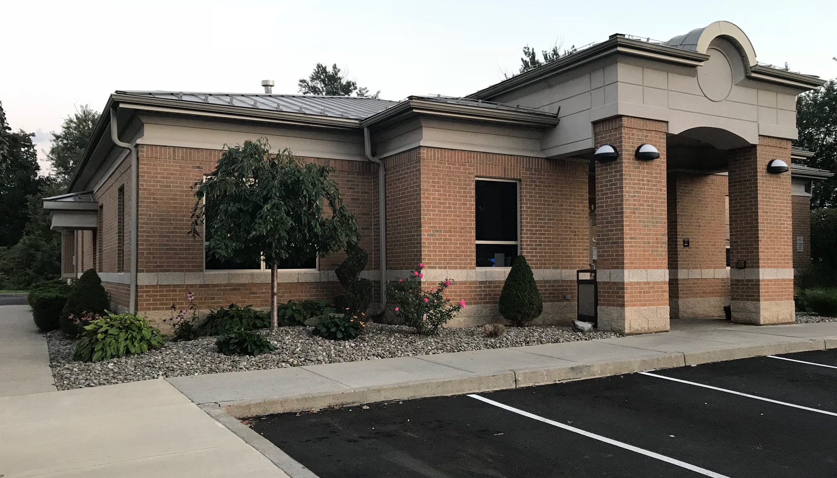
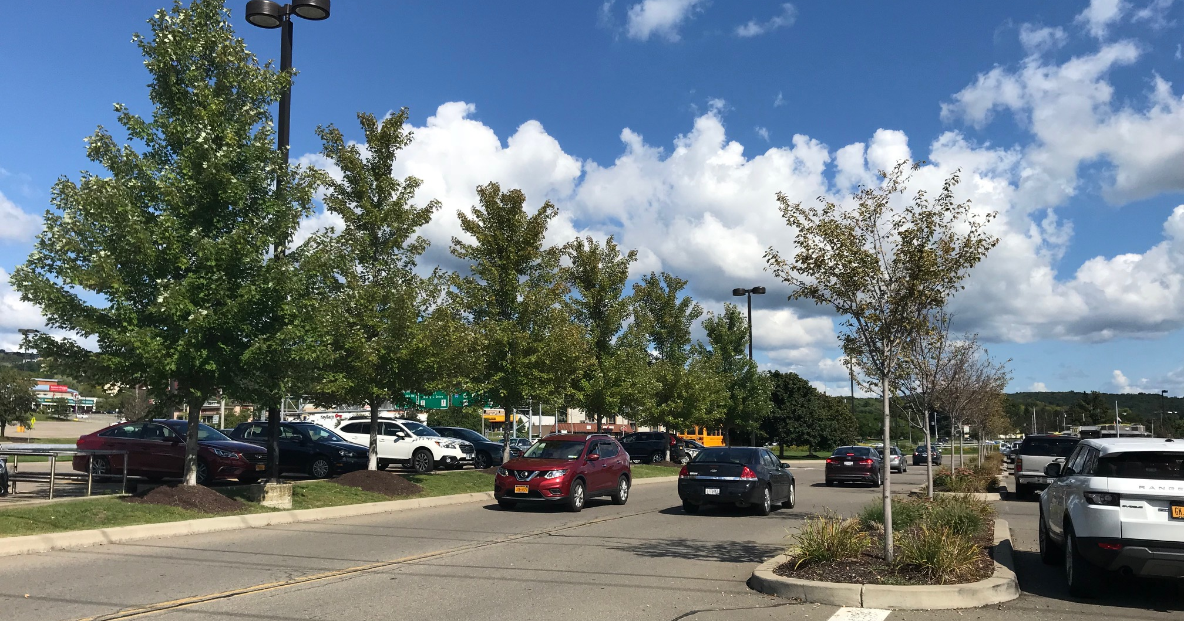
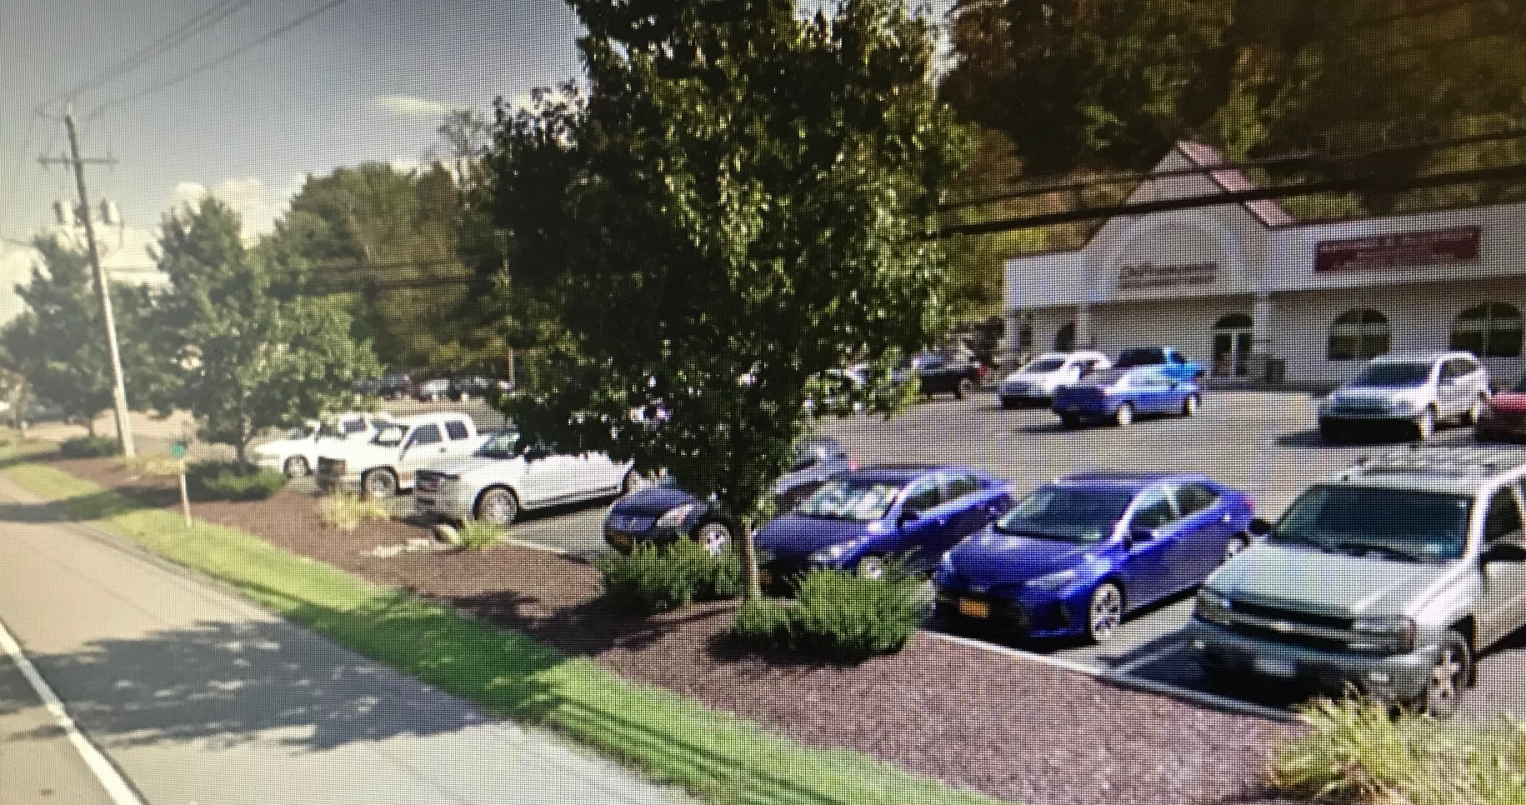
Protection of Community Character
Site Layout and Building Design, Aesthetics, and Landscaping
Elevations, Renderings, Landscape Plan, Visual Impact Study

Slide 29
Drainage
Special Flood Hazard Area
DEC Wetlands
NWI Wetlands
Watersheds
Drainage
SWPPP
Structural Safety Report

Slide 30
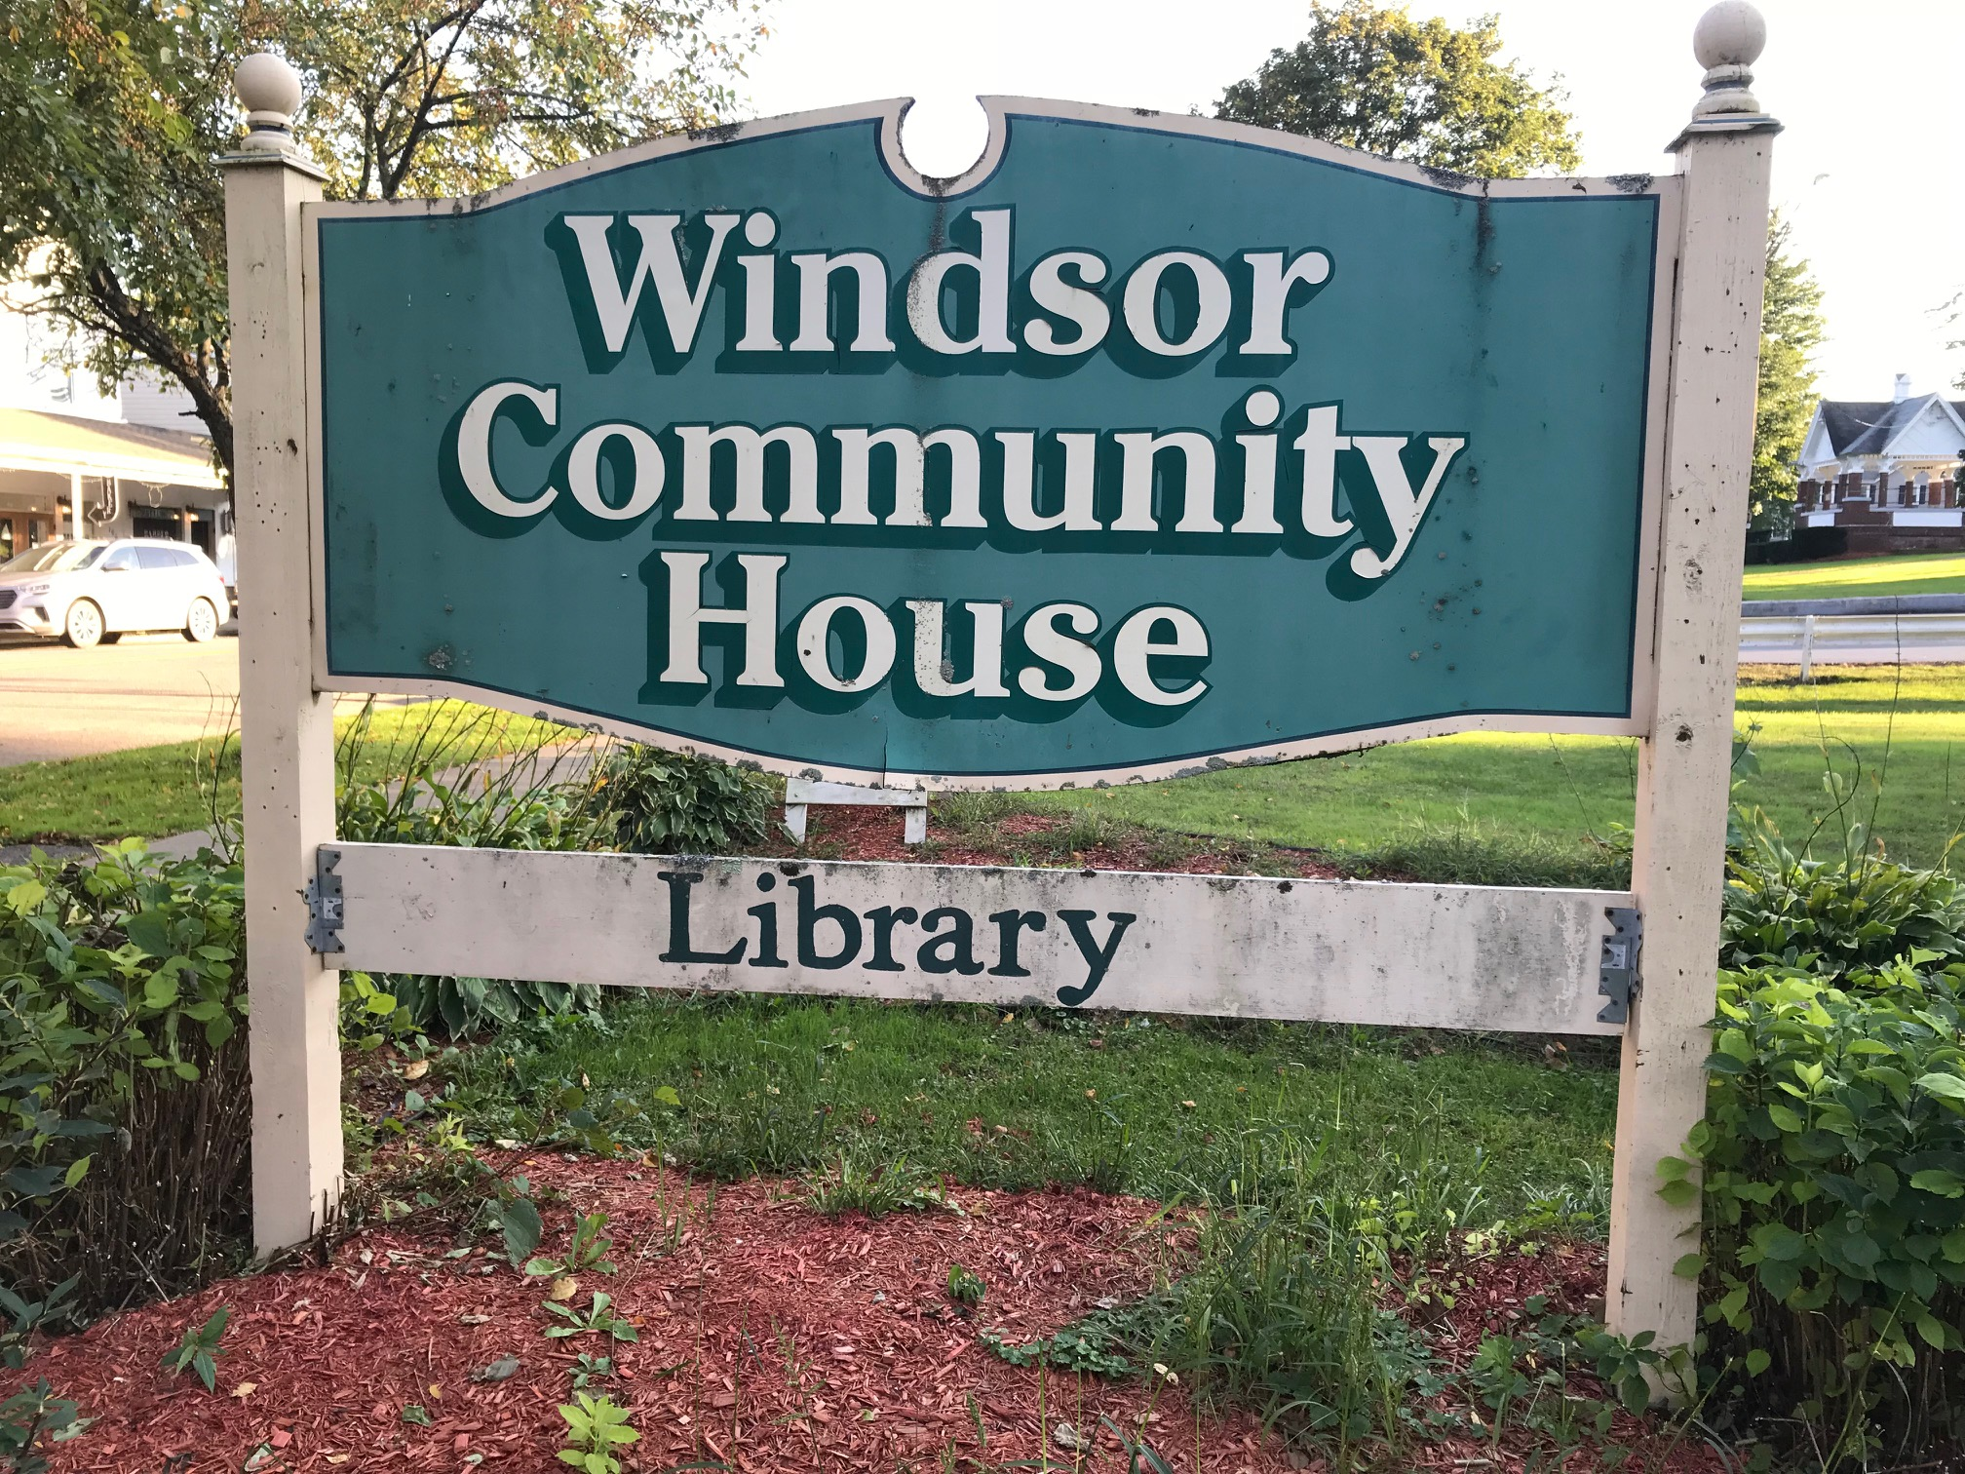
Community Facilities
Noise
Traffic Safety and Security
Noise Study
Traffic Study

Slide 31
Official Municipal, County, and State Development Policies
SEQRA
Broome County Comprehensive Plan
Action Items:
Inviting Place to Live, Work and Play
Taking Pride in Our Urban and Village Centers and Scenic Beauty
Maintaining High Standards in Infrastructure and Building Design
Becoming More Resilient – floodplain, stormwater management
Making Comments through 239 process
Municipal Comprehensive Plans
Zoning Ordinances and Local Laws
Municipal Design Guidelines
Municipal Parking Studies
State Laws and Policies
County-wide and Region-wide Plans

Slide 32
What Do Broome County Planning Comments Mean to Municipal Board?
GML §239-m
Recommendations are advisory opinions.
No significant county-wide or inter-municipal impacts with no comments
No significant county-wide or inter-municipal impacts with advisory comments or recommendations
Significant county-wide or inter-municipal impacts and recommendation of Denial and reasons for recommendation of Denial
No significant county-wide or inter-municipal impacts with conditions

Slide 33
Broome County Planning Comments Examples
No significant county-wide or inter-municipal impacts with advisory comments or recommendations
Site Plan Review and Special Use Permit: Restaurant porch expansion for dining, parking lot revisions, gazebo and fencing to protect BBQ pit located along DPW roadway
Broome County Planning did not identify any significant countywide or inter-community impacts.
DPW commented that nothing may be placed within the County Right-of-Way and line of sight at the corner for vehicles turning right should be maintained.

Slide 34
Broome County Planning Comments Examples
No significant county-wide or inter-municipal impacts with advisory comments or recommendations
Area Variance: Pole barn exceeding allowed size from 1500 SF to 6960 SF and exceeding allowed height from 16 FT to 30 FT
The variances seem substantial, and the Town ZBA should consider the precedent granting this variance would set. Clear documentation of the particularly unique site and project circumstances justifying such a variance is recommended to avoid unintended consequences elsewhere, particularly in the Residential District where the general character is smaller in scale, allowed maximum density per acre is greater and required minimum lot size and setbacks are less.
The Town ZBA should also consider the recent Town Board efforts and adoption of Local Law to amend and set the allowable square footage for detached garage at 1,500 SF (not to exceed 1,500 SF).
The site plan should show compliance with BCHD comments, zoning notes, drainage, and appropriate emergency vehicle access.
The site plan and SEQR SEAF should include/address the area of disturbance and NWI wetlands that occupy the project tax map (see BCGIS).
The Town ZBA should consider the need for before and after renderings of the project site to demonstrate that the existing trees would block the-majority-of the structure from town road as indicated in the project submittal and to assess potential impacts to the visual character of the area and the need for additional tree screening and/or tree maintenance to the extent necessary.
The Town ZBA requested the applicant downsize the pole barn and the Town resubmitted the project for 239 review for 5000 SF pole barn.

Slide 35
Broome County Planning Comments Examples
Significant county-wide or inter-municipal impacts and recommendation of Denial and reasons for recommendation of Denial
(land use compatibility, traffic, impacts on county or state uses, drainage, community facilities, and official county development policies)
Site Plan Review: Drive-Thru Only Coffee Shop along Greenway and Town road and service road to NYSDOT highway
Uncertainties about significant impacts to traffic and pedestrian access and inconsistencies with significant improvements and investments to enhance multi-modal transportation needs in the project area.
BMTS pointed to land use inconsistencies, impacts to vehicular, pedestrian, and bicycle traffic and to the regional trail system and inconsistencies with regional development policies and projects to make the transportation system more walkable and bikeable, and more safe and more efficient for all users.
This completely automobile-oriented development as proposed would not allow for personal interactions, would not be walkable or bikeable; and would not be the most safe and efficient for the users of the new Greenway or for the surrounding residents.
It would not accommodate pedestrian and bicycle traffic from the Greenway or from the surrounding residential and commercial uses and from the conservation area.
It would not support the objectives, efforts, and investments Greenway (NYSDOT) project or with the intent of the more recent infrastructure investments, including the Greenway and sidewalks further west, to facilitate different modes of transportation.
BMTS recommends a TIS to ascertain the traffic impacts of this first drive-thru likely only coffee shop in the area and notes that many existing drive-through coffee shops in our area have known operational traffic impacts and that traffic may increase, delays could increase, and there may be potential safety impacts to trail users.
The NYSDOT comments also point to traffic/safety uncertainties and inconsistencies with the regional plans and requests a trip generation summary for NYSDOT and BMTS to evaluate and requests revisions to the site plan to account for the new Greenway facilities upon completion and the drainage swale along the service road, a sidewalk along the local street because the project will likely increase foot traffic, and inclusion of Complete Streets principle in the site design.
The SEQR traffic response should include the BMTS and NYSDOT comments.
The applicant revised the site plan and the Town sent the revised site plan, trip generation, stormwater report, photometric plan, and applicant response letter – see revised site plan, will apply for Highway Work Permit before construction, revised driveway along service road in accordance with NYSDOT, Town road has been revised to Town standards, drainage study completed, and trip generation submitted, sidewalk added along Service Road and along Town road, existing drainage swale will be piped for proper grading along Service Road, Complete Street principles added to site design, and no signage planned to be placed within State Right-of-Way. Town Engineer wrote Town PB will make acceptance contingent on HWY Work Permit and drainage study.

Slide 36
Denial or Modification Requires Supermajority Vote or “Extraordinary Vote”
GML §239-m
Advisory opinions only; however,
If County Planning recommends denial or modification, municipal board may only act contrary to recommendation by a majority plus one vote of all the board members.
Called Super-majority vote or “Extraordinary Vote”.

Slide 37
How Long Does the County Review Take?
GML Section 239-m:
Broome County Planning has 30 days after Receipt of the Full Statement or such longer period agreed upon by County Planning and Referring Body.

Slide 38
What is Date of Receipt of the Full Statement?
GML 239-m:
If mailed, the postmark date is the date of receipt.
If hand delivered, the date hand delivered is the date of receipt.
If emailed, the email date is the date of receipt.

Slide 39
When and How May the Municipal Board Take Action?
GML 239-m
30 days after Receipt of the Full Statement or such longer agreed upon date and super-majority vote applies.
If Broome County Planning fails to report within 30 days, Municipal Board may take final action by a simple majority vote.
2-Day Rule and Super-Majority Vote applies.

Slide 40
What Happens After Final Action? Report of Final Local Action
GML 239-m
Send decision or final action to County Planning within 30 days.
If act contrary to recommendation of modification or denial, note reasons for the contrary action in the report.

Slide 41
What Happens if Municipal Board Fails to Follow GML §239-l, -m, -n, & –nn? Article 78
May invalidate the final municipal action.
Open the municipality to an Article 78 legal challenges and overturned decisions by a judge.

Slide 42
How do Municipalities Benefit from the 239 Review Process?
Receive professional assistance
Learn of inter-municipal and county-wide impacts
Avoid inter-municipal and county-wide impacts
Avoid Article 78 legal challenges

Slide 43
Tools and Guidance
Broome County Planning Department 239 Reviews webpage:
GMU §239-l, -m, -n, -nn
Broome County Guide to 239 Review Process in Broome County
239 Review Submission Form – Fillable Form
Go to: https://www.gobroomecounty.com/landuse239reviews
Broome County GIS Parcel Mapper
New York State Department of State
Presentation slides: https://gobroomecounty.com/municipaltrainingfallseries

Slide 44
Questions?
Broome County Department of
Planning and Economic Development
239 Review Contacts
Beth Lucas, Director 607-778-2375 Beth.Lucas@BroomeCountyny.gov
Lora Zier, Senior Planner 607-778-2370 Lora.Zier@BroomeCountyny.gov

