Slide 1
Notes:
Introduce - Answer the questions, what is a Food Bank and who is the Broome County Food Council. Why am I here representing both? NYS Health’s Healthy Food Healthy Lives goal

Slide 2
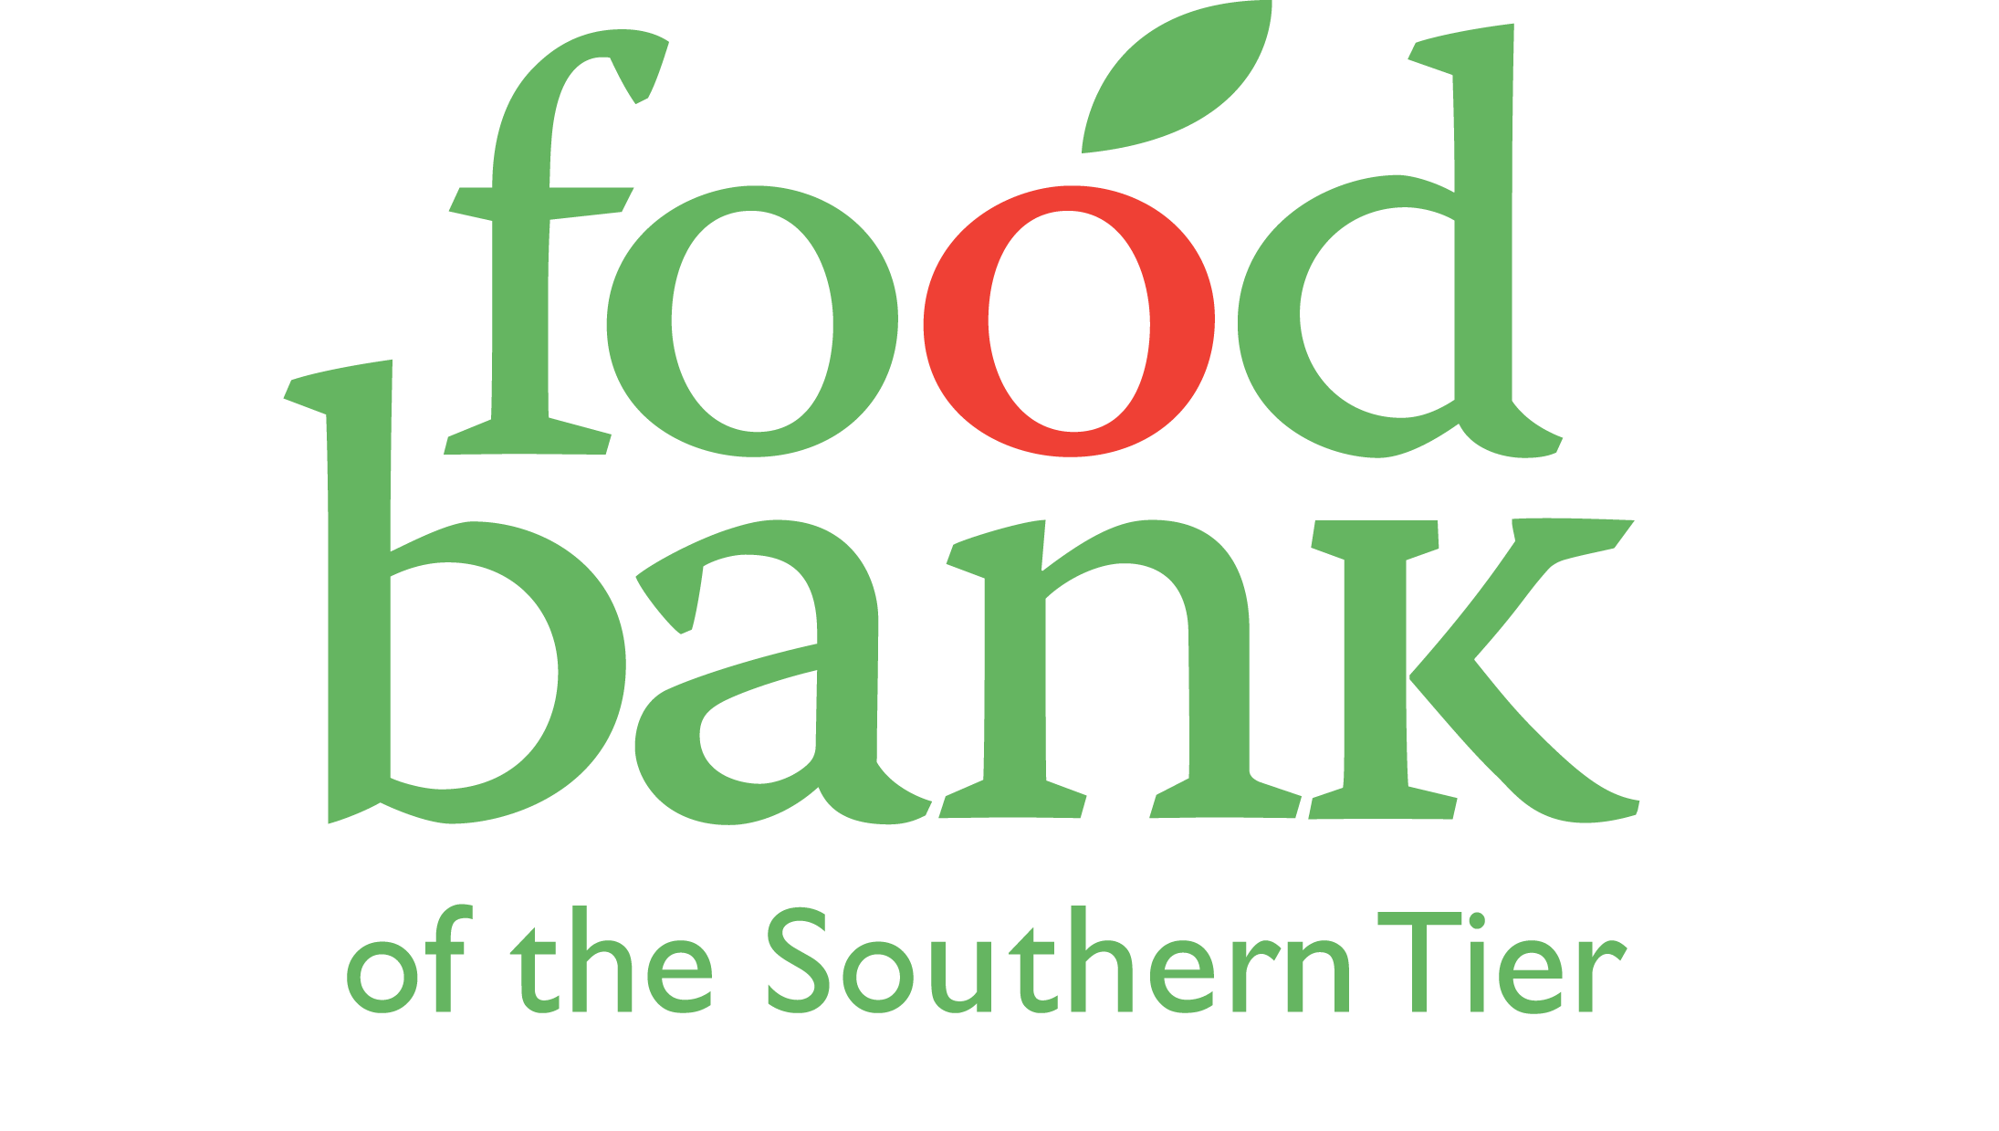
What is a Food Bank?
A regional agency of Catholic Charities and a member of Feeding America
Notes:
Today I’m going to share with you the basics of how food banking works and how our local food bank operates.

Slide 3
Our Mission & Vision
Mission
Working together to build and sustain hunger-free communities throughout the Southern Tier.
Vision
The Food Bank of the Southern Tier is committed to creating a future without hunger where access to healthy food by all is recognized as fundamental to the well-being and success of individuals and the foundation of a strong, vibrant society.
Notes:
Read aloud (or ask for volunteer) each.
Mission – emphasize the word “sustain.” EX: “We know we cannot only distribute food to those experiencing food insecurity if we want a sustainable model, so part of what I’ll be going over is FBST’s work beyond charitable food distribution to look at root causes.”

Slide 4
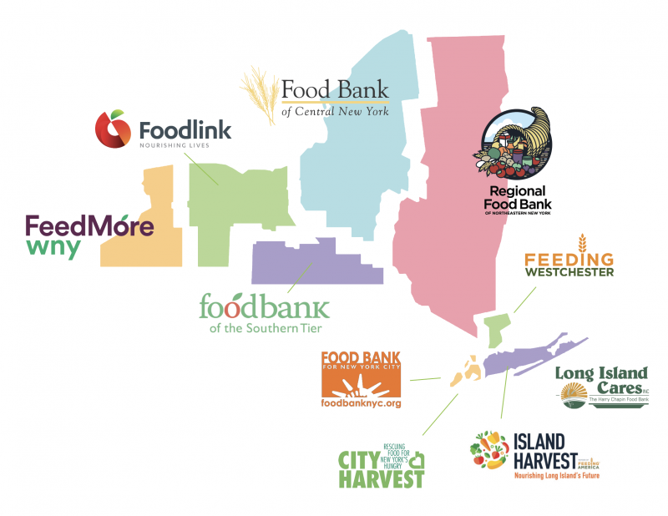
Food Banks in New York State
Notes:
We are part of a larger network of food banks that collectively serve the state of New York.
We are one of 10 member food banks of Feeding NYS (state food bank association)
There are food banks operating out of each major metro area, including:
--FeedMore based in Buffalo
--Foodlink based in Rochester
--Food Bank of CNY based in Syracuse
--Regional Food Bank based in Albany
We, the Food Bank of the Southern Tier, cover six counties: Tompkins, Tioga, Broome, Schuyler, Steuben, and Chemung.
We work together with these food banks across the state on policy advocacy issues, but also on sharing of other resources, including food, and best practices.
AND as a Council, I have networked with many of these directors across the state and attended our 1st in-person Summit in Syracuse this past August.

Slide 5
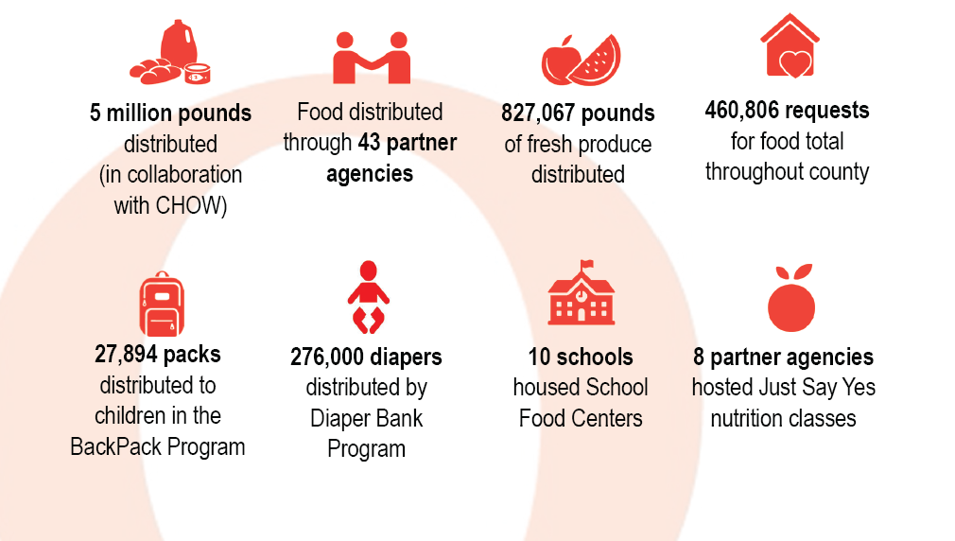
2022 BROOME COUNTY FACT SHEET

Slide 6
Forced to Make Difficult Choices
53% HAD TO CHOOSE BETWEEN FOOD & HOUSING
60% HAD TO CHOOSE BETWEEN FOOD & UTILITIES
55% HAD TO CHOOSE BETWEEN FOOD & MEDICAL CARE
55% HAD TO CHOOSE BETWEEN FOOD & TRANSPORTATION
Notes:
Due to low wages, systemic issues like the Racial Wealth Gap, and other factors, individuals are living on the edge, causing them to make tough choices
In a study of Food Bank of the Southern Tier clients, more than half said they had to choose between food and other essentials such as housing, utilities, medical care, and transportation. These are, obviously, impossible choices no one should have to make.

Slide 7
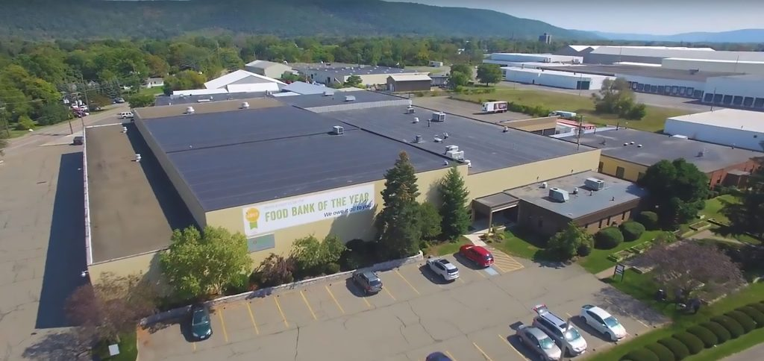
This is Where the Food Bank Comes in…
Notes:
So this is where the food bank comes in – we want to make it so as few people as possible need to face those difficult choices.
This is a photo of our headquarters in Elmira out of which we serve all six counties of the Southern Tier. In this building is a 65,000 sq ft warehouse and many offices.

Slide 8
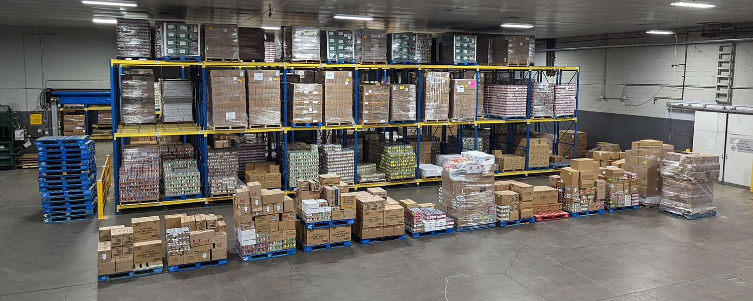
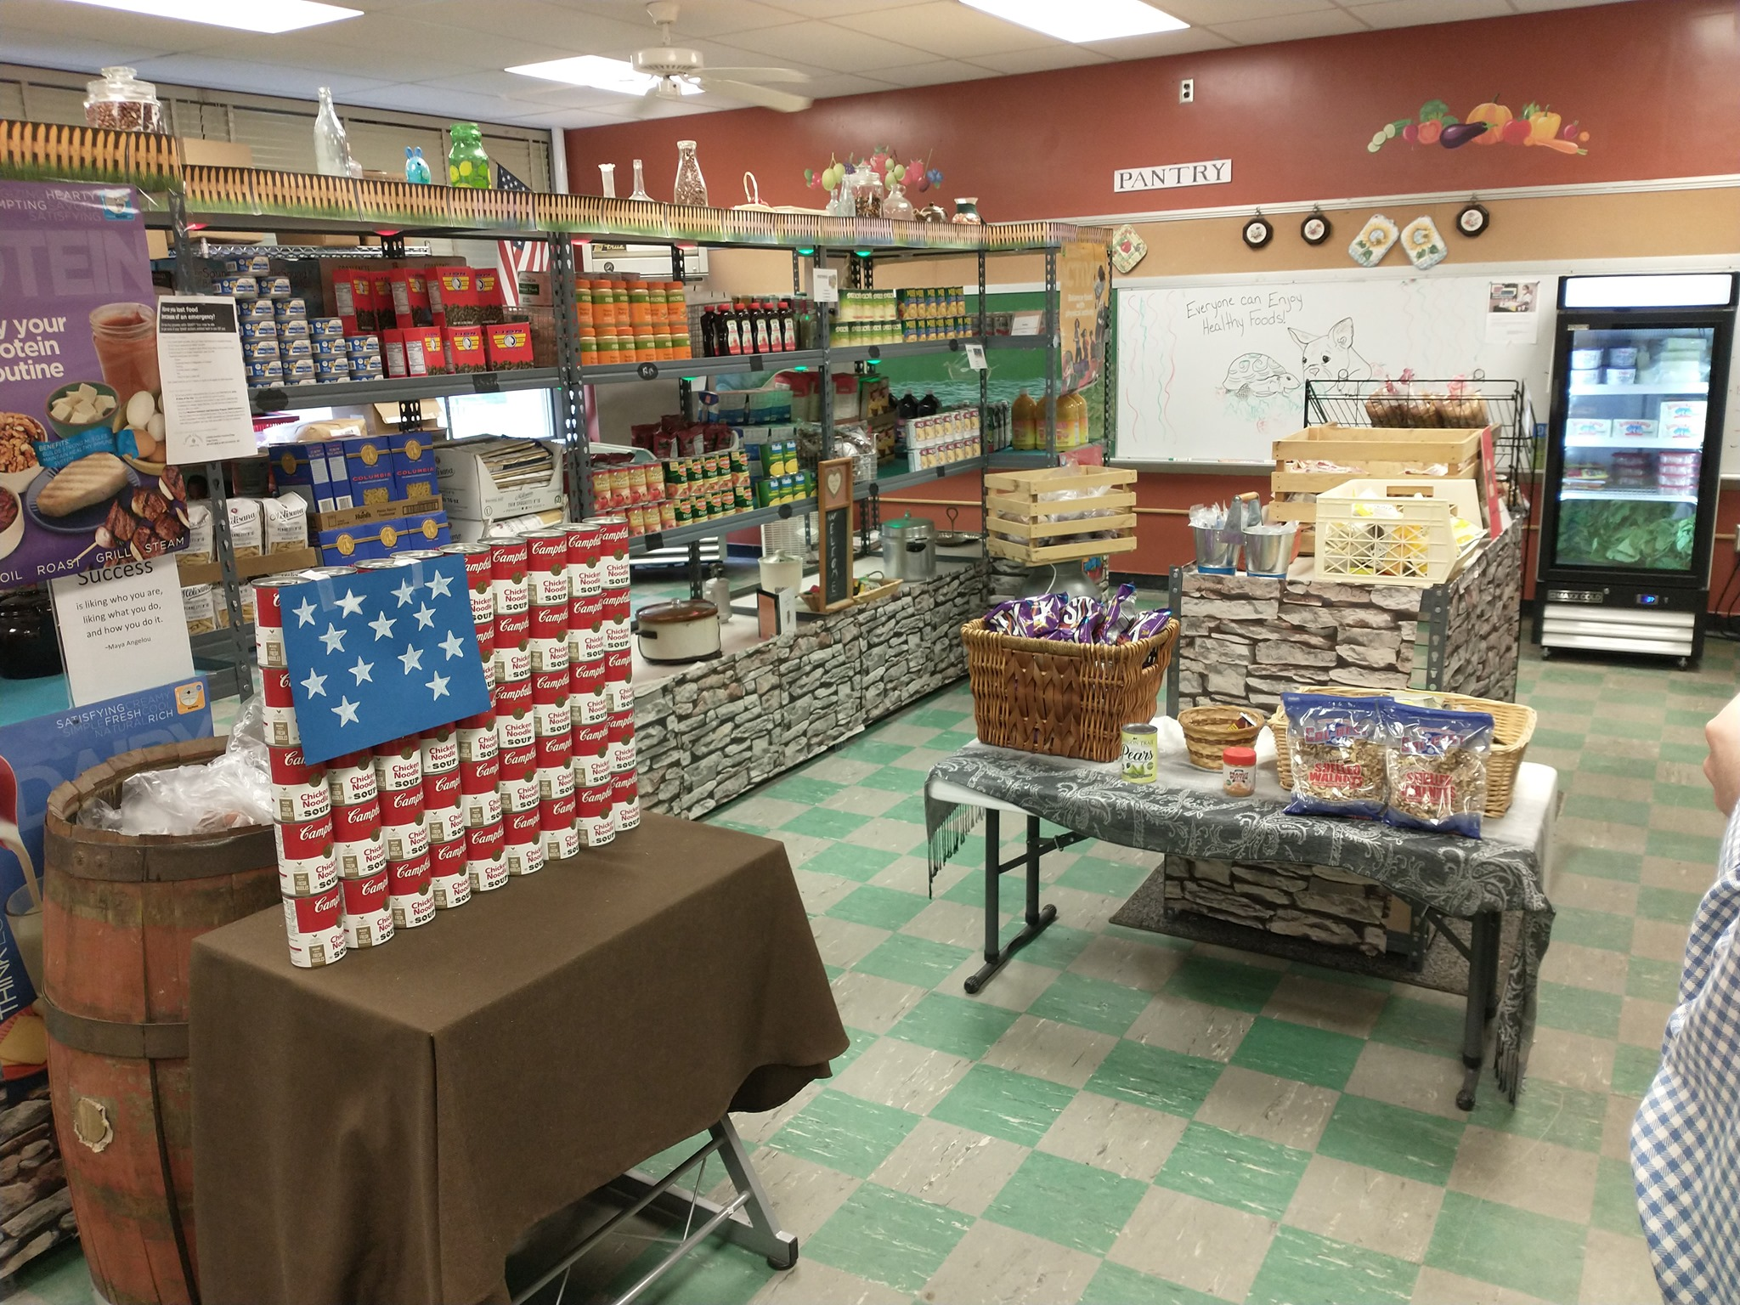
Food Banks are Different from Food Pantries
Food Bank is the Wholesaler
Food Pantries are the Retailers
Notes:
One important thing to know about food banking is the difference between a food BANK and a food PANTRY.
You can think of food banks like a wholesaler (click) and food pantries as the retailer (click), or the place you go to get what you need.
This top photo shows just one section of our 65,000 sq ft warehouse in Elmira, where we receive millions of pounds of food per year, sort it and ensure its safety, then distribute it back out to food pantries across our service area where community members can get what they need.

Slide 9
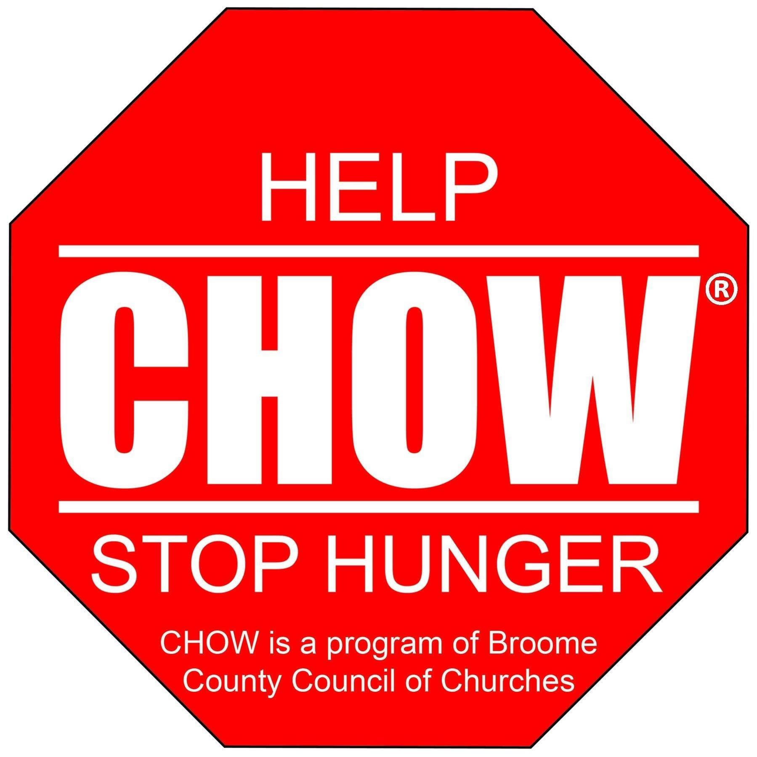
Working in Partnership to Meet the Need CHOW – a redistribution organization of the Food Bank – and FBST work in partnership to leverage national, regional, and local resources to end hunger in Broome County. CHOW operates its facility in concert with the Food Bank, receiving food from FBST and relying on food and monetary donations from local residents, organizations and companies to fulfill our collective mission of ending hunger for all.

Slide 11
OUR VISION: We envision an equitable food system that provides healthy, affordable, and accessible food sources for all community members of Broome County. www.broomecountyfoodcouncil.org
OUR MISSION:
The Broome County Food Council (BCFC) is composed of diverse partners, including people who have experienced food insecurity, with a goal to increase food security in Broome County through innovative & equitable solutions, lasting collaboration, education, communication, and advocacy.
Notes:
In one year, our Council has accomplished much, and I am privileged to share with you our progress to date. Broome County has been home for 36 years and it is very geographically interesting with the bulk of the Urban areas in the middle of the county surrounded by very rural areas at it’s West, North and Eastern boards. Southern border is the state line of PA. Data: According to Feeding America BC Poverty rate in 2021 is 11.6%, county food insecurity rate is 11.9-23.6%, child food insecurity rate is 15.1%. Interviewing partners and community advocates revealed a picture of BC that gave the Council a starting point to start discussions. Part of our discussion was to form a foundation, a lens in which we could view our actions. Our Mission, Vision and Core Values were formed. The Steering Committee and Work Groups also formed a purpose statement for their role on the council.

Slide 12
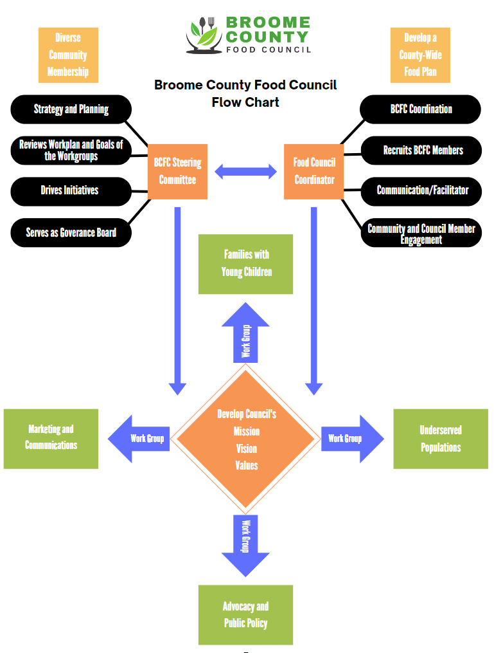
175 MEMBERS, 70 Agencies & Organizations
STEERING COMMITTEE – meet monthly
4 WORK GROUPS – meet monthly
Underserved Populations and Families with Young Children Work Groups – data analysis from the Community Survey –Food Access Plan by 2024
Our Advocacy and Public Policy WG – concentration on education and working on SNAP benefits at Farmer’s Markets
Marketing & Communication – printing, designing, and publication
Partnership with Binghamton University - Food Justice group and Geography Dept. Emergency Food Access Map (EFAM) & Community Resource Map (CRM) – Story Map
Meet quarterly. Next meeting Wednesday, November 29th
Notes:
Steering Committee – serves as the Governance board and to monitor the Council & WG activity. Four work groups were formed based the food insecurity data for BC.
Our Data Analysis is being done four BU students in the Digital and Data Studies , Prof. Melissa Haller

Slide 13
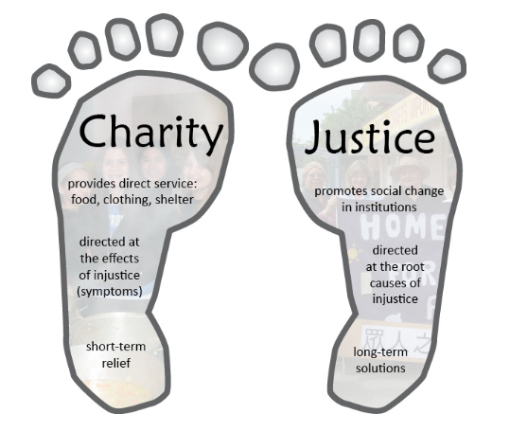
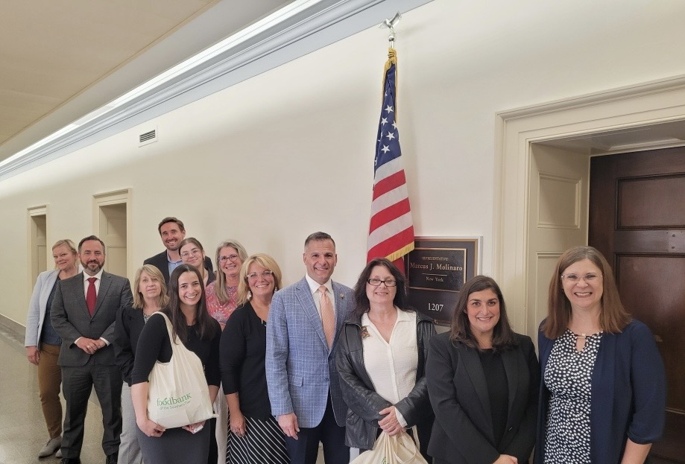
Advocacy And Public Policy
Notes:
We also do public policy advocacy work and have relationships with our elected officials on the local, state, and federal levels. The picture on the right here is of food bank staff, Community Advocates Program members, and partners in Washington, DC at the Anti-Hunger Policy Conference.
In addition, as a member of Catholic Charities, we strive to abide by the Two Feet of Catholic Social teaching, which are charity and justice. We at the Food Bank know that charity alone will never solve hunger, and that government supports, such as SNAP and school meals, are an essential component to address the issue. We view our work as a public / private partnership. We saw this during the pandemic, when the government stepped in and provided additional SNAP benefits, free school meals for all, and more, while also supporting food banks with additional federal commodities from the USDA.

Slide 14
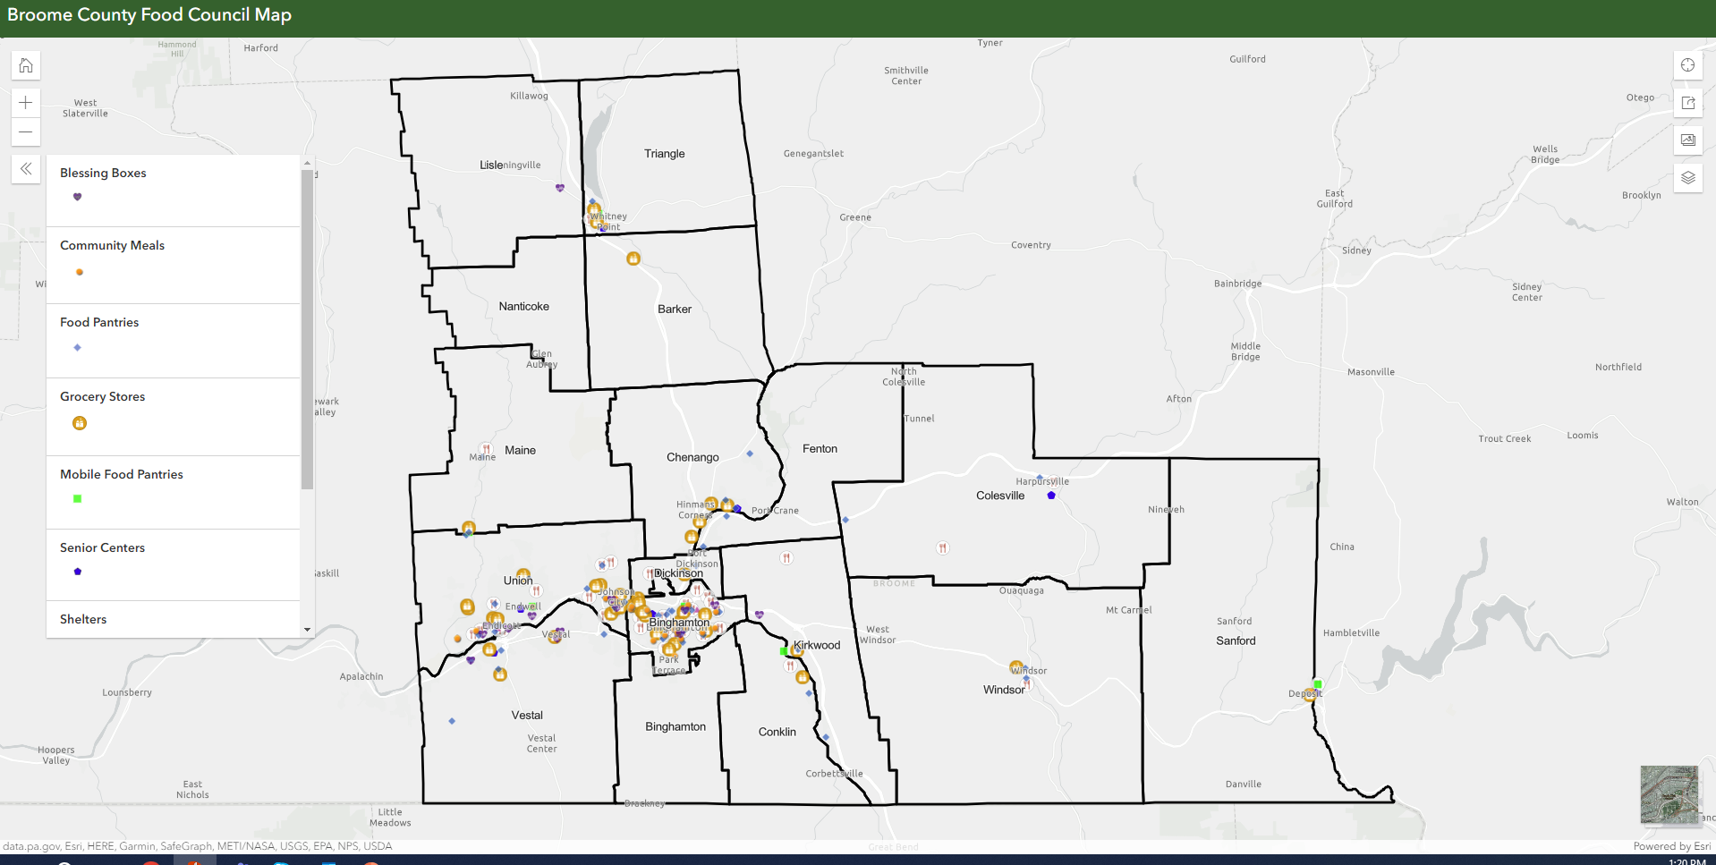

Slide 15
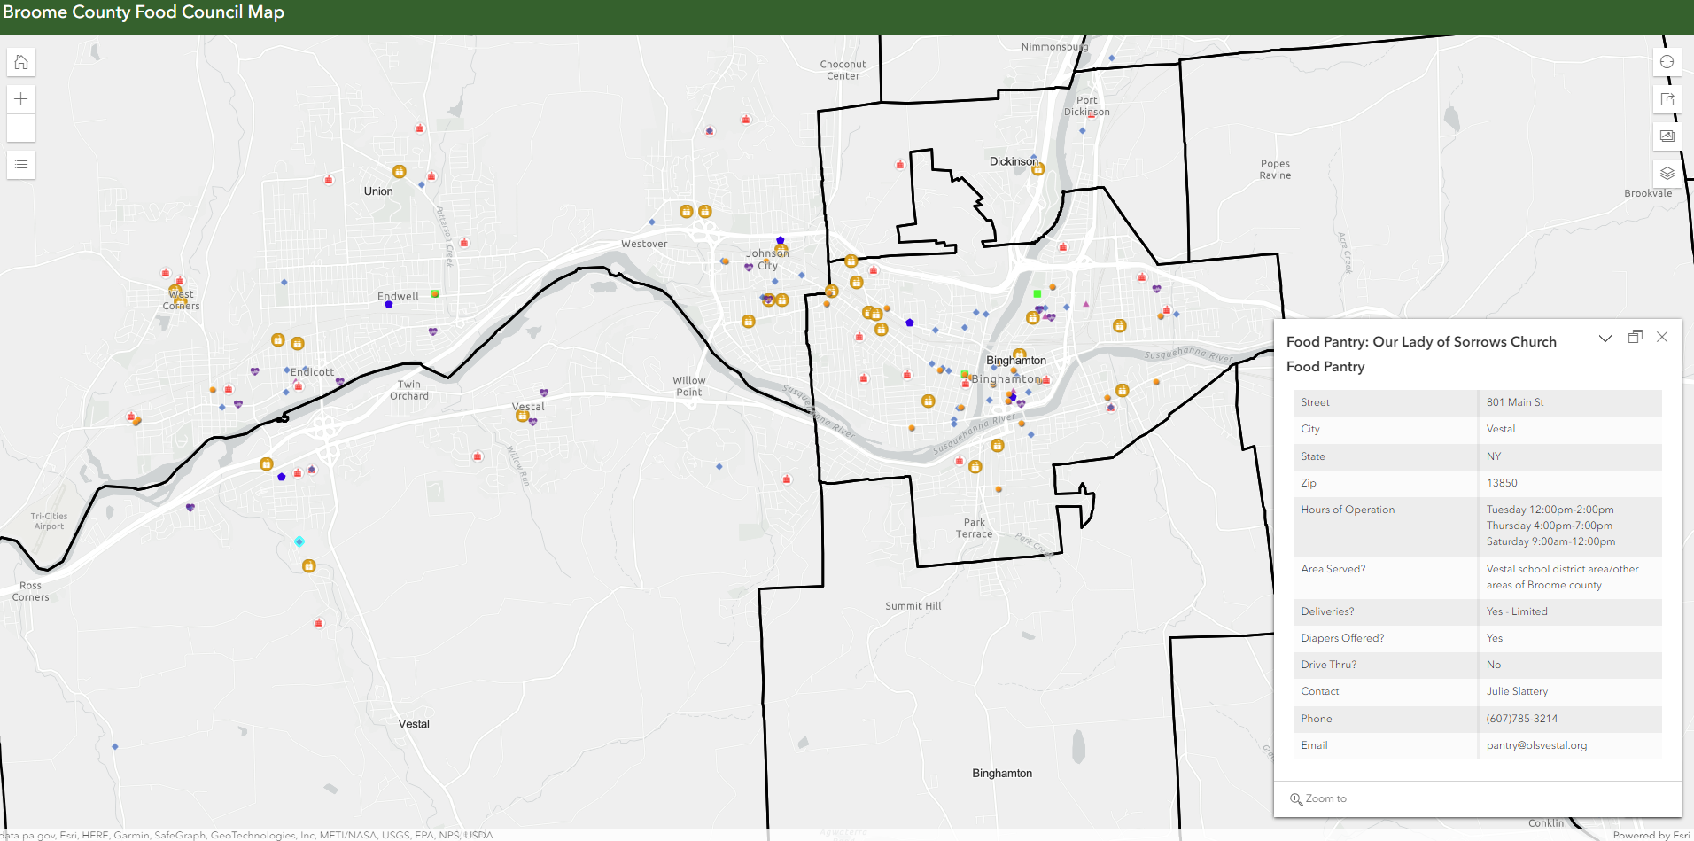

Slide 16
BCFC: SUMMER SURVEY INITIAL ANALYSIS
Digital & Data studies – BU
Food insecurity is complex
Biggest barrier to food access: transportation & income
Advocacy work around income
People to the food or food to the people
Advocacy work around income
Digging deeper
Notes:
1292 responses – 1000 were paper surveys
Food insecurity is complex for people who are experiencing it. How do we approach this holistically? Families with Young Children/Seniors/College students Qualitative data. Because we handed surveys out, we have data to qualitative data to support the numbers
Transportation and Income were tied for the biggest barrier to food access in Broome County. Income is a symptom of poverty. Continue Advocacy work
YES Transportation: Food/Resource Hubs, GGG bus
Students are digging deeper. They will overlay their Mapping with the EFAM
They will finish their correlation and data prediction study
Council meeting on November 29th where members will hear details on the initial study and provide feedback
Final analysis by Dec. 8th: Work Group meeting on Dec. 14

Slide 17
BCFC TIMELINE
DATA ANALYSIS: OCT. – DEC. 2023
STORY MAP & STRATEGIC INITIATIVES: DEC. 2023 – JAN.2024
BEGIN TO WRITE THE FOOD ACCESS PLAN – FEB. 2024
DRAFT COMPLETED FOR BCFC REVIEW – MARCH 2024

