Slide 1

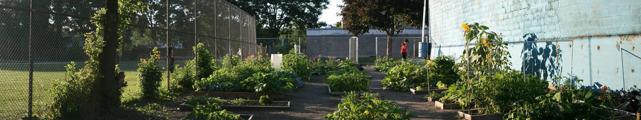







Farm Share
Community Gardens Binghamton Urban Farm Youth Empowerment
GROWING FOOD. GROWING COMMUNITY.

Slide 2
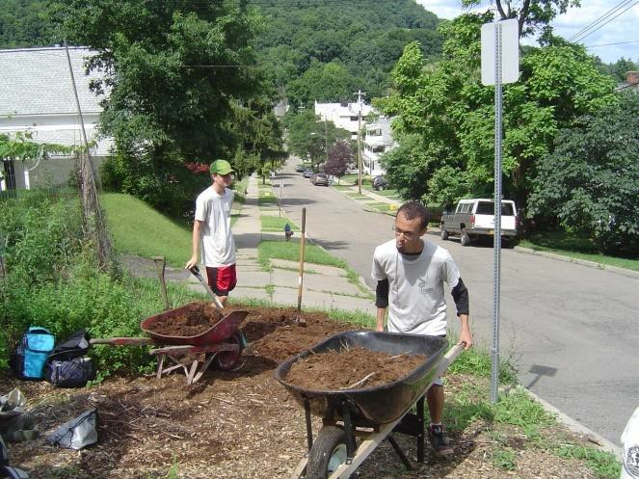
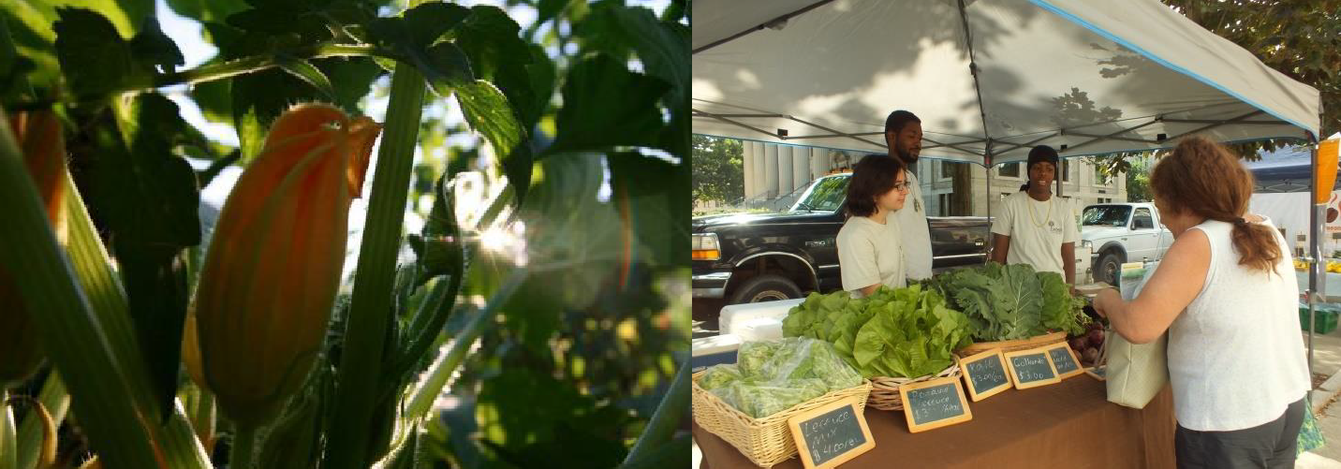
VINES’ MISSION
VINES is an organization committed to developing a
sustainable and just community food system.
what we do why we do it how we do it
Transform
Cultivate
Empower
Revitalize
neighborhoods
Healthy people
Self sufficiency
Gardens
Education & youth development
Volunteer service

Slide 3
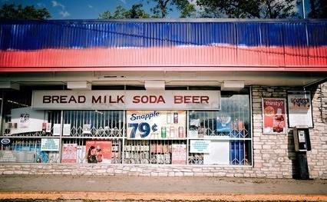
FOOD DESERTS

Slide 4
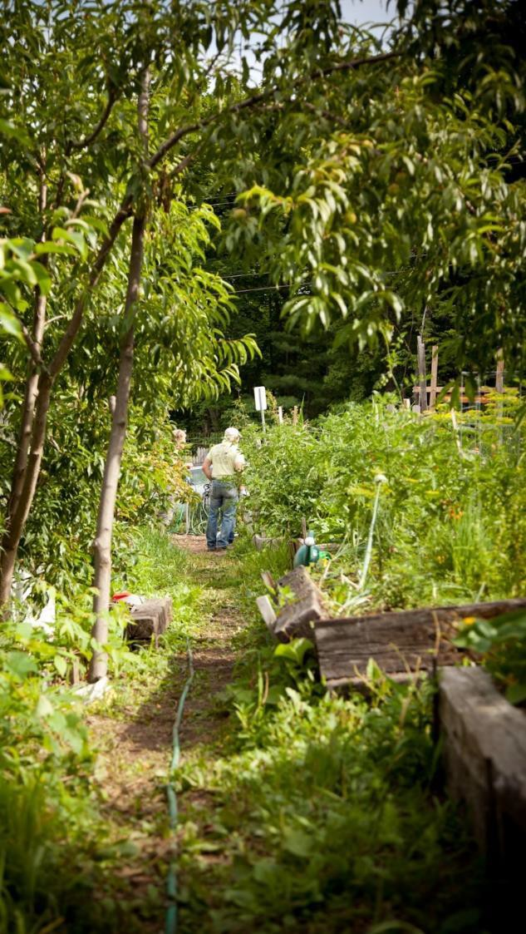
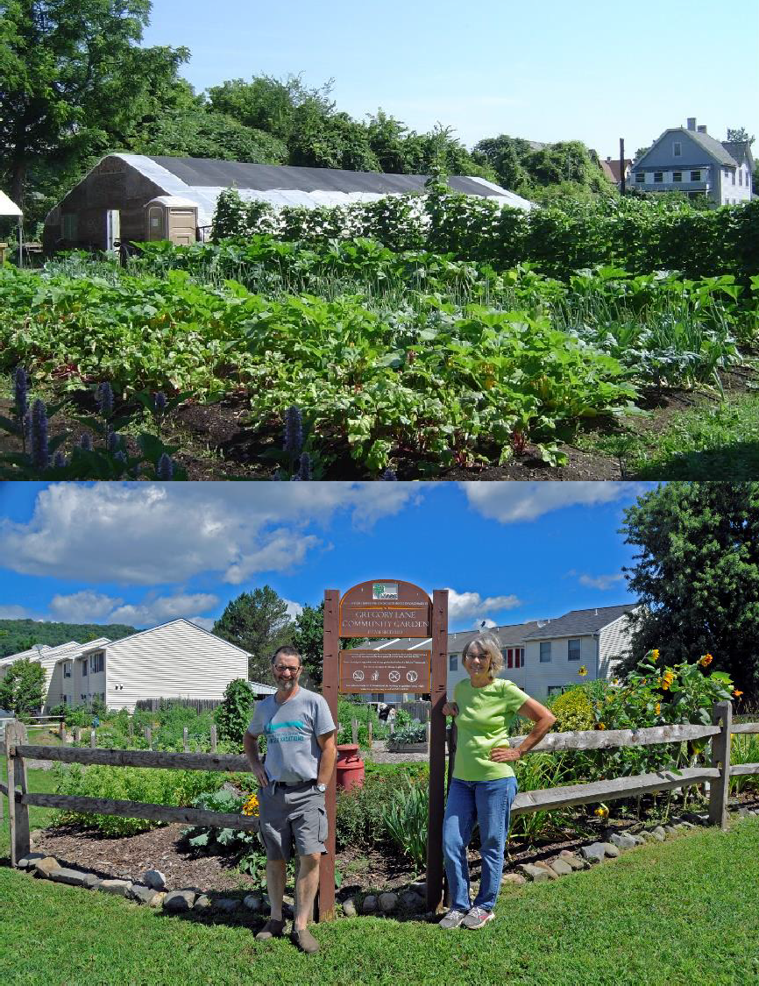

Slide 5
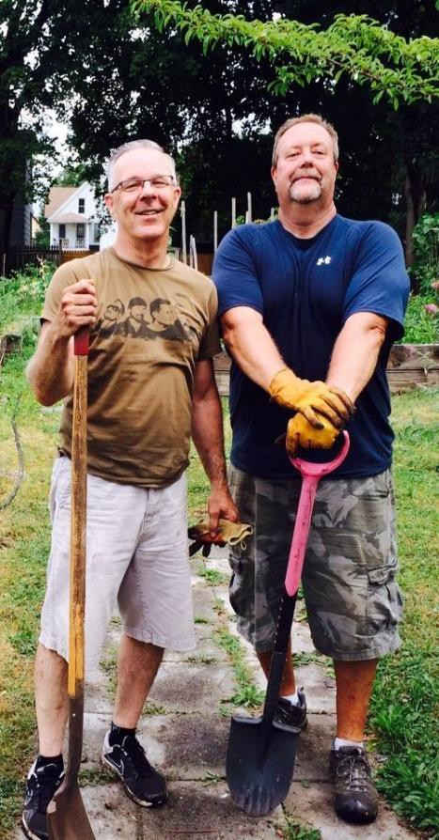
Benefits of Community Gardens and Urban Agriculture
Neighborhood beautification
Creation of public space for people to grow food
Improved food security
Providing education around gardening and nutrition
Improving the quality of life for residents
Stimulating neighborhood and community development
Creating opportunities for recreation,
exercise, and socializing

Slide 6
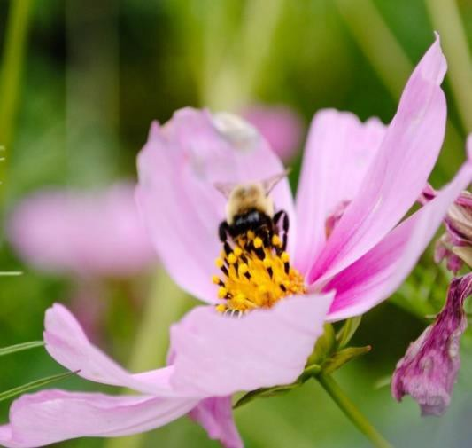
OUR PROGRAMS
Community Gardens
Green Thumb Workshops
Binghamton Urban Farm
Grow Binghamton youth employment program
Farm Share
Build a Garden Program

Slide 7
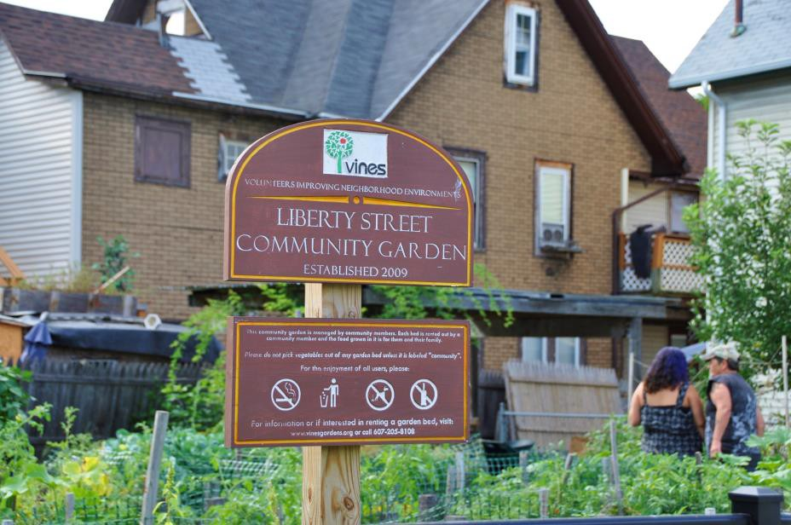
WHAT IS A COMMUNITY GARDEN?
A community garden is a property that is managed and developed by community members to produce food crops for personal consumption.
22 gardens with 500+ garden beds
Plot rentals: $20-30 per year
Cooperative maintenance

Slide 8
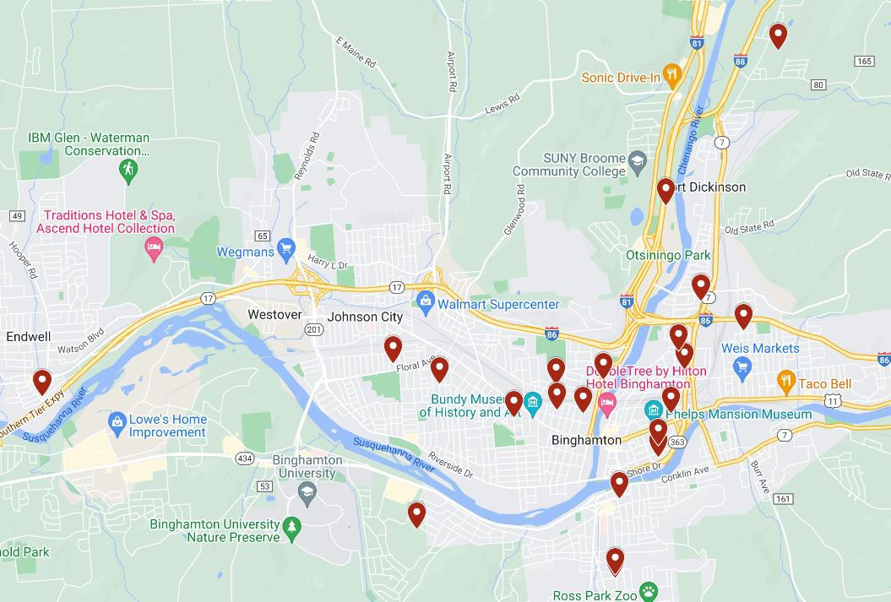
VINES GARDEN SITES

Slide 9
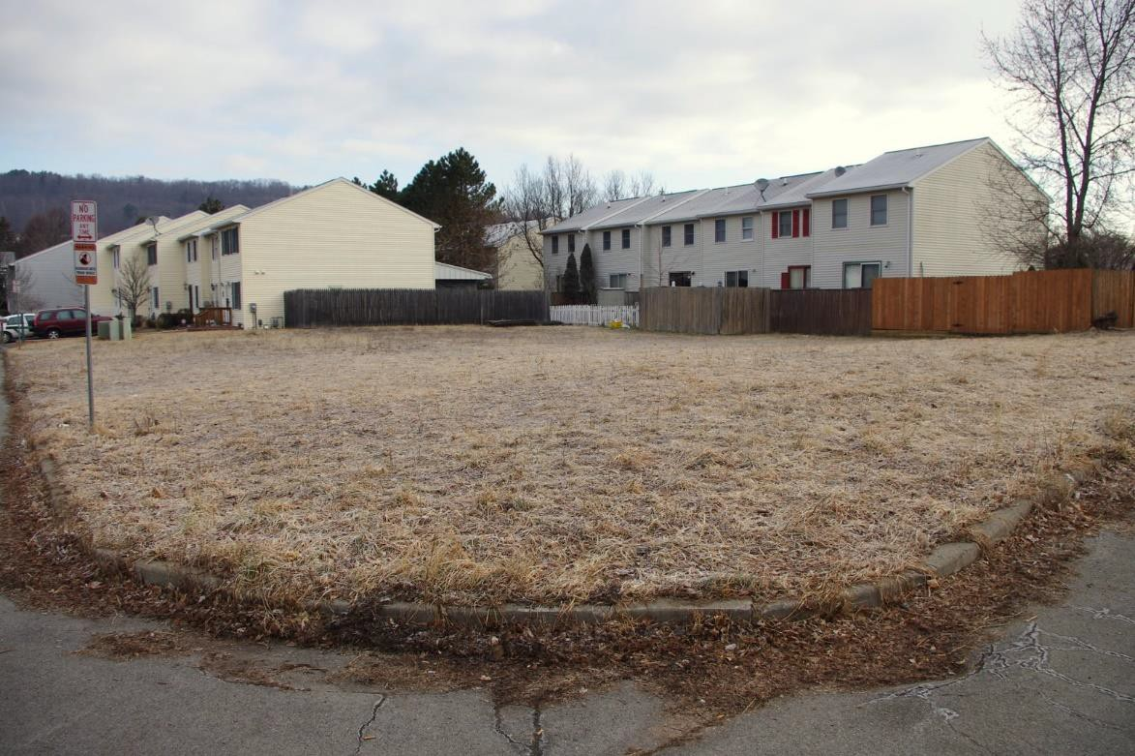
GREGORY LANE COMMUNITY GARDEN BEFORE

Slide 10
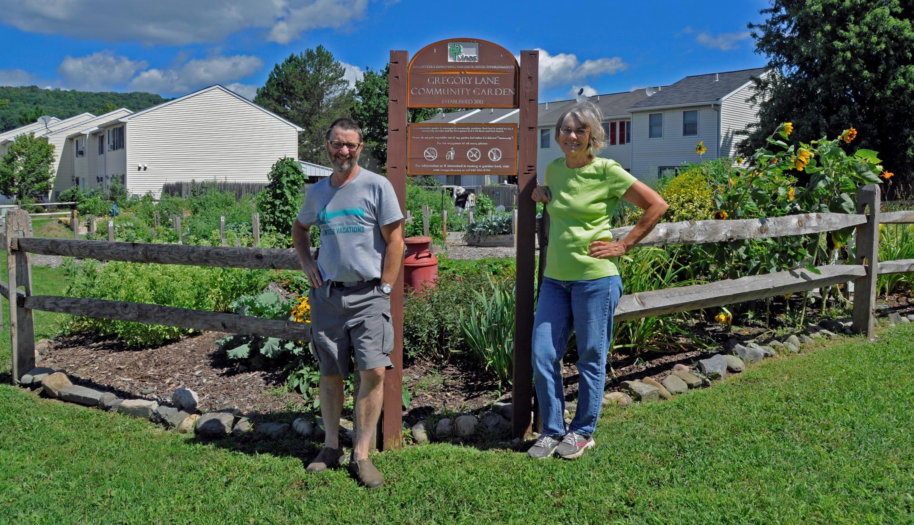
GREGORY LANE COMMUNITY GARDEN AFTER

Slide 11
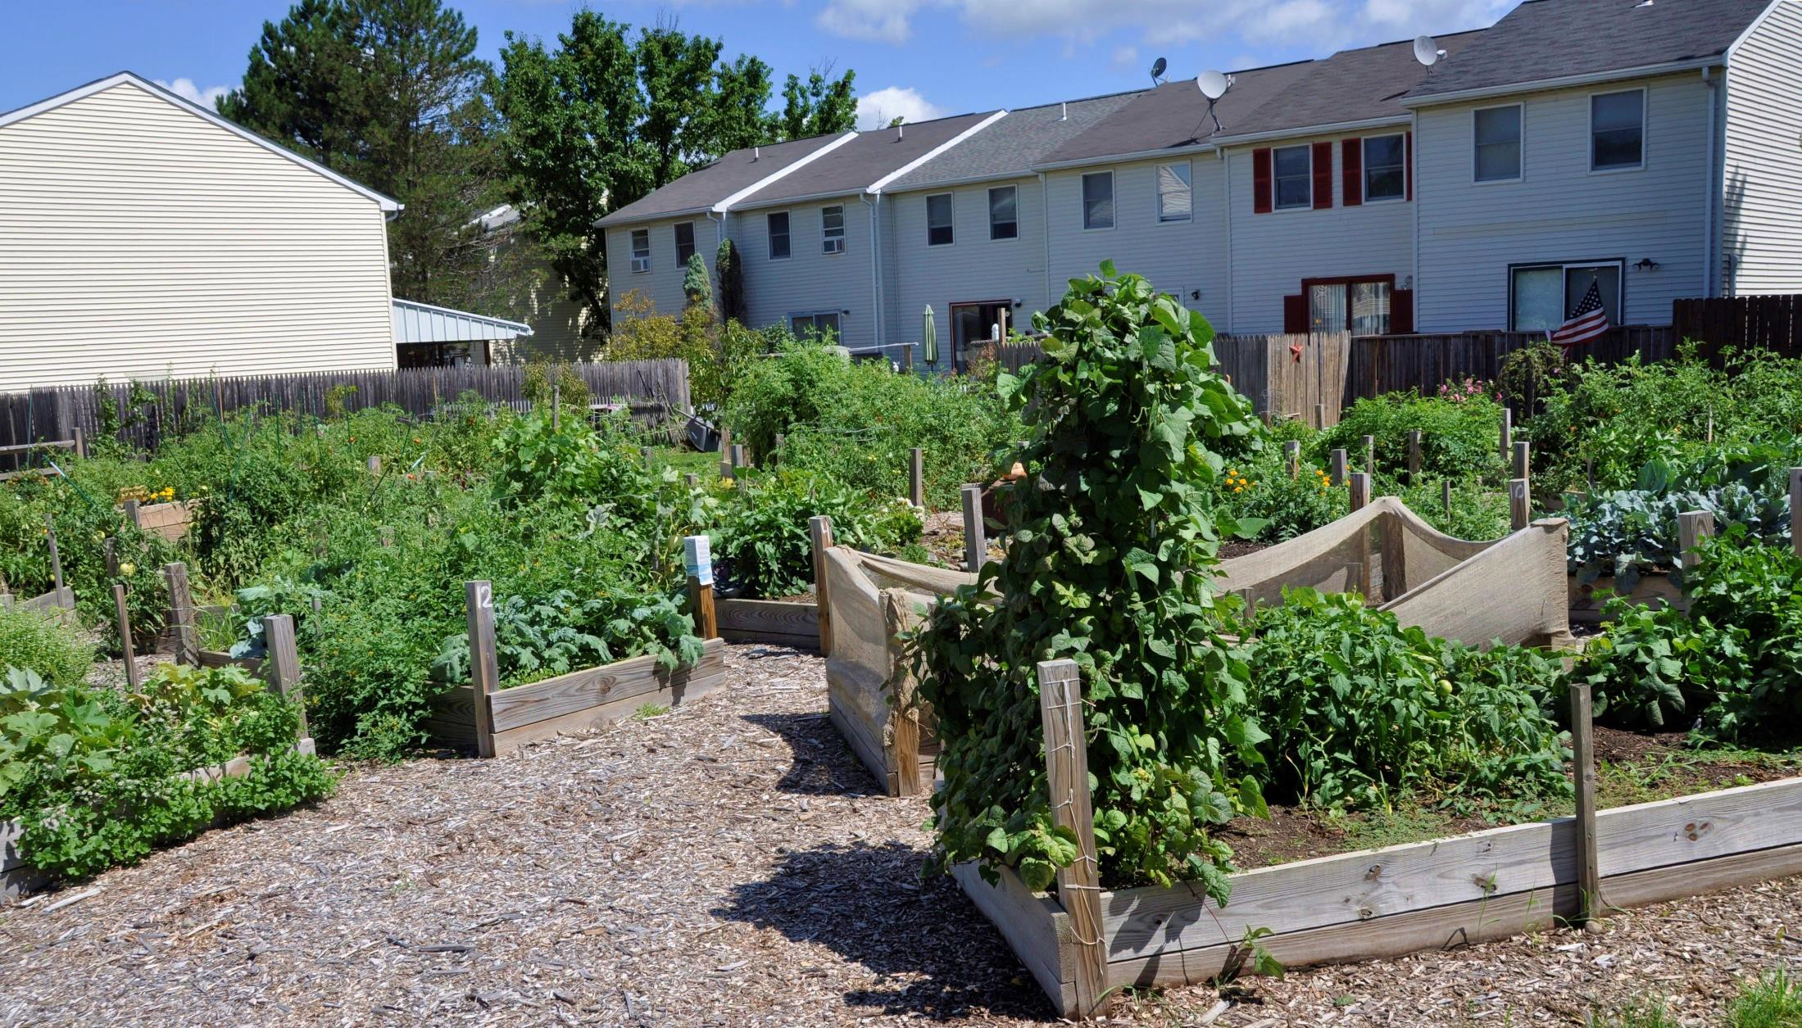
GREGORY LANE COMMUNITY GARDEN AFTER

Slide 12
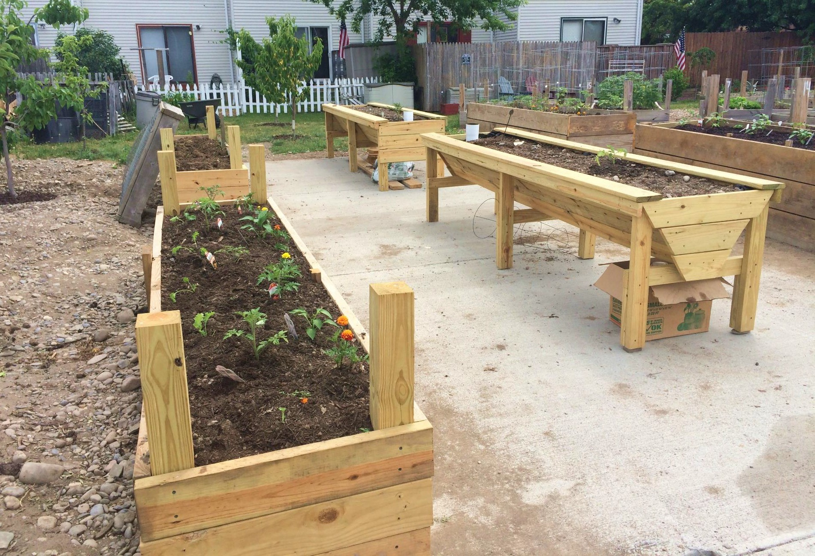
GREGORY LANE COMMUNITY GARDEN AFTER

Slide 13
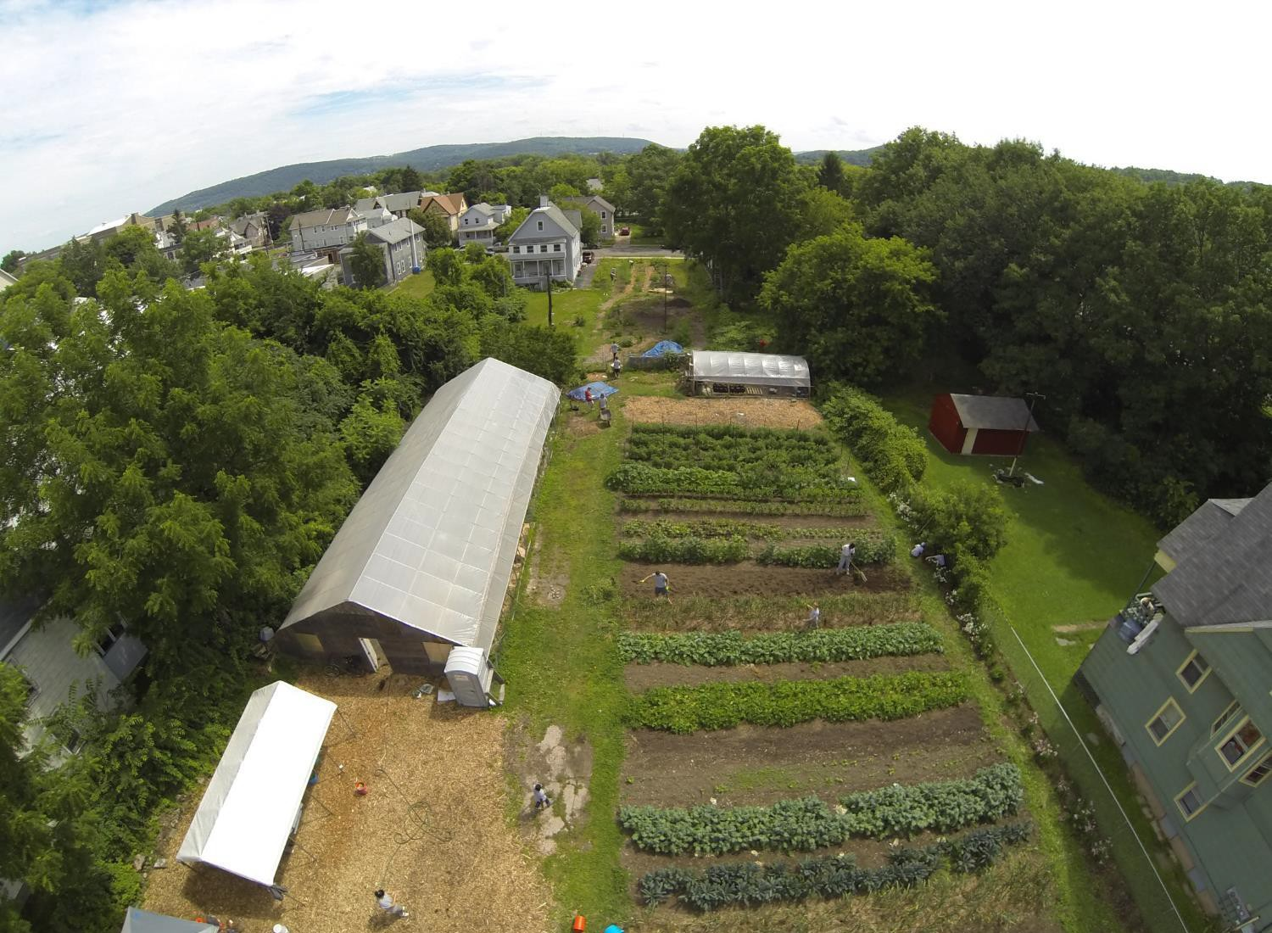
BINGHAMTON URBAN FARM
The Binghamton Urban Farm is located in downtown at 16 Tudor Street on 2 ¼ acres and encompasses 16 contiguous city lots. We grow primarily vegetables and have a perennial food forest.
Where you can buy our produce:
Buy a Farm Share: mini, small, and large sizes available
Pop-up Farm Stand on Susquehanna St.
Downtown Farmers Market
Old Barn Market

Slide 14
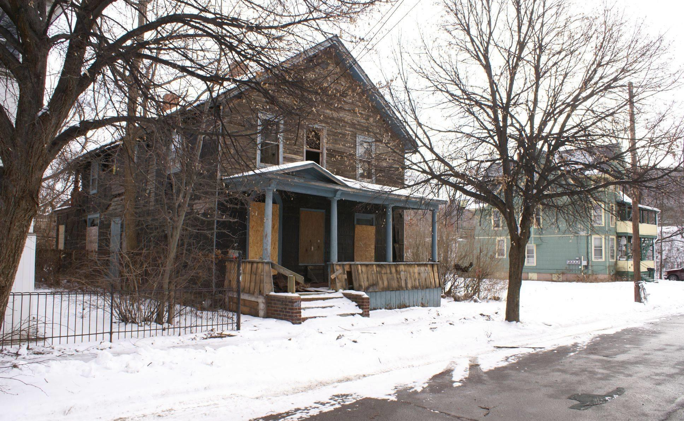
BINGHAMTON URBAN FARM PROJECT TUDOR ST SITE BEFORE

Slide 15
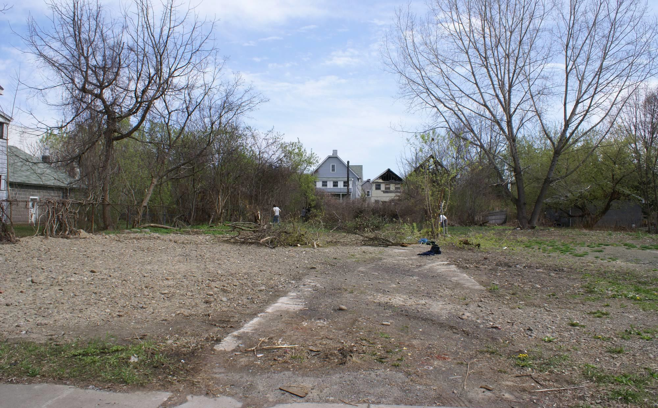
BINGHAMTON URBAN FARM PROJECT TUDOR ST SITE BEFORE

Slide 16
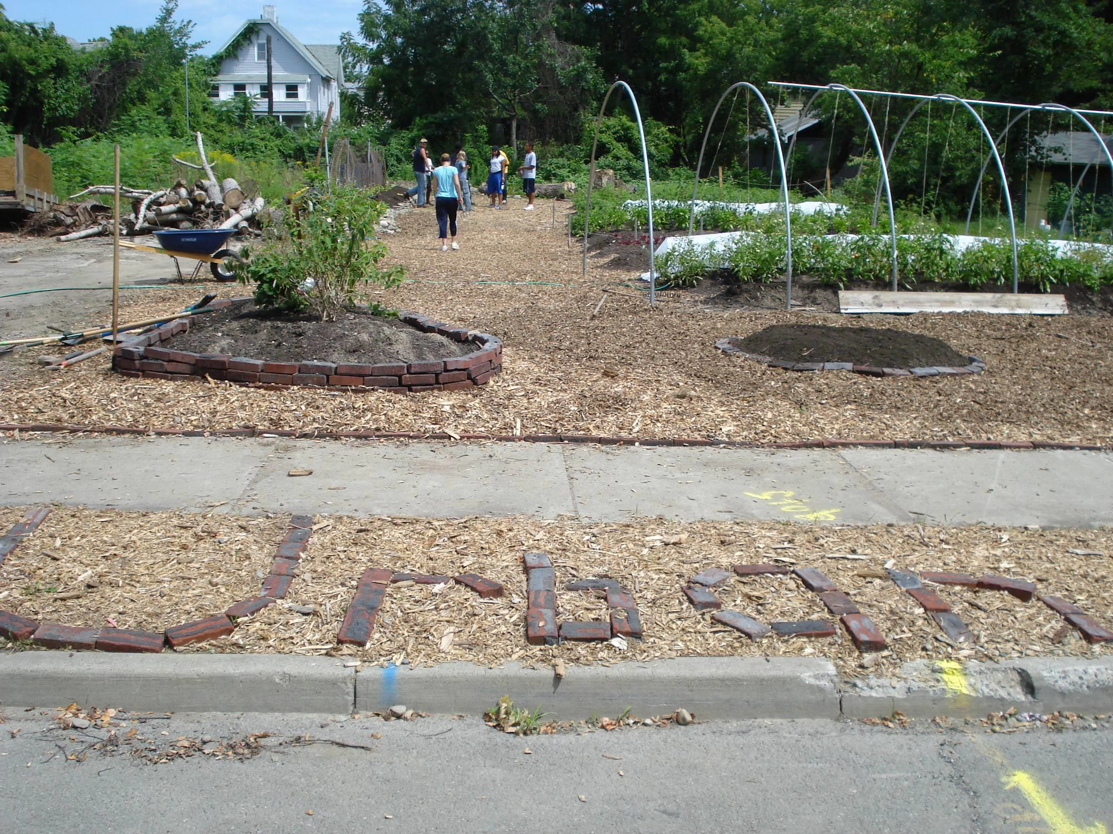

Slide 17
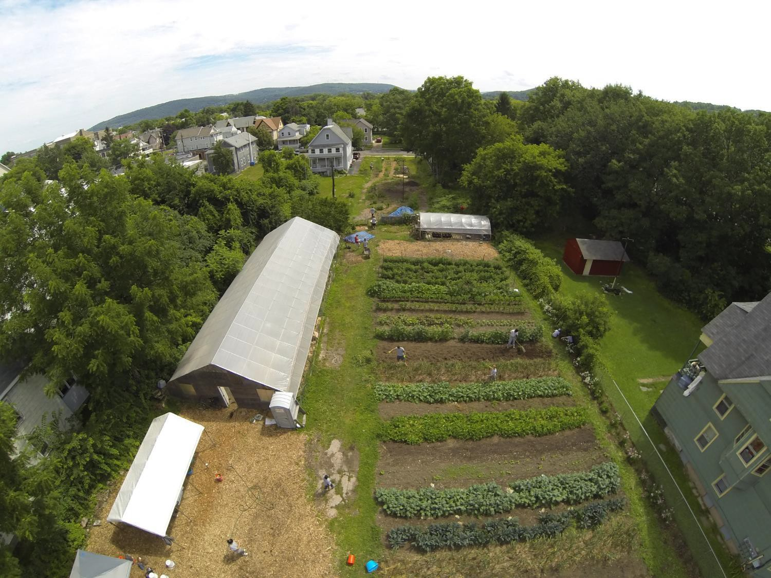

Slide 18
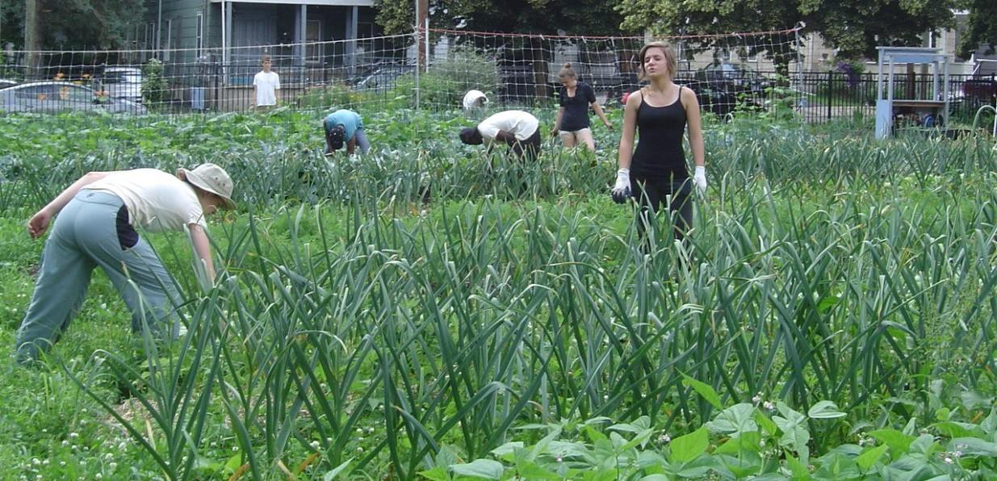
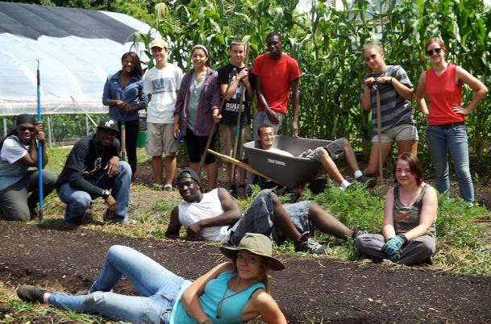
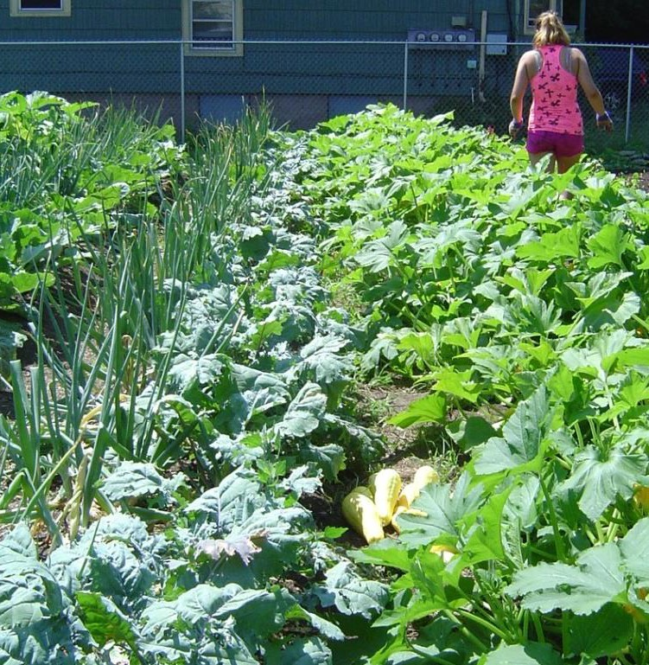
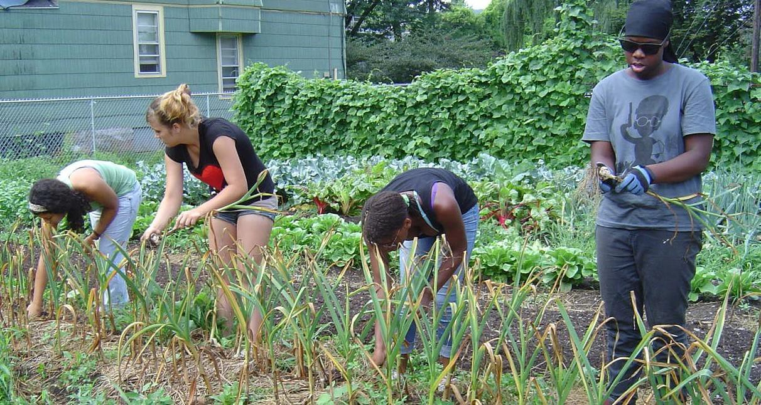
BINGHAMTON URBAN FARM PROJECT TUDOR ST SITE AFTER

Slide 19
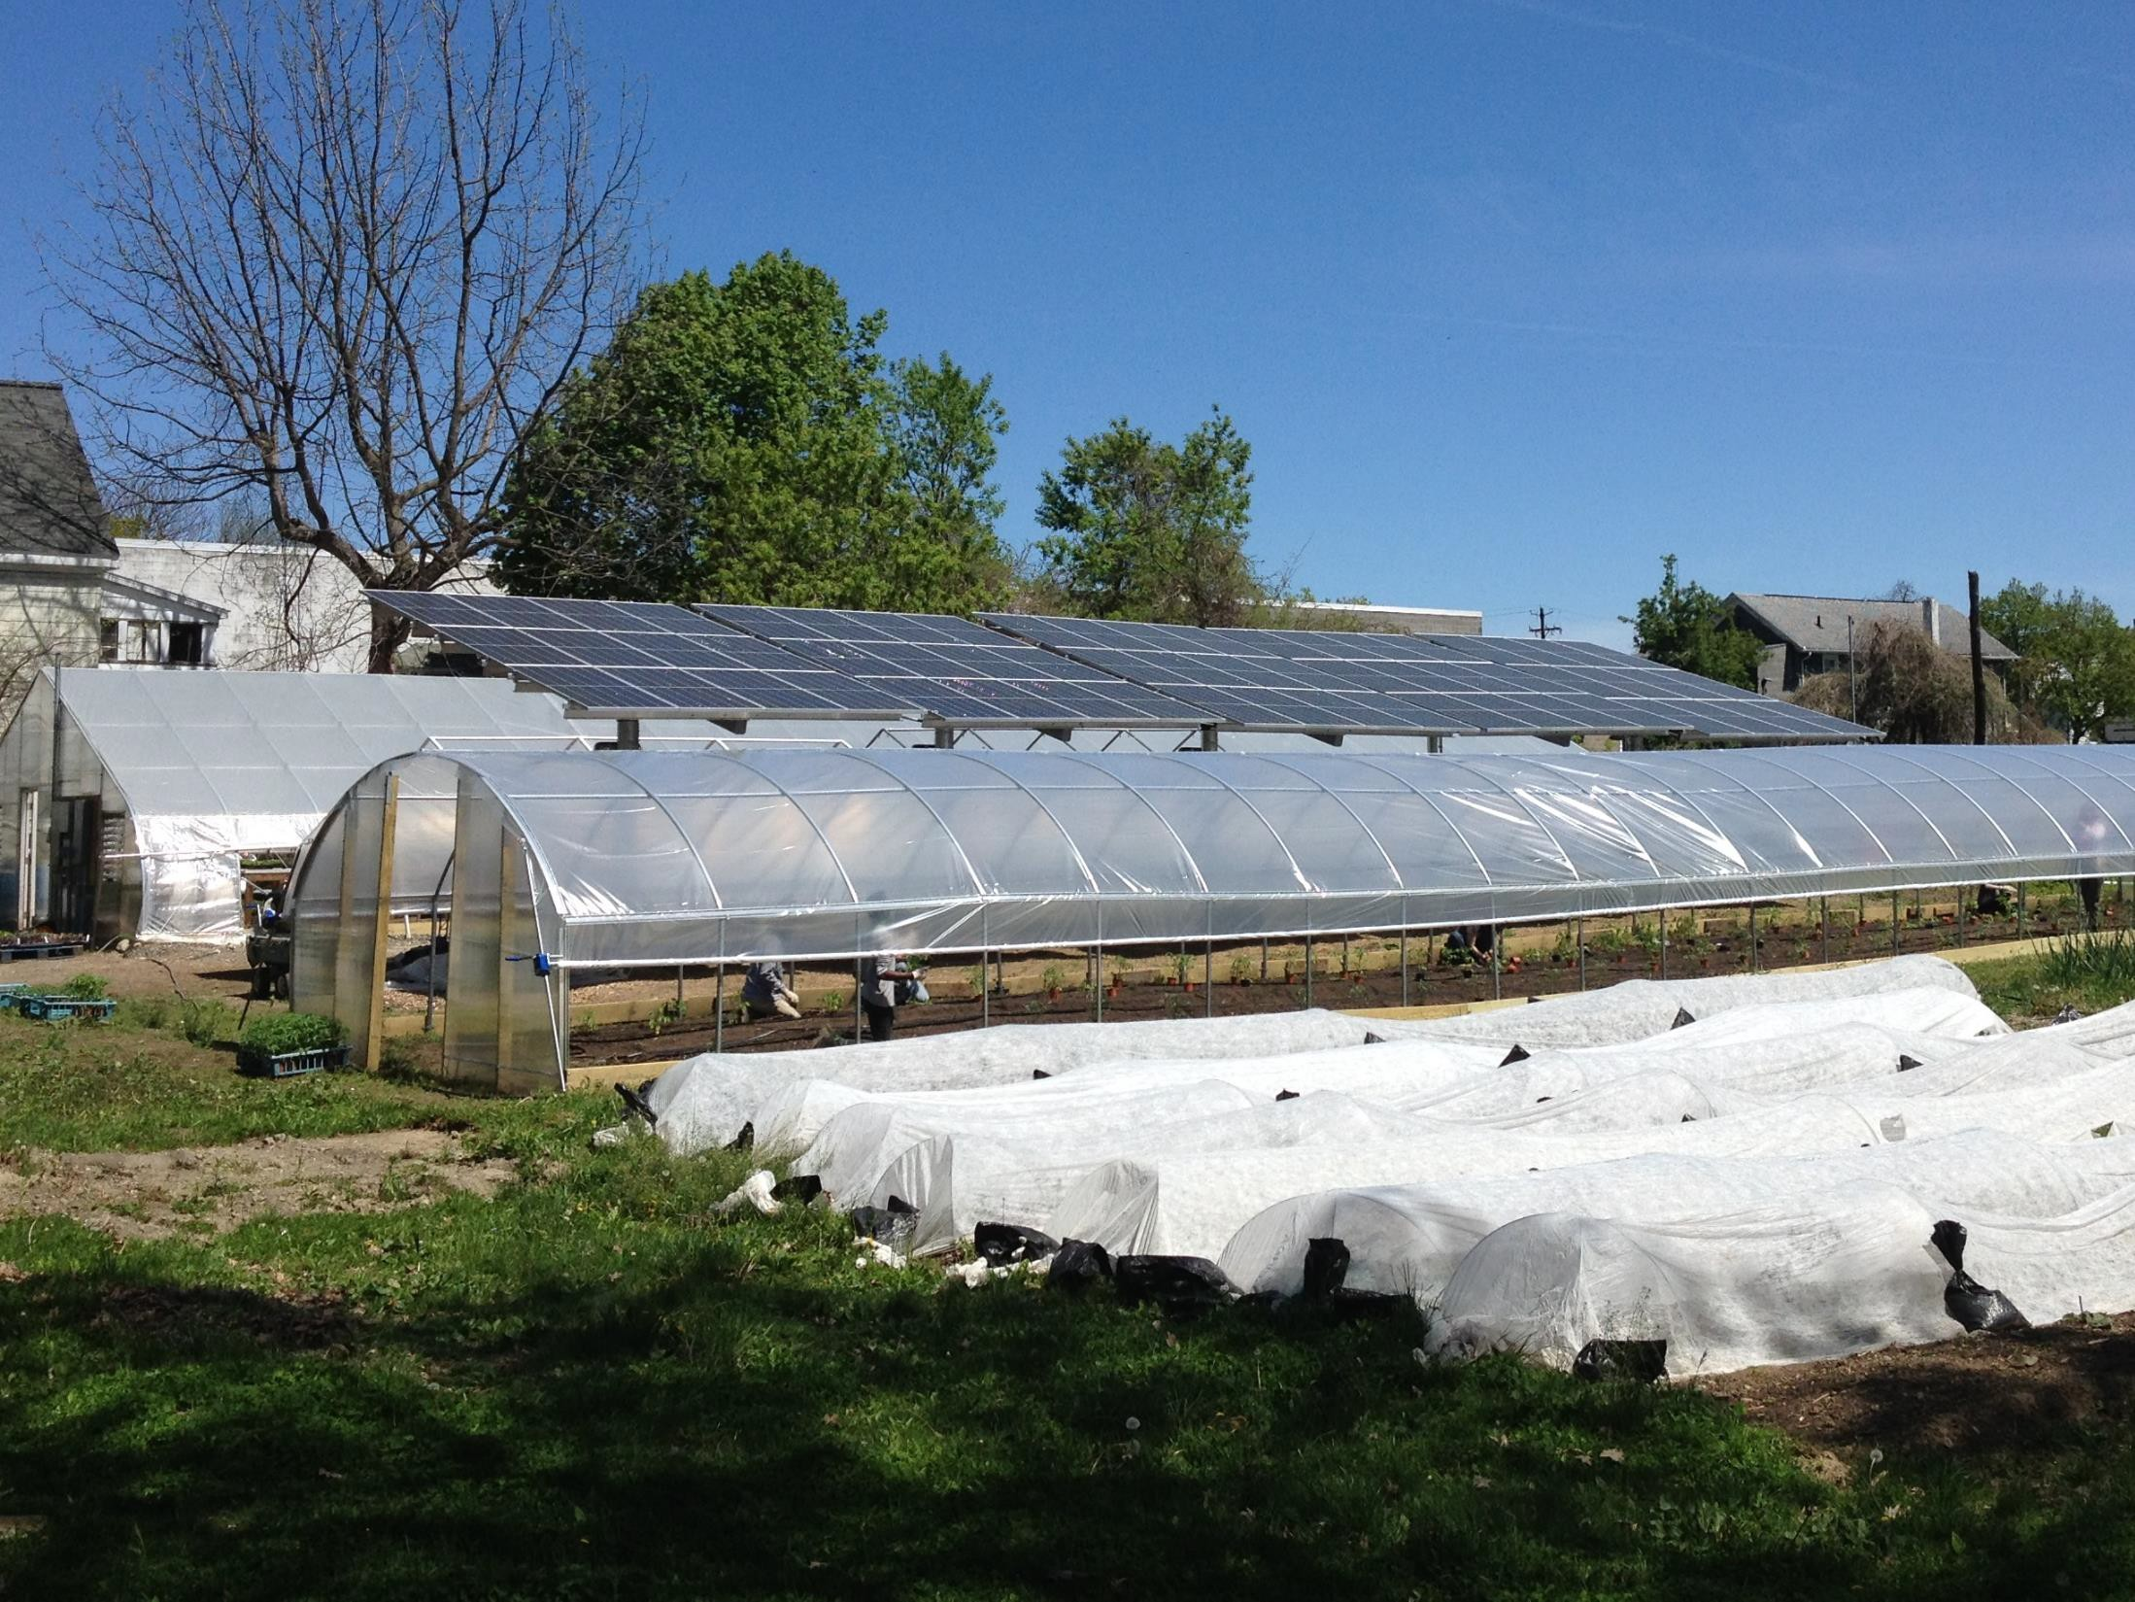

Slide 20
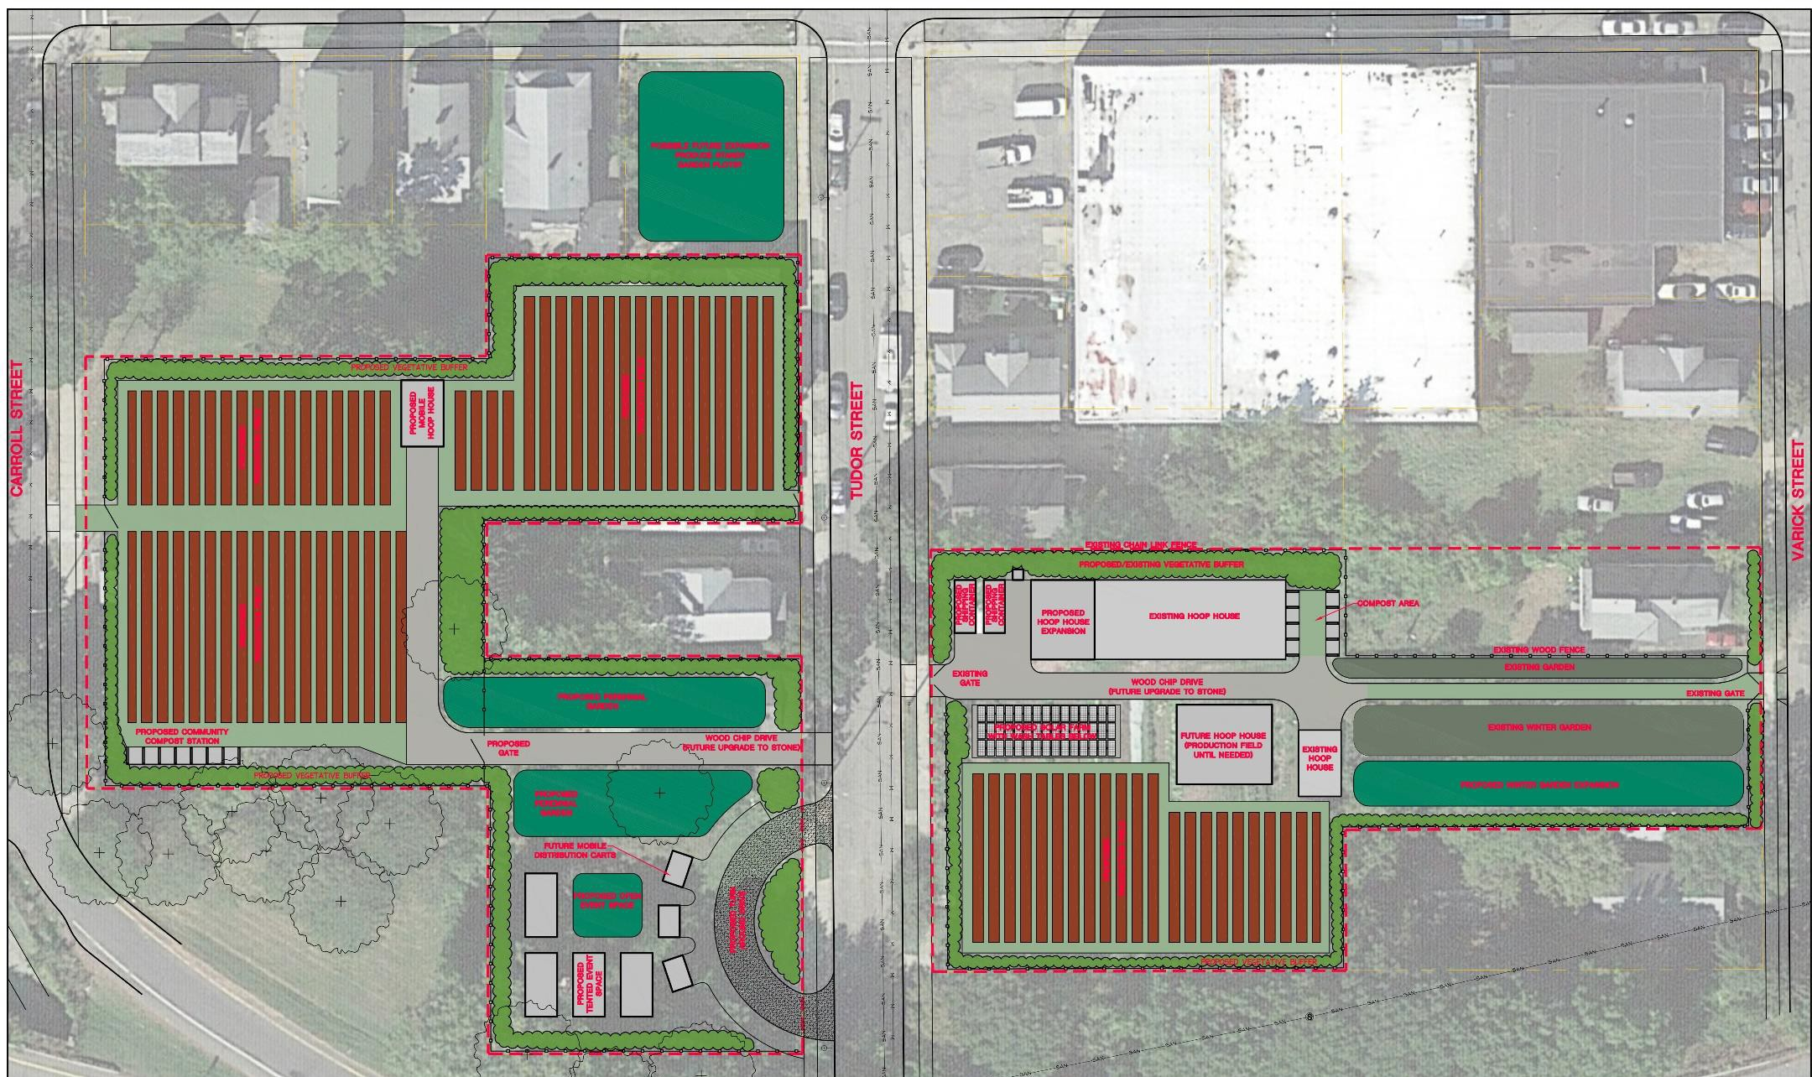
BINGHAMTON URBAN FARM EXPANSION

Slide 21
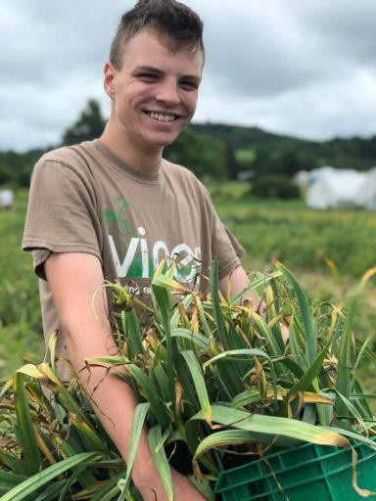
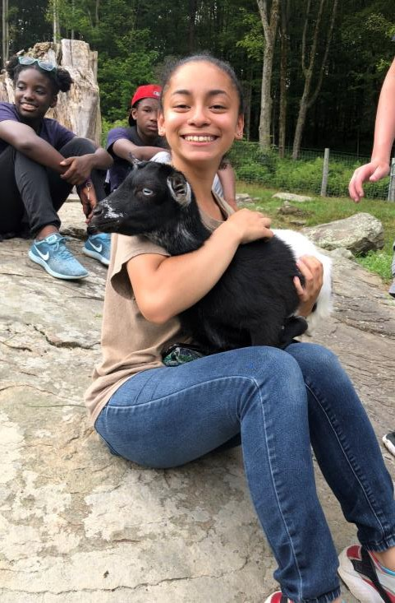
GROW BINGHAMTON YOUTH EMPLOYMENT
Paid youth employment (Ages 14-21)
Three sessions: Summer – 6 weeks (25 youth), Spring & Fall – 8 weeks (8 youth each)
Hard Work & New Skills!
Urban Farm: Growing 5,000+ pounds of food for 60+ families/year
Build-A-Garden: constructing home gardens – serving 50+ homes/year
Trainings: Financial literacy, resume writing, interview prep, cooking, & Tours of Farms & Food Businesses

Slide 22
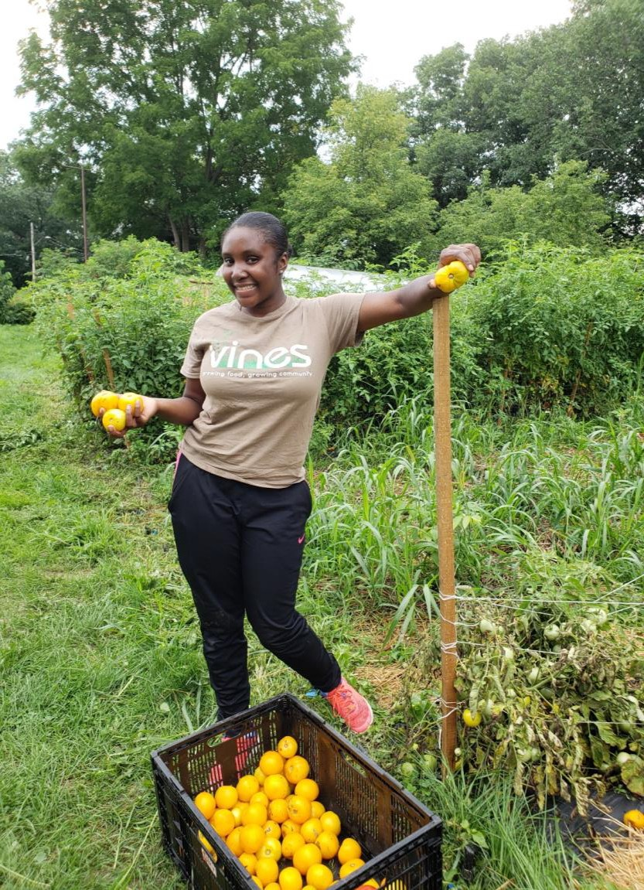
WHY FARM WITH YOUNG PEOPLE
Limited employment opportunities for youth
Meaningful Work
Give back to the community
Personal and social change
Develop leaders in the food system
Reconnection with where food
comes from
Interdisciplinary learning

Slide 23
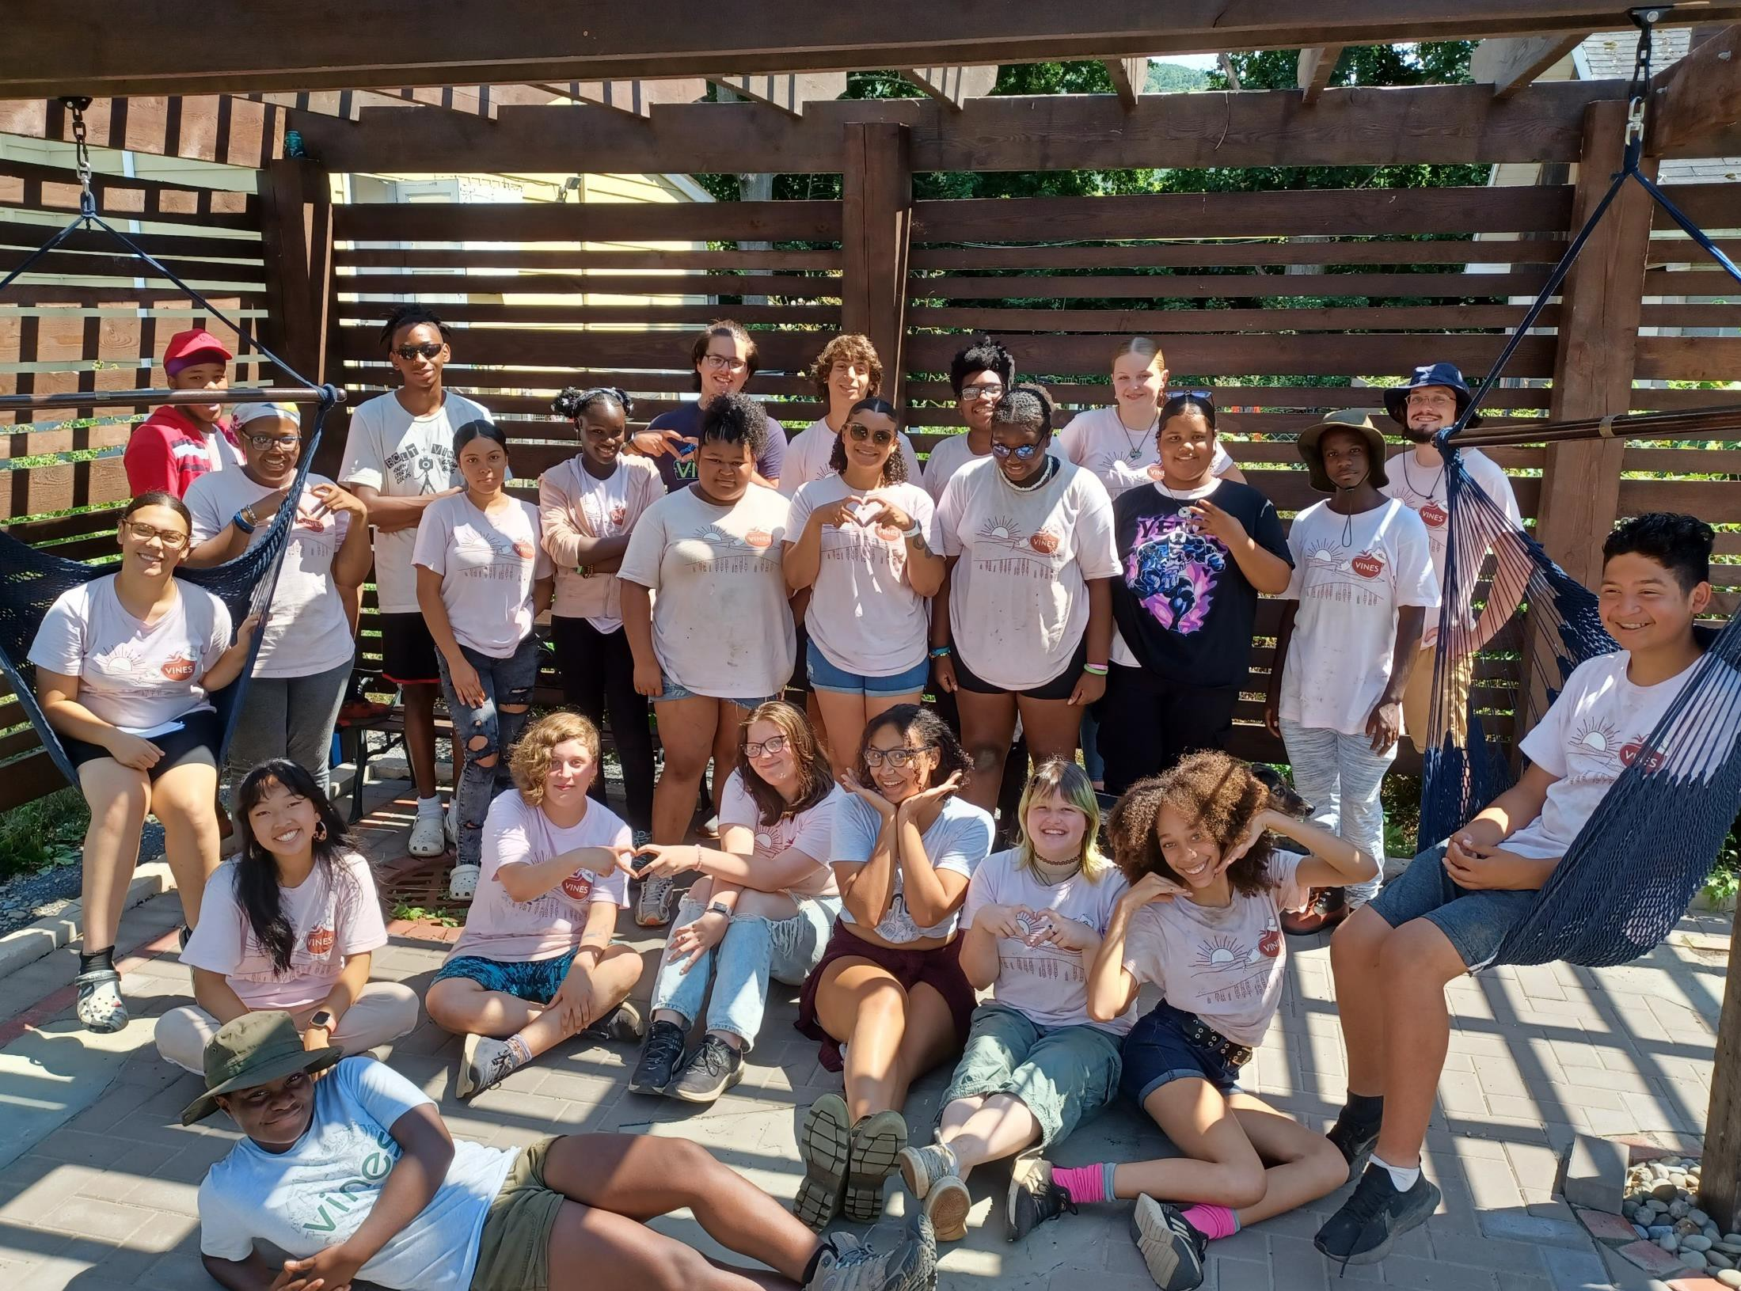
GROW BINGHAMTON CREW 2022

Slide 24
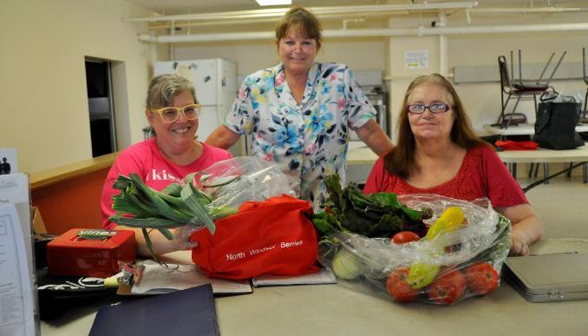
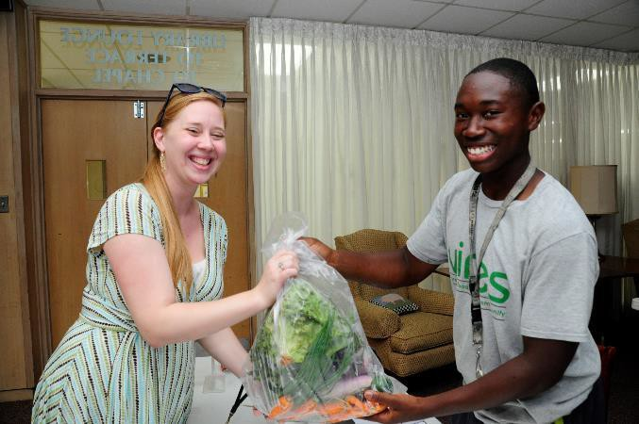
FARM SHARE PROGRAM
Farm Share is a modified CSA targeted to low-income residents (but open to anyone)
The program offers:
Flexible payment plans
Discounts for low/moderate income customers
Several share size and price options
14 Neighborhood distribution sites

Slide 25
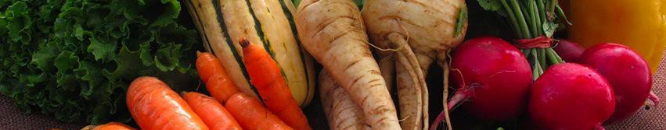
FARM SHARE BY THE NUMBERS
Distributed to 725+ community members in 2022
15% growth each year, 215 weekly shares in 2022
56% of members receive discount
90+% of members reported learning how to prepare
new vegetables
75+% of members reported increasing their daily intake of vegetables
$87,000+ in locally grown produce sold annually
“The program increased the amount of vegetables my
family ate while decreasing my grocery bill.”
– Farm Share customer

Slide 26
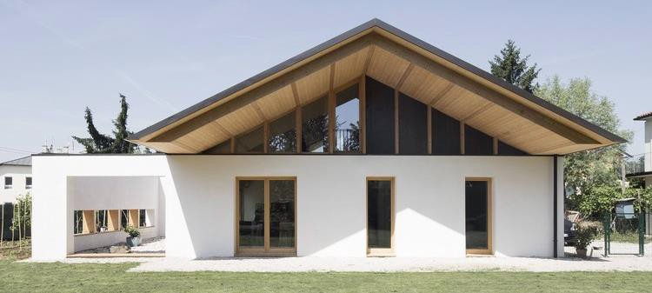
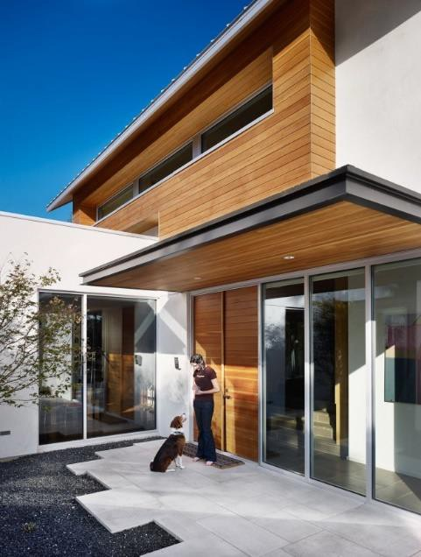

VINES NET ZERO OFFICE PROJECT
Downtown Binghamton, 157 Susquehanna Street
4,000 square-feet, 3 story
Net Zero Energy with onsite PV
Strawbale Construction with steel frame
Construction Timeline: April 2023-September 2024

Slide 27
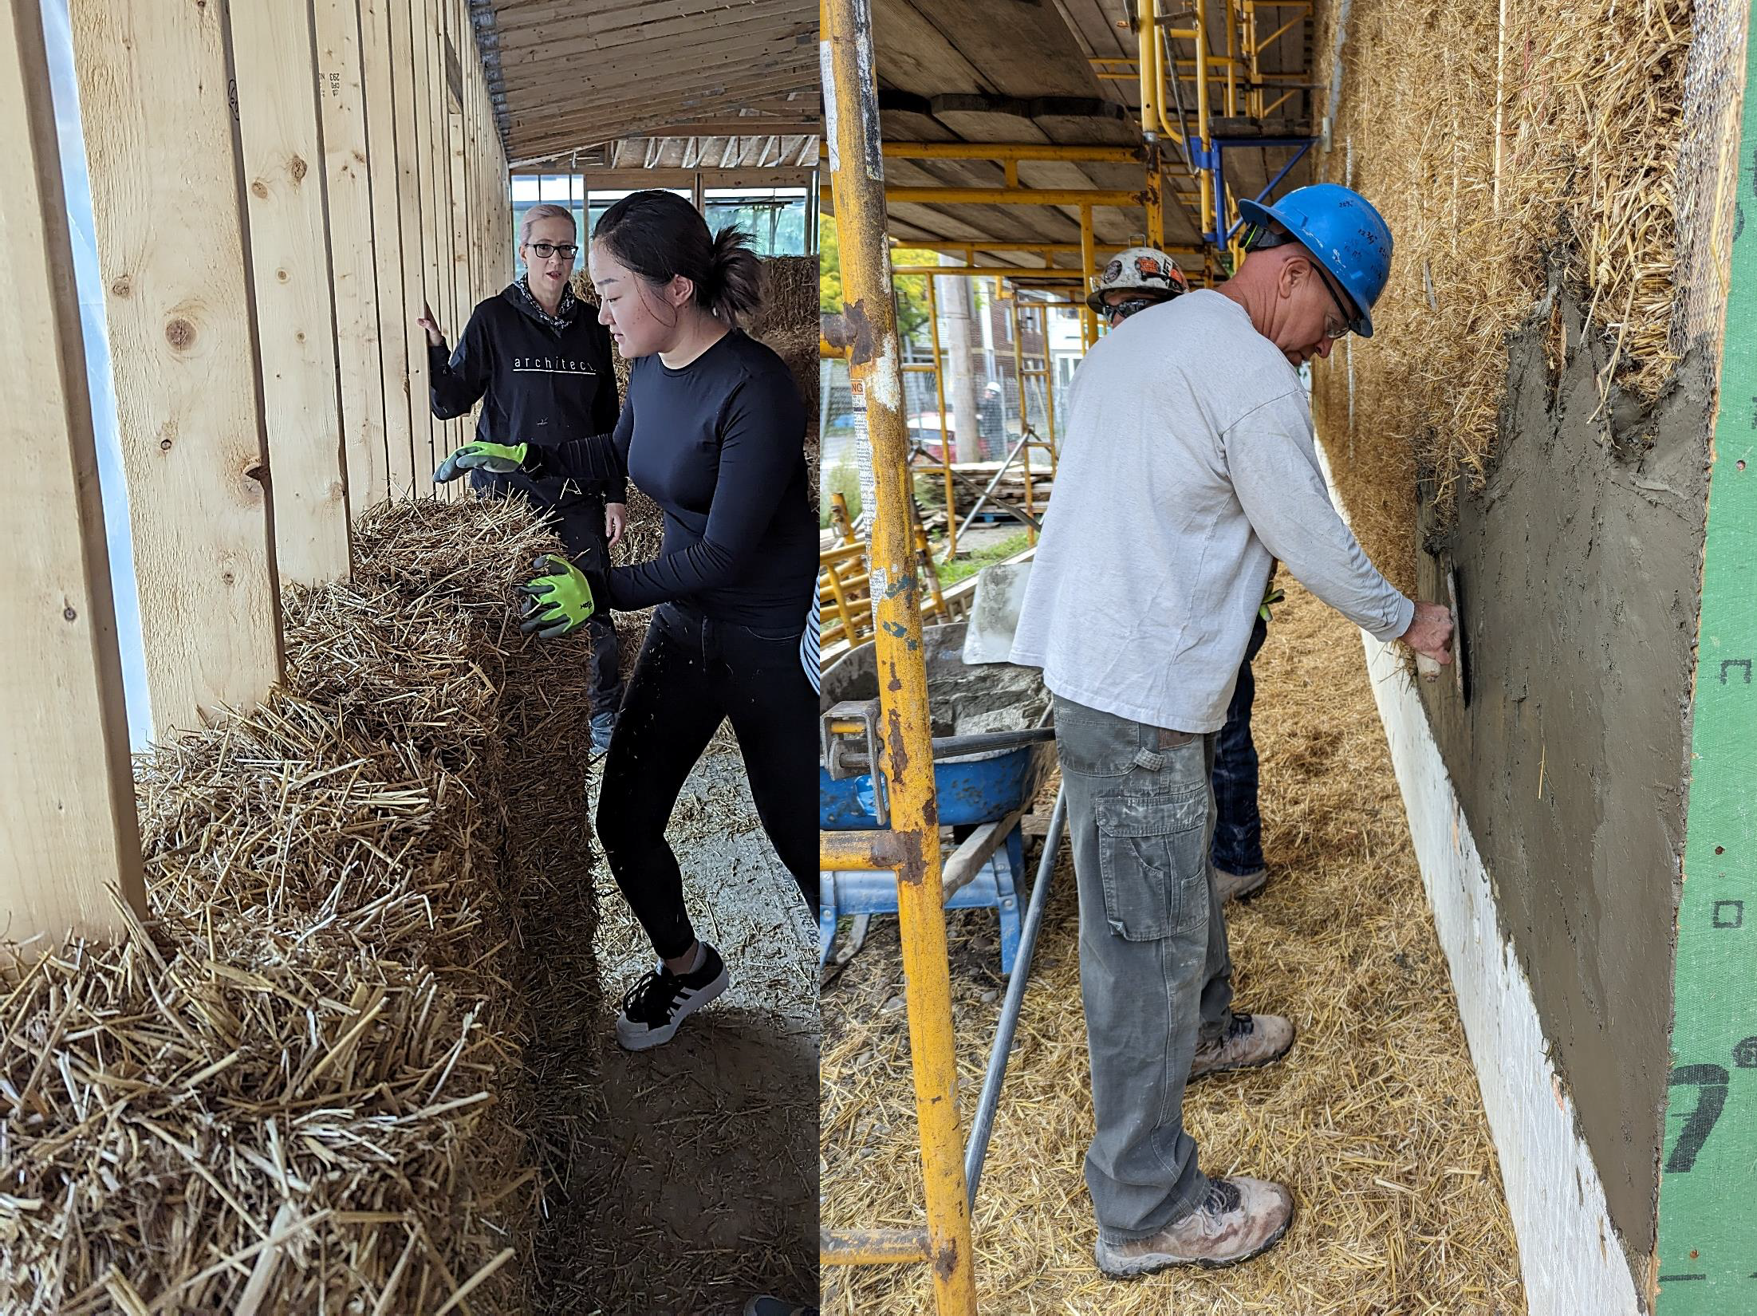

Slide 28
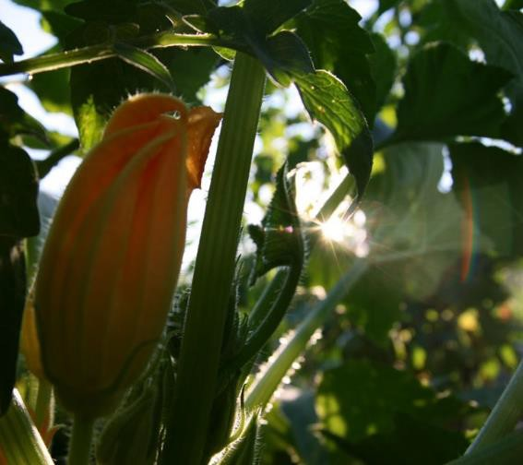
ASSETS AND CHALLENGES
‘Young’ organization - growing pains
Zoning Laws
  City of Binghamton
    Community gardens are a defined and allowed land use
    Water access is codified
  Other Municipalities
    Zoning grey area
    Water access not codified
Funding

Slide 29
