Slide 1
Greater Binghamton Airport
Legislative update 4/8/2021
Presented by Mark Heefner, Commissioner of Aviation

Slide 2
Legislative Presentation
Air Service
Current Projects
Short-term plans
Collaborations
Community Impacts

Slide 3
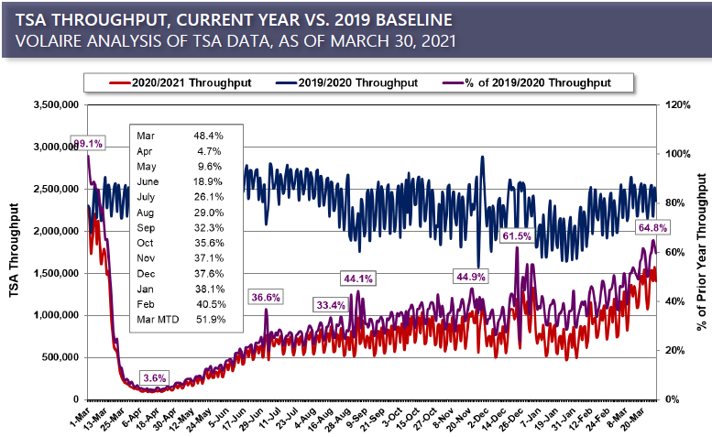
Air Service
Covid-19 Impacts
  Nationwide – 2019 was the greatest travel year in US Aviation. This past weekend saw the highest amounts of travelers since March 2020 (64% of April 2019).
  State – lagging behind the national average by 20-30% (Depressed throughput by 65-80% overall)
  Local – We have fared a little bit better than the rest of the state.
Notes:
NYS is ranked in the top 10 of the most restricted states for COVID-19 throughout this pandemic

Slide 4
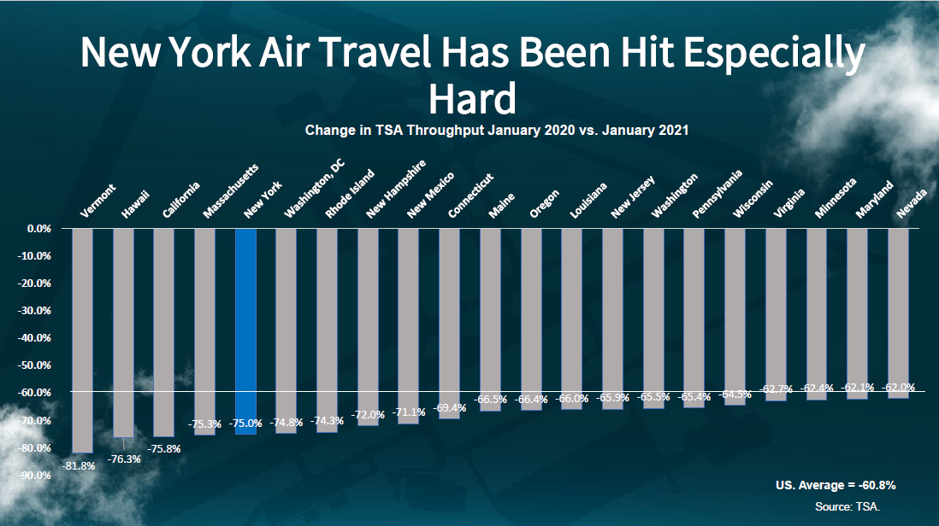
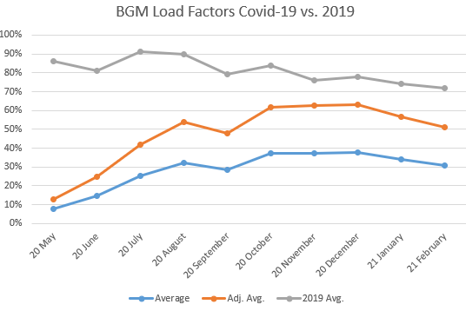
NYS – January 2021
BGM Load factors Covid-19 vs. 2019
Notes:
NYS change is -75% State wide when comparing January 2020 to January 2021. SYR and UA/Frontier – talked to them in February about schedule in April.

Slide 5
Air Service
Current efforts
  Delta contact regarding May & June schedule
  SCASD Application 3/5/21
    “Let’s go South” (IAD, CLT, ATL)
  Marketing and outreach
    Communication with new companies
    Continued communication with non-traditional small market airlines
    Outreach to public on the safety of flying and the updated guidelines
    Continued efforts through NYAMA Board of Director’s position
Short Term Goal (6mo – 1 year)
  Retention
  Restoration
  Plane size increase
  Frequency increase
Mid range goal (1 – 2 years)
  Air service increase (utilize the SCASD)
  Increase frequency with larger plane
Notes:
SCASD Timeline ; Marketing to airlines, our community/businesses, and to the State; Goals and expectations that are reasonable given the climate and how aviation works for small markets

Slide 6
Short term plans
Current efforts
  Environmental reviews
  FAA 163 determination for land use
  Interested parties
    Solar – land lease
    Hangar Lease Tenant
  Grant Solicitations underway
    AvGas Self-Serve fuel farm
    Airport Parking Revenue System Rehabilitation
    Customs and Border Protection and HVAC improvements
    Runway Safety Improvements
    Airfield Electrical Vault Renovations
Short-term direction
  Diversify revenue streams
  Prepare and market current available acreage
    Continue working with The Agency
  Grant solicitation and funding support
    Tiered approach to the Upstate Airport Revitalization Grant
    FAA AIP Grants in upcoming years to expand safety, create space for growth, and reinforce infrastructure.
  FBO Review
  Aviation Corporate Park solicitation
Notes:
1-2 years from now to down the road. Begin working to diversify, set the wheels in motion for future building projects, lay the foundation that will make companies and airlines want to come to BGM

Slide 7
Collaborations
The Agency
  Current study with properties
  Interested parties – Greenhouse
  Shipping companies and Air base connections
  Airport Corporate Park concept
McFarland Johnson
  Environmental
  FAA 163 Assistance
  Master Plan Update
Volaire Aviation Consulting
  Relationships with Delta
  Key contacts at startup airlines
  Outside the box ideas
Notes:
Our work with the Agency cannot be understated. They have been great in brainstorming, linking up with solid connections and potential partners

Slide 8
Community Impacts
General Aviation
  Medical Flights
  Private Aviation
  Flight Training
  Mechanical and Aircraft sales
  Cargo
Jobs – Estimated 75-100 continuous employment because of BGM
  Engineering, Construction, and Ancillary from projects
Training
  Test flights
  Flight operations (helicopter training for SP)
  Law enforcement
  Military
Commercial Aviation
  Rental Car agencies
  TSA
  G2 Secure Staff
Air Show
  Drive-in Style
  Performers
  Community involvement
  Upcoming information
  Partners in Planning and Operations

