Slide 1

Broome County Police Reform & Reinvention Collaborative plan 2021

Slide 2
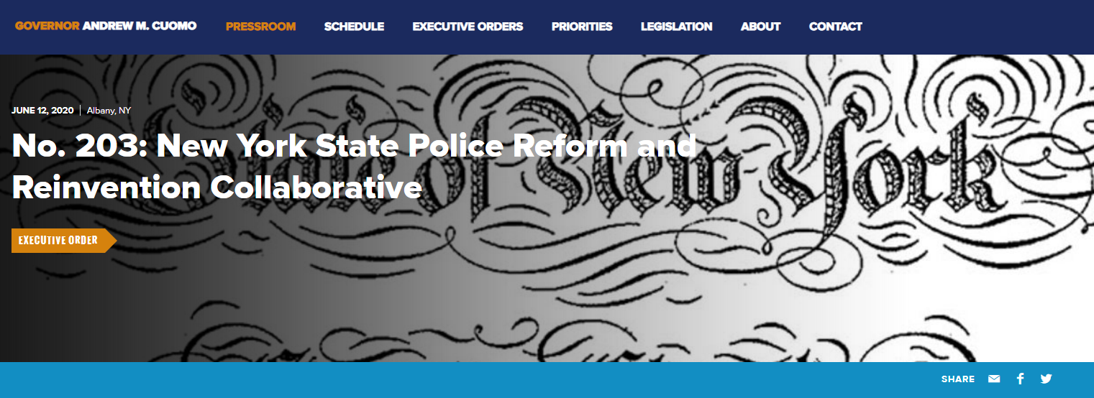
Process as dictated by New York state
In June Governor Cuomo signed an Executive Order requiring local governments to perform a comprehensive review of current police force deployments, strategies, policies, procedures, and practices, and develop a plan to improve them.
Per the Governor's Executive Order, every locality must adopt a plan for reform by April 1, 2021 to be eligible for future state funding.

Slide 3
Broome County Police Review Taskforce timeline
Meetings with Taskforce via Zoom
12/8/2020 – 2/10/2021
Public Listening Session via Zoom
1/13/2021
Public Comment Form Launched Online
Public Hearing on Draft Plan Via Zoom
2/16/2021
Feedback Also Accepted via Email

Slide 4
Taskforce Recommendations:
In consultation with community groups, the Broome County Sheriff’s Office will create and maintain a plan to recruit minority candidates for the law enforcement profession at the Broome County Sheriff’s Office
Expand mental health programs in our community, like the Mental Health Association of the Southern Tier’s Crisis Intervention Team
Find additional ways to assist individuals who are arrested, but not incarcerated, in receiving treatment for substance use disorders if necessary

Slide 5
Taskforce Recommendations:
Implement a program to provide Civil Service Testing Educational and Physical Fitness Training Opportunities in Broome County
Strategize ways to promote community engagement and educate the public about programs the Broome County Sheriff’s Office provides to the community
By April 1st, 2022 the Broome County Sheriff’s Office will provide an update on recommendations and implementation

Slide 6
Questions?
https://gobroomecounty.com/countyexec/policereviewtaskforce

