Slide 1
Visit Binghamton Film Office
Mission Statement:
The Visit Binghamton Film Office supports filmmakers and production teams when bringing their productions to Broome County. We are dedicated to driving economic growth in the region by providing resources and assistance with locations, permits, permission, crewmembers, and industry vendors.
Vision Statement:
As the hometown to Rod Serling, the Visit Binghamton Film office looks to inspire the next generation of film industry professionals. Broome County’s diverse location options make us the perfect place to bring your cinematic vision to life.

Slide 2
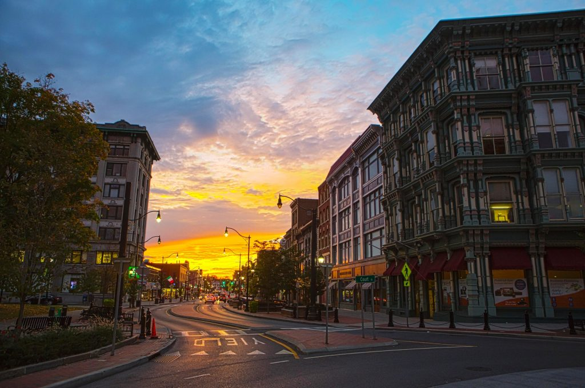
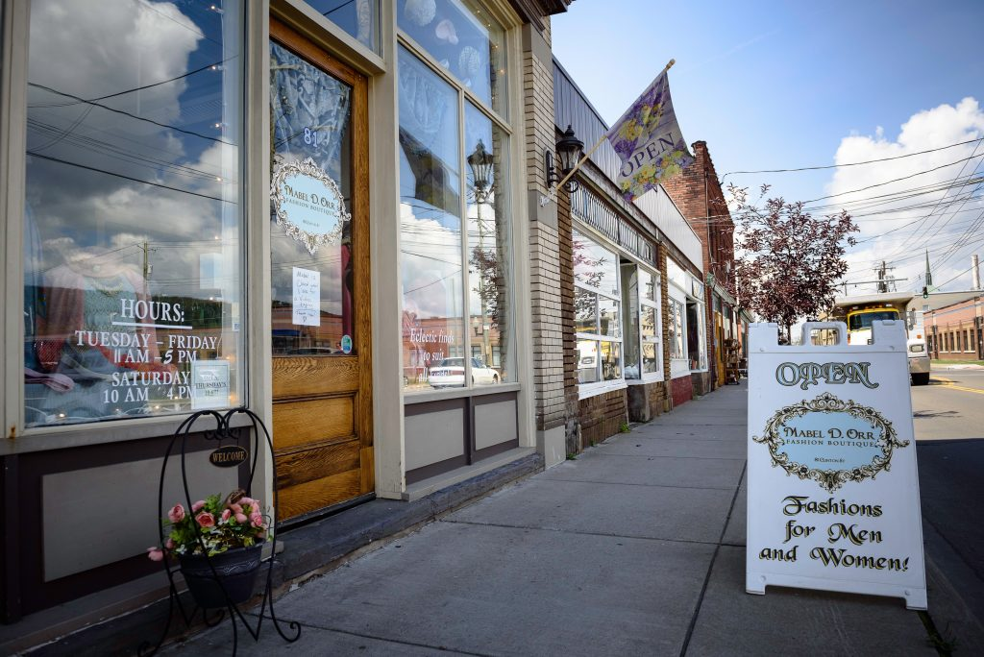
Visit Binghamton Film Office
The Visit Binghamton Film Office is a new and exciting initiative under the Visit Binghamton & Greater Binghamton Chamber of Commerce umbrella.
The Visit Binghamton Film Office will assist film & television productions while on-location in the Greater Binghamton area. We will also act as a liaison between governmental departments and agencies to coordinate filming on public property.
New York's film incentive program is one of the best in the nation and offers film, television, and commercial production and post-production tax credits for qualified expenditures in New York State. Kelly Fancher has joined the Visit Binghamton staff as the Film Development & Social Media Manager. Kelly has valuable experience in the film industry and that has helped us launch this program.

Slide 3
Visit Binghamton Film Office
We officially launched the Visit Binghamton Film Office in November 2020
Our website is live, https://visitbinghamton.org/film/ and will act as Industry directory which will also act as a hub for our local film industry as well as a resource for location scouts, producers, and production companies.
Economic Benefits of creating a Film Office- will create new jobs and revenue sources that will positively impact the community and tourism industry. We have had discussions with the “Local 52” union about doing career training. We will work with SUNY Broome, GBEOP, and Broome County workforce partners to implement.
Successful Zoom Presentation with the surrounding municipalities
SmugMug – Location Gallery used to host friendly locations
We are working closely with the New York State Governor's Office of Motion Picture & Television Development (MPTV) and the ESD. We are currently the only film commission listed in the Southern Tier REDC
We are listed as a Regional Film Office on the ESD website representing the Southern Tier Counties: Broome, Chemung, Chenango, Delaware, Schuyler, Steuben, Tioga, Tompkins County https://esd.ny.gov/regional-film-offices

Slide 4
Visit Binghamton Film Office
We have four Qualified Production Facilities listed for Broome County: The Visions FCU Veterans Memorial Arena, the 434 Sports Plex, DoubleTree Ballroom, SUNY Broome Baldwin gym. We are working with the airport manager to get three of the hangars qualified
The Visit Binghamton Film Office has officially wrapped on three film projects and two HGTV Shows! The first, a short film called “Sammy Waits for a Call” written and directed by Gregg Kearns starring local director/actor/editor Daniel Masciari (Stationed at Home writer/director). The Independent Feature Film “The Harbinger” written and directed by Andy Mitton. And another short film “Safe House” with professional dancer turned filmmaker Blake Zelesnikar who is originally from Binghamton but based in NYC now and just finished touring with “Mean Girls”.
Two HGTV shows (Lottery Dream Home / Lakehouse Renovation)
The Visit Binghamton Film Office will continue to assist Daniel Mascari towards the completion of his feature film “Stationed at Home” set to shoot next winter
We are working with Bob Murphy and the City of Binghamton on a possible summer project.
Memberships with NY Women In Film & Television and the Association of Film Commissions International

Slide 5
Visit Binghamton Film Office
Economic Impact Data from “The Harbinger” filmed here in February
Over thirty people were hired, three local catering companies used on sight COVID testing 3x a week by Ascension Lourdes, car and truck rental, location fees paid for two of the main locations (a farm-house owned by Donna Stack in Conklin and The Goodwill Theatre and Firehouse Stage complex.)
There was a three- week hotel room block used ($23,003.15),
We also coordinated the rental of the Visions Federal Credit Union Veterans Memorial Arena for the film's qualified production facility (QPF), the use of the Ansco Camera Factory building and a local funeral home.
Based on the budget of the film we estimate a total of around $210,000 in economic impact from this project. And with COVID compliance staff on site, there were no cases of COVID due to filming.

