Slide 1
Trends in the Aging Population of Broome County
Analysis of Census Data
Presented by Anne Muha - Binghamton University MPA Candidate

Slide 2
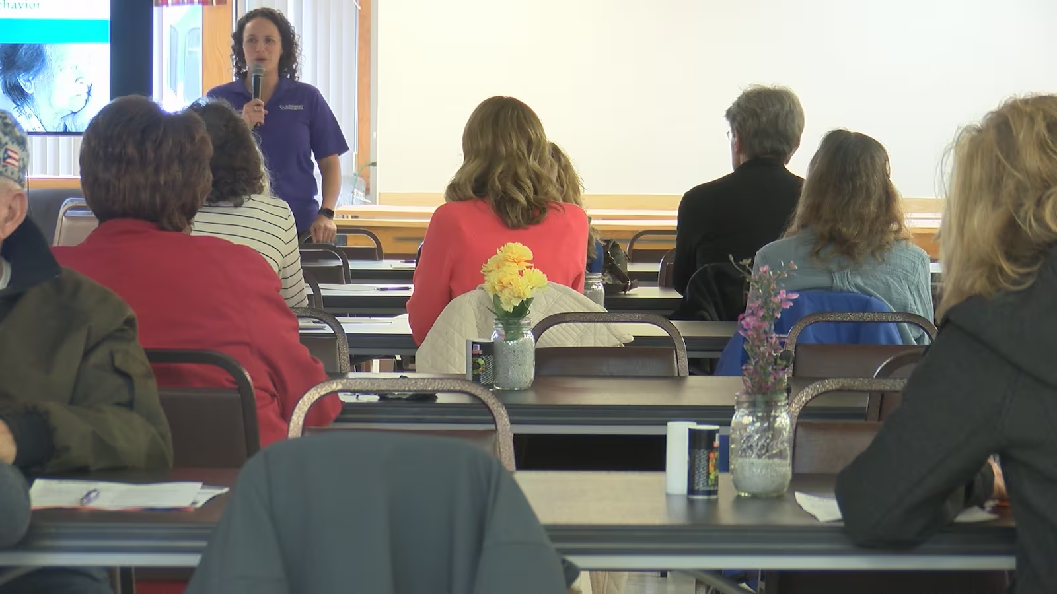
Guiding Questions
How has the age composition of Broome County changed over time?
How racially diverse is Broome County? How has the population diversified over time?
What is the economic makeup of older adults in Broome County?
How might these demographic factors inform how OFA structures its services?

Slide 3
Data Used in this Analysis
American Community Survey (2022 5-year estimates)
The 5-year estimates offer most complete picture outside of decennial census.
Allows for detailed comparisons of demographic data.
Community Assessment Survey for Older Adults (2023)
The 2023 survey was the first of its kind conducted in Broome County, meaning no trends are available.

Slide 4
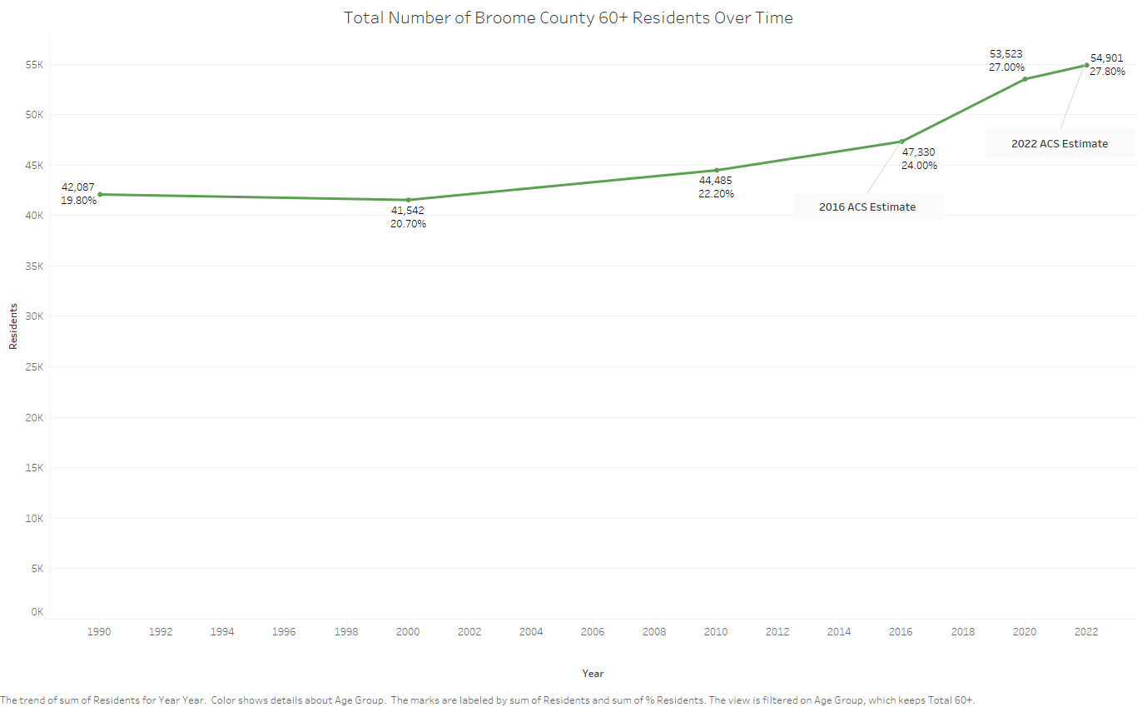
Important to note is that even as the county population increases, their share of that number is increasing, too, even in the 2000 census where the count decreased.

Slide 5
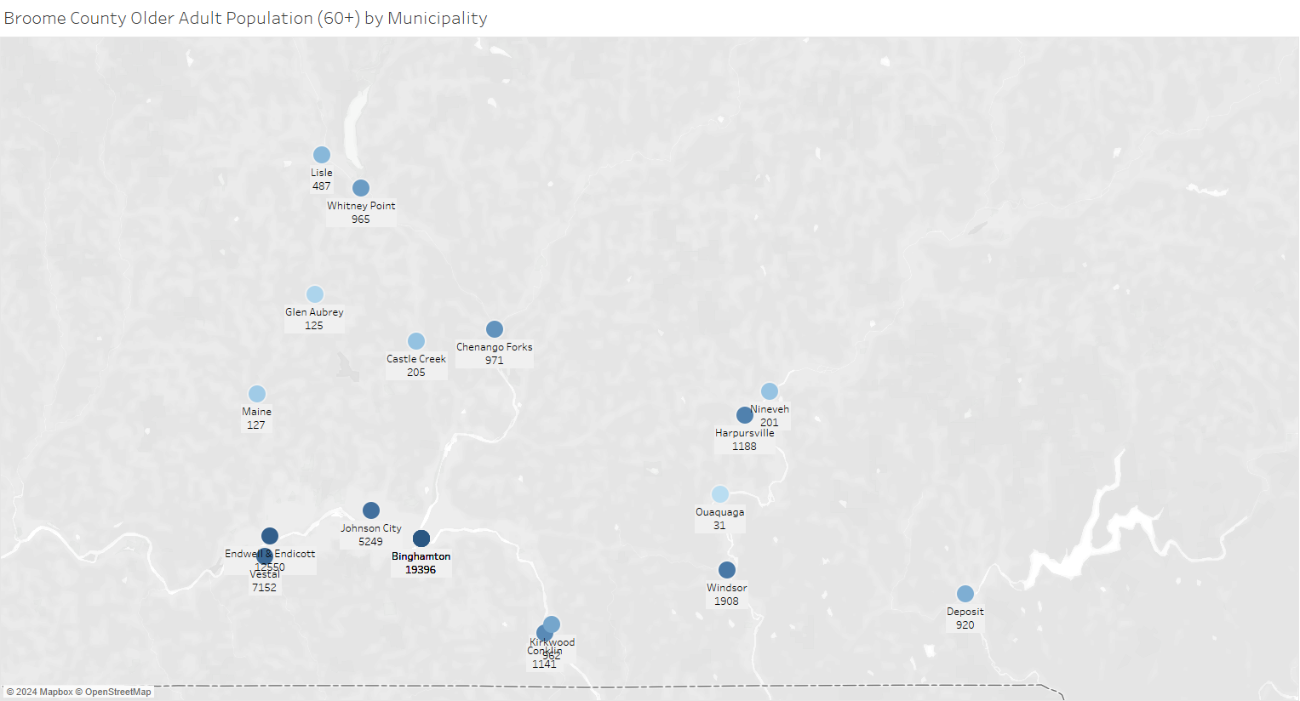
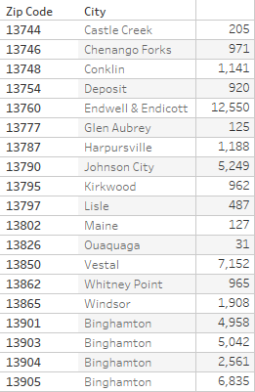

Slide 6
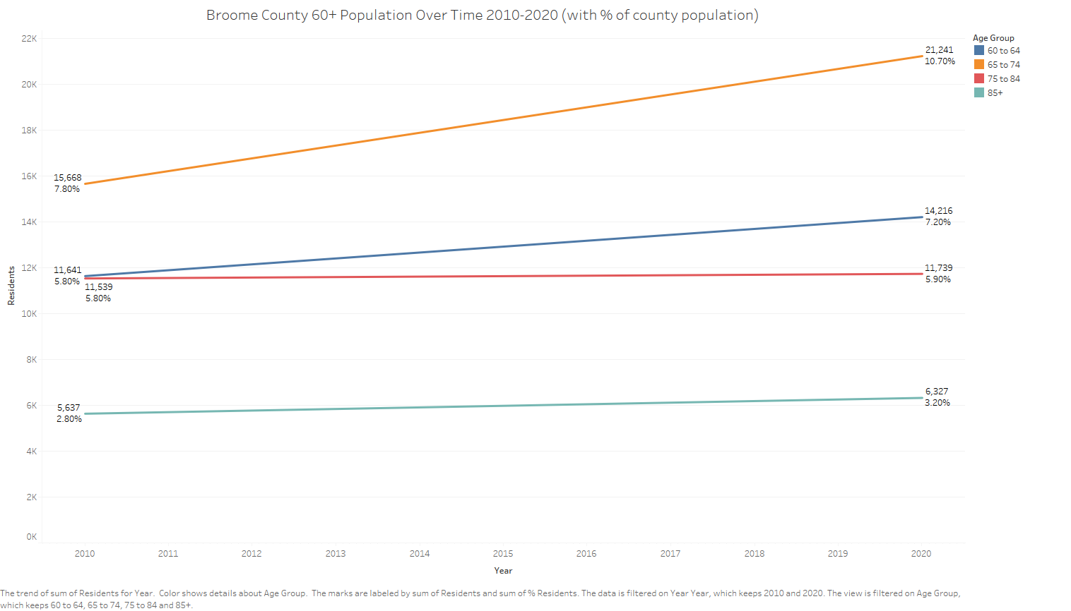
Source: ACS 2022 5-Year Estimates

Slide 7
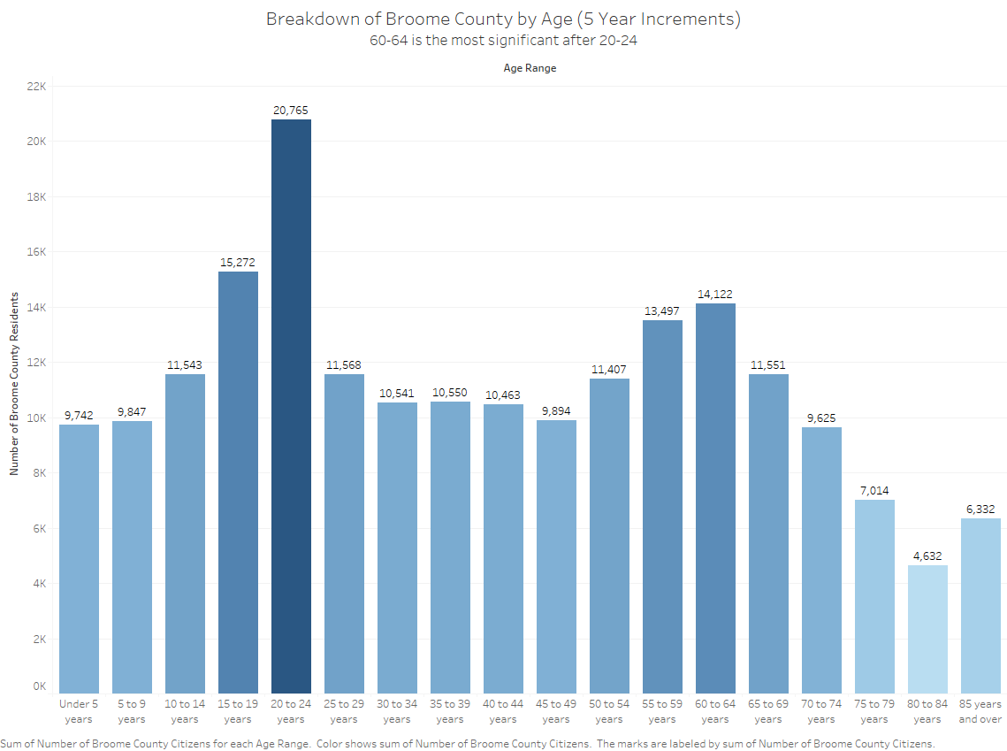

Slide 8
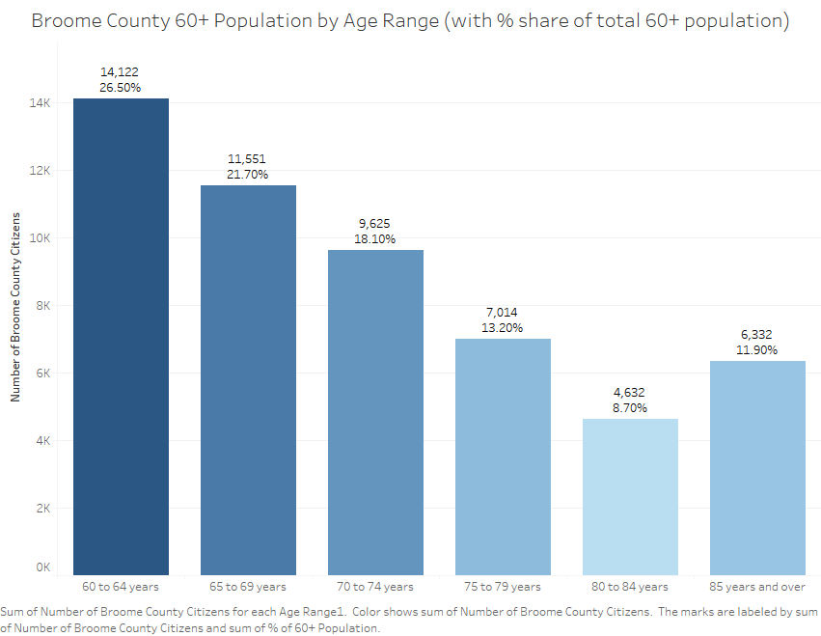
Source:
ACS 2022 5-Year Estimates
(S0101)

Slide 9
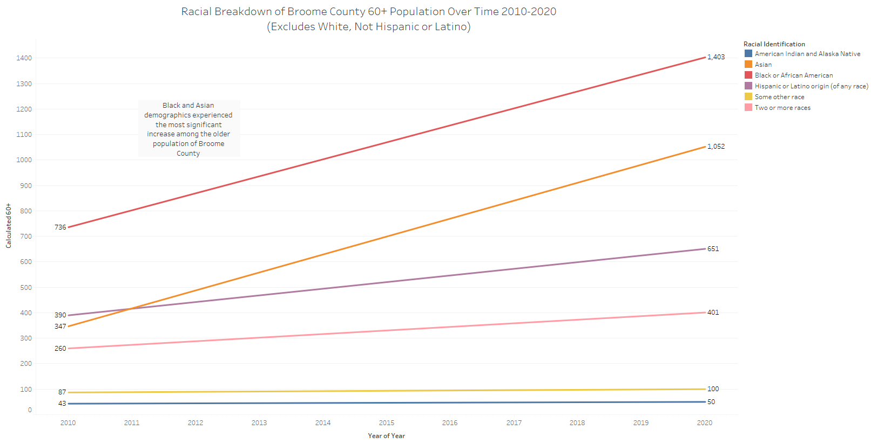
Source: ACS 2022 5-Year Estimates

Slide 10
From the OFA Sample (Above) From 2022 ACS Survey
Percentages taken from total clients excluding Percentages taken from total 60+ population (53,276)
Not Available & Race Missing (5,646)
American Indian/Native Alaskan 0.67% 0.2%
Asian 0.97% 2.1%
Black or African American 4.3% 2.9%
Native Hawaiian/Other Pacific Islander 0.07% 0%
White - Hispanic 3.35% 1.4%
White - Not Hispanic 90.63% 92.3%

Slide 11
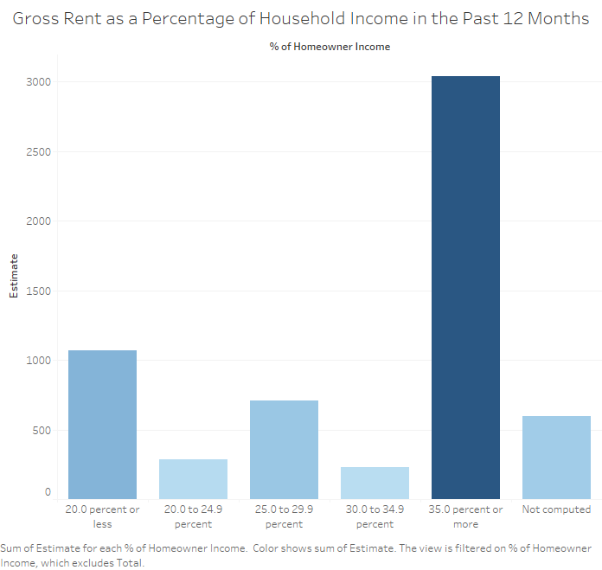
Households spending more than 30% of gross income on rent are considered cost burdened by the Census Bureau.
According to recent ACS estimates, about 51% of 65+ homeowners in Broome County are burdened by their rent. Compare to:
15-24 years: 55%
25-34 years: 32%
35-64 years: 38%
Source: ACS 2022 5-Year Estimates

Slide 12
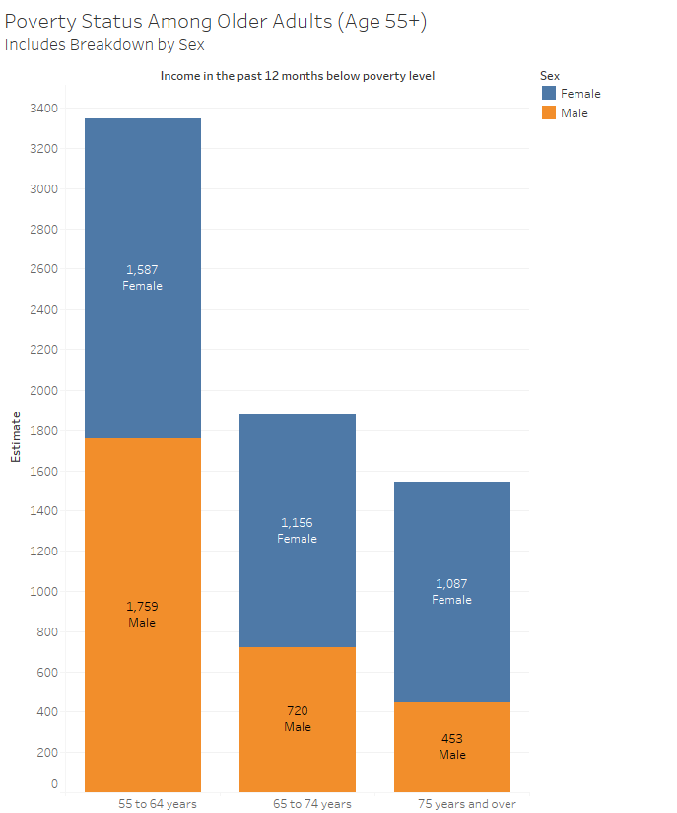
According to the 2022 estimates, males age 55 to 64 are most likely to be living below poverty line although females generally see much higher rates of poverty
About 6700 older adults living below poverty level overall.
Including 55+, this constitutes about 11% of the older adult population in Broome County
9.5% of older males overall
10.7% of older females
Source: ACS 2022 5-Year Estimates

Slide 13
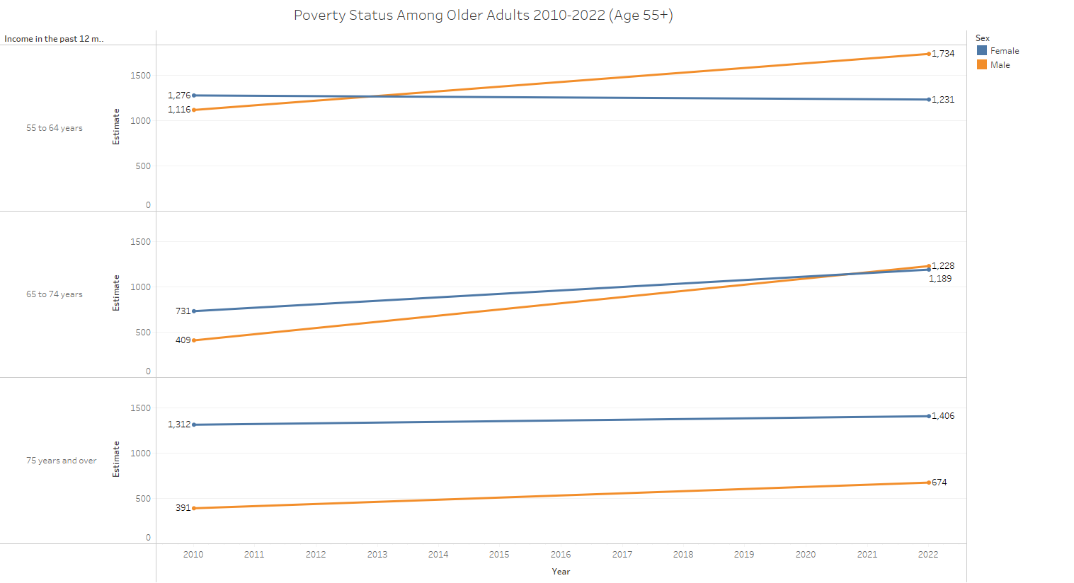

Slide 14
Other Notable Statistics
An estimated 27% of adults over 60 are employed; less than a percentage point are still in the labor force and unemployed (looking for work), while the remainder are retired and not considered part of the workforce.
The mean income of employed older adults (2022 inflation adjusted) was $71,853, which is less than the overall county mean of $82,934.
Of homeowners over 65, 16.7% made less than $20,000 annually. Contrast this with 19.2% in 2020 and 30.8% in 2010, and it shows a marked improvement in the income of older adults.

Slide 15
85%
29%
26%
23%
What are the most significant difficulties reported by older adults in Broome County?
Not knowing what services are available to older adults in their communities.
Heavy or intense housework
Maintaining physical health
Community Assessment Survey for Older Adults (2023)
Meeting Daily Expenses

Slide 16
85%
49%
42%
19%
In the Past 12 Months…
Reported voting in the most recent local election
Participated in religious or spiritual activities within their communities
Utilized resources at their local library
Community Assessment Survey for Older Adults (2023)
Attended their community’s senior center

Slide 17
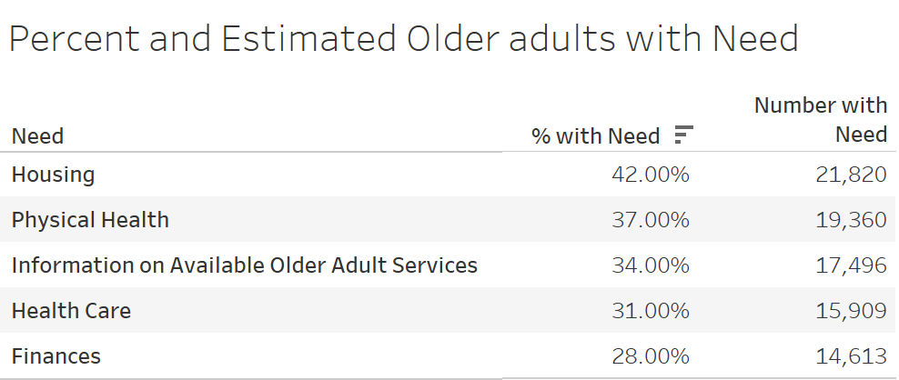
What do older adults need the most assistance with?

Slide 18
Key Takeaways & Further Questions
As Broome County’s population ages, the baby boomer generation will skew the older populations further.
What problems and challenges will this group face as they age?
A diversifying population will see greater proportions of Black, Asian, and other races aging and becoming eligible for OFA services.
Do we have capacity to interface with clients in other languages?
Housing persists as a key issue for older adults, and options should be considered as to how to alleviate high costs for older low-income residents.
What financial assistance can be provided in other areas to alleviate the burdensome costs of housing?
What options are available for affordable housing for older adults?
Thank you for your time!
You may reach me at Lmuha1@binghamton.edu with any further comments or questions.

